Slide 1
Insurtech and Parametric Insurance to Increase Climate Resilience

Slide 2
Acknowledgment
This course module is made possible through a grant from FM Global
through the Spencer Educational Foundation.
FM Global is one of the world’s largest business property insurers (www.fmglobal.com). Their clients include more than one out of every three FORTUNE 1000-size companies in more than 130 countries. For nearly 200 years, clients have worked with FM Global to develop robust property insurance and engineering solutions to protect their business operations from fire, natural disasters, and other types of property risk.
The Spencer Educational Foundation is a 501(c)(3) nonprofit organization funding the education of tomorrow's risk management and insurance leaders through scholarships, grants, internship opportunities, on and off campus experiential learning, and support of risk management/insurance curricula. Since Spencer was founded in 1979, they have awarded over $9.5 million in scholarships and over $8 million in grants to universities and professional institutions impacting over 70,000 students through their programming. For more information, please visitwww.spencered.org.

Slide 3
Acknowledgment
Also supported by:
Insurance and Financial Services Center, Strome College of Business
Department of Engineering Management & Systems Engineering, Batten College of Engineering and Technology
Old Dominion University
College of Emergency Preparedness, Homeland Security, and Cybersecurity University at Albany
and
Engineering and Technology Management Program, Voiland College of Engineering and Architecture
Washington State University

Slide 4
This module contains the following sections:
Introduction
Insurtech and Risktech
Indemnity vs Parametric Insurance
Specific Applications of Parametric Insurance

Slide 5
Introduction
Risk management is essential in balancing threat and opportunity in the decision-making process.
Traditionally, how was risk viewed?
More recently, how is risk taking also viewed?
What is risk taking essential for?
What should the goal of risk management be?
Notes:
Traditionally, risk was viewed only as hazard. meaning a negative view, for organizations and individuals. More recently, risk taking is also viewed as an opportunity, and as essential for growth. In other words, the goal of risk managers should be to reduce threats and take advantage of opportunities.

Slide 6
Insurtech and Risktech
What is insurance?
What is the relationship between insurance and risk management?
What does insurtech use technology to do?
What is the relationship between insurtech and risktech?
Notes:
Insurance is a type of risk transfer, meaning a type of risk financing, and sometimes referred to as risk sharing.
Risk management is the over process: scan the environment, risk identification, risk analysis, risk treatment, and risk monitoring and review.
Insurance is just one of the techniques (risk transfer) to treat risk.
Other risk treatment techniques used in the risk management process are risk avoidance, risk exploitation, risk mitigation, and risk retention.
Insurtech uses technology to make insurance functions more efficient. These include production (sales and distribution), actuarial, underwriting, and claims functions.
Insurtech is a subset of risktech.
Risktech goes beyond insurtech to make all parts of the risk management process more efficient, not just risk transfer.
Risk mitigation means to reduce both the likelihood for risks to materialize and the severity of the loss that occurs if the risk does materialize.

Slide 7
Insurtech and Risktech (continued)
What are some of the technologies being applied to disrupt both parametric and traditional indemnity insurance?
Internet of Things (IoT)
Blockchain
Artificial intelligence (AI) and machine learning (ML)
Big data and data analytics
Digital twins
Notes:
These technologies will be discussed on the following pages.

Slide 8
Insurtech and Risktech (continued)
Internet of Things (IoT)
What does IoT stand for and what does it refer to?
What is an example of a smart product?
What is an example of IoT used in motor vehicles?
What do risktech and insurtech typically involve?
Notes:
IoT stands for “Internet of Things” and refers to the network of physical objects that can include sensors, software, and internet connections that allow the monitoring of devices and systems and exchange of data, and even allowing remote control of physical devices, such as turning off the water flow in water supply pipes.
An example of a smart product is an IoT system with a flow sensor and an actuator attached to the water pipes in a building or house.
If a water line in your house breaks, you will be notified on your smart phone and can turn off the water remotely, which can save you a huge water bill and also reduce damage to your house.
Often insurance companies will give you a discount on your homeowners’ insurance because such an IoT system can save the insurer tremendous amounts in claims
Telematics is a type of IoT used in cars and uses GPS so insurer can learn more about your driving habits and determine premiums based on your actual driving instead of approximate risk categories used in traditional underwriting. Policies can be customized to closely align with the policyholder’s risk. IoT can allow “monitored risk” insurance.
Risktech and insurtech typically involve smart products producing a lot of data, which can be analyzed with the goal of reducing uncertainty in the prediction of future events.

Slide 9

Insurtech and Risktech (continued) IoT (continued)
What technology can be used for the data collected from IoT devices to ensure they are from a trusted source and independently verified?
What is often used to share and store data generated by IoT devices, then what can be applied to the data for predictive modeling?
What type of model are these technologies moving insurance to?
What is an example of using IoT devices for marine insurance?
What is a risk of the proliferation of IoT devices?
Notes:
Blockchain can be used for the data collected from IoT devices to ensure they are from a trusted source and independently verified.
Cloud computing is often used to share and store data generated by IoT devices, then advanced analytics can be applied to the data for predictive modeling.
These technologies can be used to improve ratemaking, underwriting, and claims functions for traditional indemnity insurance.
These technologies are making parametric insurance possible for climate-related risks that have been almost uninsurable, especially for low-income communities. An example is microinsurance for drought and flood for small farmers around the world.
These technologies are moving insurance from a “repair and replace” to a “predict and prevent” model.
For marine insurance, IoT devices can be employed for monitoring and tracking cargo, which can support risk authentication in traditional coverages and are also opening the way to parametric and blockchain-enabled products.
A risk of the proliferation of IoT devices is that they vastly increase the number of attack surfaces for cyber attacks. For example, hackers have gotten control of IoT devices to mount DDOS attacks.

Slide 10
Insurtech and Risktech (continued)
Blockchain
What is blockchain?
What are four characteristics in theory that make blockchain valuable?
What are possible benefits of blockchain for the insurance industry?
For blockchain, when are records actually recorded in the ledger?
Notes:
Blockchain is distributed data-storage technology with a real-time decentralized ledger that allows secure and trusted transactions without requiring a third party for verification.
Four characteristics that make blockchain valuable in theory are:
Immutability: Transactions cannot be tampered with after being recorded to the ledger. For any changes, there is a new transaction and the original record and change both remain visible.
Consensus: Any transaction or change is not made until all participants agree it is valid.
Provenance: Every participant can see the entire ownership history of an asset.
Finality: Every participant can see the ownership of an asset and completion of a transaction, meaning every one sees the same shared ledgers. There are not multiple copies.
Possible benefits of blockchain are smart contracts, increased accuracy, and efficiency compared to current record keeping practices, reduced costs, streamlined transactions between insurers and policyholders.
Before records are recorded in the decentralized ledger, a consensus process called "mining" is first used to confirm the veracity of the data. This can help to reduce insurance fraud.

Slide 11

Insurtech and Risktech (continued)
Blockchain (continued)
What kind of contracts can blockchain be used to create and what is the benefit for the insurance industry?
What is a cybersecurity issue for blockchain?
What is a potential environmental issue for blockchain usage for insurance?
Notes:
Blockchain can be used to create smart contracts.
The benefit for the insurance industry of smart contracts is that insurance policies can be modified quickly, efficiently, and accurately in a way that can be trusted by all the involved parties.
This can reduce the time risk managers need to spend on verifying the accuracy of insurance policies in force.
Smart contracts can also be valuable for parametric insurance by making a loss payment as soon as the parameters of the contract are reached. This basically automates the claims process.
In theory, the transaction history of the blockchain digital ledger should be hack proof. However, as has occurred with digital currency underpinned by blockchain, data sources offchain and the software of the network's access has experienced breaches.
The way that mining is currently used to verify transactions, huge amounts of energy are used. This could cause environmental issues if blockchain is scaled up to be commonly used for insurance.

Slide 12
Insurtech and Risktech (continued)
Artificial intelligence (AI) and machine learning (ML)
What is AI?
What is ML?
Notes:
In simple terms, artificial intelligence (AI) means computing and algorithms can make decisions that traditionally require human intelligence, such as by classifying, analyzing, and making predictions from data.
Machine learning (ML) is a type of AI in which computers can learn and improve from experience without explicit programming. In other words, can continually improve decision making based on previous results and new data.

Slide 13

Insurtech and Risktech (continued)
AI and ML (continued)
What are some examples where AI is being used in insurance?
Notes:
There are various ways that artificial intelligence (AI) and machine learning (ML) are being used in insurance:
Pricing and actuarial: can analyze larger data sets to find new rating factors and develop new pricing models.
Property insurance underwriting: can be used to analyze data that is scraped from publicly available information to reduce the amount of info that needs to be provided by the property owner.
Being used in the claims process to:
Analyze photos and videos of damaged buildings, such as from drones, to determine the amount of property damage.
Analyze photos of millions of damaged vehicles and the repair required to develop guidelines for rapid claims adjusting.
Review policy wording exclusion/limit details for the policy review claims process.
Minimizing insurance losses: used with computer visions to reduce the likely at crime at policyholder facilities.
Parametric insurance: analyzing the huge amount of data, for example produced by IoT devices, to increase the number of risks that can be covered by parametric insurance. AI can be used with data science and sensor technology to develop a wider range of indexes that can be used as triggers for parametric insurance.
Health insurance: can analyze huge datasets to move medical decision making from a reactive model to a predictive and preventative model that greatly reduces healthcare costs.

Slide 14

Insurtech and Risktech (continued)
Big Data and analytics
What is Big Data?
What is the Big Data revolution fueled by?
What is structured data? Unstructured data?
Notes:
Big Data are very large data sets that are more complex, and continually added to from new data sources.
The data is so large that traditional data processing software and typically not handle them.
The data can be analyzed to reveal patterns, trends, and associations, especially related to human behavior and interactions and can be used to address business problems that could not have been addressed previously.
Big Data is characterized by the three Vs: greater variety, increasing volume, and higher velocity.
The Big Data revolution is fueled by data capture, storage, and analysis.
For insurance purposes, data is often captured by smart products, such as IoT devices.
The data can be stored in the cloud and shared.
Advanced analytics can be applied using artificial intelligence and machine learning.
Data can consist of both structured and unstructured data.
Structured data consists of clearly defined data types that makes then data easily accessible.
Unstructured data is not easily searchable and are in formats such as video, audio, and social media.
Data can also be scraped from publicly available information.

Slide 15

Insurtech and Risktech (continued)
Big Data and analytics (continued)
What has the growing availability of Big Data and advances in AI and ML made it possible for insurers to do?
What is relation of Big Data and predictive analytics?
What has analytics applied to Big Data allowed underwriters to do?
Notes:
The growing availability of Big Data and advances in AI and ML make it possible for insurers to not only predict and plan for risk but also to develop insurance products for specific risks that were previously uninsurable.
Predictive analytics is the use of advanced software tools, which can include AI and ML, that can analyze the data to extrapolate and predict outcomes.
Analytics applied to Big Data has allowed underwriters to segment policies and base rates on attributes that were previously not possible.

Slide 16
Insurtech and Risktech (continued)
Digital Twins
What a digital twin?
What should be used to create the digital twin and in what way should it be similar to its real-world counterpart.
What should the digital twin be able to predict?
Digital twins should be updated almost continuously, using data from what for example and what can be used with the digital twin to make decisions and respond dynamically in real time?
Notes:
A digital twin is virtual simulation (digital replica, mirror, or representation) of a physical object, for example of a car or building, but can be any asset and can be a device, process, system, or product.
Real world data should be used to create the digital twin and be similar in behavior, response, and operation of its real world counter part.
The digital twin should be able to predict how its real-world counterpart will act under "what-if" scenarios.
Digital twins should be updated almost continuously, for example, using data from Internet of Things (IoT) and can use artifical intelligence (AI) and machine learning (ML) to make decisions and respond dynamically in real time.
Sources and for more information:
https://www.guidewire.com/blog/technology/the-future-impact-of-digital-twins-in-p-and-c-insurance/
https://www.plainconcepts.com/digital-twins-insurance-industry/
https://beinsure.com/digital-twins-can-help-insurance-industry/

Slide 17
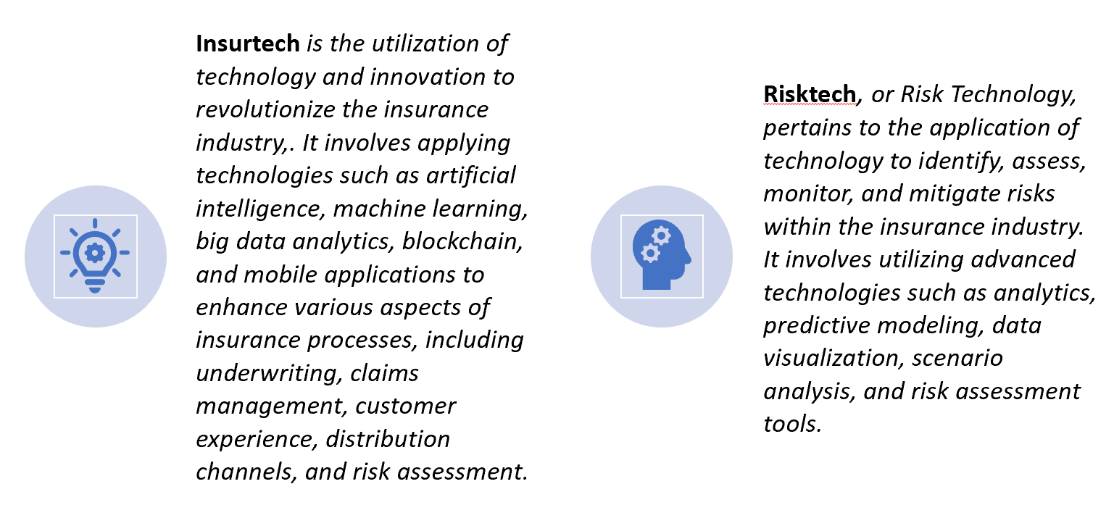
Insurtech and Risktech (continued)
Digital Twins (continued)
What is an example where a digital twin can be used for the claims function?
How can digital twin be used for the underwriting function?
How else can digital twins be useful for the insurance industry?
Notes:
An example of how the digital twin can be used in the claims function is for an auto accident.
A digital twin of the actual vehicle could be subject to the same crash as the actual vehicle to determine damages and elimate the need for an actual claims adjuster.
This could also increase the likelihood of uncovering fraudulent claims by flagging claims that seem statistically inconsistent.
Insurers can also use digital twins to change the underwriting process from the traditional method that uses the law of larger numbers, risk pooling and risk transfer. Digital twin can be used to customize underwriting for individual policyholders instead of trying to overcome adverse selection and roughly placing PHs into large risk pools.
Digital twins can do more than just help with each individual insurance function and can be used by insurers in a holistic manner and not just for risk transfer but increase the ability of insurers to advise their policyholders (PHs) on risk mitigation to reduce the likelihood and severity of losses.
The insurer can create digital twins for all of the PH's insured assets to make a complete portfolio for entire insurance life cycle PH to add in real-time decision making.
Insurers can use digital twins as a virtual lab to evaluate any risk scenario and make better decisions to prevent the risk from materializing or to reduce the severity of the loss if the risk materializes.

Slide 18
Indemnity vs Parametric Insurance
Traditional insurance is referred to as “indemnity insurance”.
What does indemnity imply in the case of insurance?
Why is this important?
What’s an example?
What does indemnity attempt to control?
Notes:
For insurance, indemnity implies that insurance should restore the policyholder (PH) to the situation that existed prior to the loss, but not to a better situation. Traditional insurance is an indemnity contract.
Why is this important? Because indemnity means the PH may not earn a profit because of insurance.
What’s an example? If you total your car, the insurer will pay you “actual cash value” for the car, meaning the fair market value or depreciated value of the car.
The insurer won’t buy you a new car.
This follows the principle of indemnity.
Why? If the insurer bought you a new car, you would have an incentive to total your old car whenever you wanted a new one. This violates the principle of indemnity.
Why? You would be in a better situation.
What does indemnity attempt to control? Moral hazard.
How? The principle of indemnity reduces the incentive for PHs to intentionally try and game the system to make money off insurance. Indemnity means the PH may not collect more than the actual loss in the event of damage caused by an insured peril.
In other words, the principle of Indemnity greatly reduces the likelihood of intentional losses by PHs.

Slide 19
Indemnity vs Parametric Insurance (continued)
“Parametric insurance” is an alternative and a complement to traditional “indemnity insurance”.
How are the triggers for indemnity and parametric insurance different?
What is basis risk?
Which type of insurance has more basis risk?
More moral hazard risk?
Notes:
An indemnity insurance claim payout to a policyholder (PH) is based on an actual loss occurring.
Parametric insurance gets its name because the payout depends on the measurement of a parameter for an event to determine if payment is triggered. Another name for parametric insurance is “event-based” or “index-based” insurance.
A parametric insurance claim payout to a PH is based on an external trigger correlated to the loss, not on actual loss of PH as for indemnity insurance. Three criteria are important for determining the trigger.
Must be able to model the trigger, measure trigger objectively, and triggers must be independently verifiable.
Parametric insurance has “basis risk” meaning the payout might not match loss. Why? Because the payout is based on an external trigger that is correlated to the loss, not to that actual loss.
Indemnity insurance does not have “basis risk” because indemnity means that insurer in theory should reimburse the policyholder the amount of the actual loss. insurance has less moral hazard risk than indemnity insurance. Why? Because policyholder cannot affect the external trigger for parametric insurance but could affect the actual amount of loss for indemnity insurance. In other words, a parametric insurer has less worry about moral hazard by the policyholder than a traditional (indemnity) insurer.
Let’s look at this more.

Slide 20
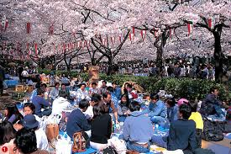
Indemnity vs Parametric Insurance (continued)
Cherry Blossom Insurance in Japan.
What is it?
Notes:
The cherry blossom season in Japan lasts from 10 to 20 days depending on how cold the weather is and is like the Mardi Gras. I lived in Tokyo for 12 years and always enjoyed the cherry blossom season.
Huge crowds are out partying under the cherry blossoms almost 24 hours a day, and it’s a huge economic boost for Japan. People spend money like crazy all over Japan while the cherry blossoms are blooming.
And there is cherry blossom insurance in Japan. What is it?
It is a type of parametric insurance. What is it triggered by? The amount of rain, not by actual losses.
Let look at it more on the next slide.

Slide 21
Indemnity vs Parametric Insurance (continued)
Cherry Blossom Insurance in Japan: An example of parametric insurance.
A food and liquor store in Tokyo might buy parametric insurance that pays off a specific amount if it rains more than 25% of the cherry blossom season.
Questions about parametric insurance in general, not just for this specific case of a weather derivative.
What risk decreases for seller of this contract (insurer) compared to risk facing traditional insurer? Why?
What is risk for buyer of this contract? What is it called?
Does indemnity apply to parametric insurance? Why?
Notes:
What risk decreases for seller of this parametric insurer (insurer) compared to risk facing traditional insurer? Moral hazard decreases. Why? Buyer (policyholder) has no control over the loss for parametric insurance, because the payment is based on an external trigger, such as amount of rain, that the buyer has no control over.
What is risk for buyer (policyholder) of this contract? Risk that payment will not match loss. What is it called? This is called “basis risk”
Does indemnity apply to parametric insurance? No. Why? Because parametric insurance does not pay you according to your loss, but according to some external trigger that is expected to be correlated to your loss.
The amount you get could be more than your loss or less than your loss.
Remember that the principle of indemnity means to put you back into the same position as before the loss.

Slide 22
Indemnity vs Parametric Insurance (continued)
Advantages of Parametric Insurance over Indemnity Insurance?
Claims
Simpler process
Rapid payout
Reduced disputes
Lower cost
Notes:
For indemnity insurance, the payment for a loss event is based on the magnitude of losses suffered by the policyholder (PH).
The claims adjustment process can be long, complex, and costly to determine whether the loss is covered and how much loss the PH suffered.
For parametric insurance, a predetermined set amount is paid according to the magnitude of an event.
For example, if an earthquake occurs in the area where the PH lives, the PH will receive an amount based on the magnitude of the earthquake, not on the losses actually suffered by the PH.
Parametric insurance can pay out claims rapidly compared to indemnity insurance because the insurer just needs to know the magnitude of the event and not the losses suffered by the PH which is complex and time consuming to determine.
Because claims are paid much quicker, the PH can recover more quickly, which is often the key to the business surviving.
Claims process is very streamlined and it the policy is a smart contract (using blockchain, the process can be completely automated.
The payouts are clearly defined, determined, and triggered by physical measurements, such as windspeed or precipitation amounts.
Triggers for payment are transparent and objective and often independently verified by a disinterested third party.
Very transparent compared to indemnity insurance. So there are fewer coverage disputes than for traditional indemnity insurance coverage.
Because of the above, claims costs are less for parametric insurance, so parametric insurance costs less for PHs.

Slide 23
Indemnity vs Parametric Insurance (continued)
Advantages of Parametric Insurance over Indemnity Insurance?
(continued)
Increased flexibility
Almost immediate post event liquidity
Improved accessibility
Notes:
Parametric insurance is flexible and can cover almost any kind of financial loss. In addition, policyholders (PHs) can use payout for almost anything.
Parametric insurance does not directly indemnify for specific damage.
This flexibility allows PHs to use the payouts where most needed, for example, to invest in increasing resilience or to offset revenue loss due to business interruption.
Traditional indemnity insurance typically will not pay for business interruption losses unless there is physical damage caused by a covered peril. Parametric insurance can pay in this case. For example, a shipping company can buy parametric insurance that pays when river debt goes below a certain point, even though there is no damage to the ships, thus covering business interruption costs.
Traditional indemnity insurance can take a long time to pay out and payments are typically staggered over time.
Because claim payments are paid almost immediately for parametric insurance, post-event liquidity is improved, so PH can start making repairs immediately and used to pay employees during business interruption.
Parametric insurance can also make insurance accessible to those where traditional indemnity insurance is not available, such as low-income communities, including developing counties.
Traditional indemnity insurance for fosses from natural catastrophes in these communities is usually not available.
This results in already struggling communities falling deeper into a poverty trap that is impossible to escape from.

Slide 24
Indemnity vs Parametric Insurance (continued)
Advantages of Parametric Insurance over Indemnity Insurance?
(continued)
Can be customized
Can be in force for longer periods
Notes:
For parametric insurance, insurers often work directly with policyholders (PHs) to customize coverage for specific risks faced by the policyholder.
A parametric policy can be adjusted using the index and payout structure to conform with the PH’s risk tolerance.
As larger datasets are used and analyzed, insurers can determine triggers that more closely correlate with actual losses to reduce basis risk.
Payouts can be paid out on a gradation. For example, for example, a windfarm can be paid out more depending on the number of days the average windspeed is below the trigger speed.
Traditional insurance plans are typically one-year policies, which can usually be renewed annually.
Parametric insurance are often multiyear policies.

Slide 25
Indemnity vs Parametric Insurance (continued)
Advantages of Parametric Insurance over Indemnity Insurance?
(continued)
Underwriting
Less uncertainty
Simpler
Notes:
More uncertainty requires higher premiums or mean no coverage is possible.
Underwriting is simpler and costs are lower for parametric insurance because there is less uncertainty.
Maximum possible loss is known because the maximum payout per policyholder is a pre-determined amount.
No need to know all the factors required for underwriting traditional indemnity insurance, such as construction material, contents, height of building, and building codes.
High uncertainty leads to higher premiums, or even no coverage, for customers.
All this makes it possible to underwrite coverage that indemnity insurance cannot, such as in less developed insurance markets.
Example triggers: flood depth, temperature, amount of precipitation over a specified period, river depth, size of hail, earthquake intensity.

Slide 26
Indemnity vs Parametric Insurance (continued)
Disadvantage of Parametric Insurance over Indemnity Insurance?
Basis risk
What is basis risk?
Why is this disadvantage of parametric insurance being reduced recently?
Notes:
Remember the purpose of indemnity insurance is to put you back in the same position as before your loss, so a claims process is required to determine your loss.
Whereas parametric insurance makes a payment of a pre-determined amount when the intensity of an event, such as wind speed, rain fall amount, or hurricane or earthquake intensity reaches a specified level.
The risk is that the payment might not match the actual loss suffered by the policyholder. Basis risk is the different between the payout and the actual loss.
The concept of parametric insurance has been around for decades and there have been parametric policies for a while.
However, it is over the last few years that the amount and types of parametric polices have grown rapidly.
One reason for the rapid growth is that basis risk has been decreasing recently for various reasons.
Technology such as satellites (optical and radar), on-the-ground intelligence, and remote sensing (such as smart devices: IoT devices with sensors)) that can measure event intensity with higher resolution (meaning smaller areas) in real time so that event intensity and resulting payouts have higher correlation with actual losses by individual policyholders.
Expanded predictive analytics capabilities, machine learning, and innovations in modeling allow dynamic pricing and can also reduce basis risk.

Slide 27
Indemnity vs Parametric Insurance (continued)
How can parametric and traditional indemnity insurance be used together?
Notes:
Parametric insurance can be used as the main insurance coverage or can be used as a supplement or complement to indemnity insurance coverage.
Traditional indemnity insurance has various limits and exclusions.
Parametric insurance can be used to cover when indemnity insurance limits are exceeded or to cover perils that are excluded by indemnity insurance.
Parametric insurance can be used to cover indemnity insurance deductible.
For example, indemnity insurance for natural castastrophes typically have a deductible which is a percent of insurance value, which can be high.
For example, hurricane coverage might have a deductible that is a percent of the insured value of a house. So if it is a 5% deductible and insured value is $500K, the deductible is 0.05 X $500K = $25K.
In this case, a parametric insurance might be used as a way to covr the deductible.
To help cover deductibles and excluded hurricane damage, homeowners in Hawaii and Florida can purchase parametric insurance that is designed to cover these.

Slide 28
Indemnity vs Parametric Insurance (continued)
How Parametric Insurance Differs From Traditional Insurance Models
https://www.youtube.com/watch?v=6uSpKVCdQ2A 6:11
Click above to watch the video then answer the questions on this and the next two slides.
What is Arbol an end-to-end insurance ecosystem for?
Arbol provides businesses the ability to insure climate risk. What risks does this mean that Arbol can insure for their supply chains or revenues and using what to determine payouts?
How would it work for an old school insurance policy?
The benefits of parametric insurance are scale, transparency, and efficiency. What does everybody know about the policy?

Slide 29
Indemnity vs Parametric Insurance (continued) How Parametric Insurance Differs From Traditional Insurance Models (continued)
https://www.youtube.com/watch?v=6uSpKVCdQ2A 6:11
What plagues traditional insurance policies?
For parametric insurance, you can scale it all over the world to cover what?
About how much of climate damages is still uncovered by traditional insurance?
For traditional insurance for a big hurricane in Florida, for example, there would be tremendous amounts of litigation and slow claims processing that takes years to settle and clients who have suffered damage are waiting. For parametric insurance, about how long would it take to get paid in this case?

Slide 30
Indemnity vs Parametric Insurance (continued) How Parametric Insurance Differs From Traditional Insurance Models (continued)
https://www.youtube.com/watch?v=6uSpKVCdQ2A 6:11
What technology is used to create smart contracts for Arbol’s parametric insurance?
Smart contracts can be used to read data that sits on what kind of network where different users can provide what, and in what kind of framework?
If a farmer buys a smart parametric insurance contract that pays out when rainfall is low and the rainfall is less than a specific limit, the payout is automated meaning the farmer receives the payment without having to do what?
Renewable energy is a big area of growth for Arbol. What can wind farms use Arbol parametric coverage to insure? What can solar farms use Arbol parametric coverage to insure? By using this unique mix of policies, what do the parametric coverages help reduce?
Why have banks and the whole financial system started waking up about climate risk, who will force them at some point to start insuring this climate risk, and what will become more frequent so they will not be able to carry so much climate risk?

Slide 31
Indemnity vs Parametric Insurance (continued)
Parametric solutions to improve liquidity following major loss events https://www.marshmclennan.com/content/dam/mmc-web/insights/publications/2023/april/Parametric%20-%20Improve%20Liquidity_v2.pdf
What may traditional forms of insurance not always sufficiently cover?
In managing the risk of natural hazards, what three-pronged problem can your business face?
How can parametric solutions enhance your risk-mitigation toolbox?
What are parametric products also referred to as and are custom-built to cover what?
Notes:
Delete answers below in student version:
What may traditional forms of insurance not always sufficiently cover? Both the physical damage and loss of income associated with business interruption.
In managing the risk of natural hazards, what three-pronged problem can your business face?
Losses from events that do not trigger insurance coverage. Depending on the nature of a specific loss, some traditional business interruption policies may not cover the resulting operational disruptions.
Inability to secure coverage for the threat in question. Some perils are more difficult to insure through traditional markets or may only be covered at a higher cost and/or for a lower limit.
Slow settlement processes. Even when coverage is available, payouts follow an arduous and lengthy claims settlement process and do not always cover the full extent of losses.
How can parametric solutions enhance your risk-mitigation toolbox? By filling gaps in coverage that could leave your company vulnerable, helping you be more resilient following a loss.
What are parametric products also referred to as and are custom-built to cover what? Referred to as event- or index-based solutions and are custom-built to cover a predefined event that could pose a threat to your business

Slide 32
Indemnity vs Parametric Insurance (continued)
Parametric solutions to improve liquidity following major loss events (continued)
https://www.marshmclennan.com/content/dam/mmc-web/insights/publications/2023/april/Parametric%20-%20Improve%20Liquidity_v2.pdf
What are some example parametric triggers for
Earthquake?
Windstorm or hurricane?
Hailstorm?
Drought or excess precipitation?
Crop shortfall:
Wildfire:
Epidemic/pandemic:
Temperature:
Solar irradiance or low wind:
Non-damage business interruption:
Notes:
Delete answers below in student version:
What are some example parametric triggers for
Earthquake? Shake intensity/ ground acceleration at a specific location or magnitude of the quake and location of the epicenter.
Windstorm or hurricane? Hurricane wind speed at/within a predefined geographical area, local anemometer wind speed, or interpolated wind speed exceedance.
Hailstorm? Hail size, based on locally installed stations or interpolated from satellite data.
Drought or excess precipitation? River height at gauges, ocean height at buoys/ gauges, satellite or local station rainfall/snowfall data, satellite flood maps, or vegetation indexes.
Crop shortfall: Crop yield indices or satellite rainfall data.
Wildfire: Satellite imagery of burned area.
Epidemic/pandemic: Mortality/ infection rates, sentiment index, or civil authority triggers.
Temperature: Local station or satellite data.
Solar irradiance or low wind: On-site solar/wind data.
Non-damage business interruption: Above triggers or custom metrics such as revenue per available room (RevPAR), air passenger data, and motor vehicle department data.

Slide 33
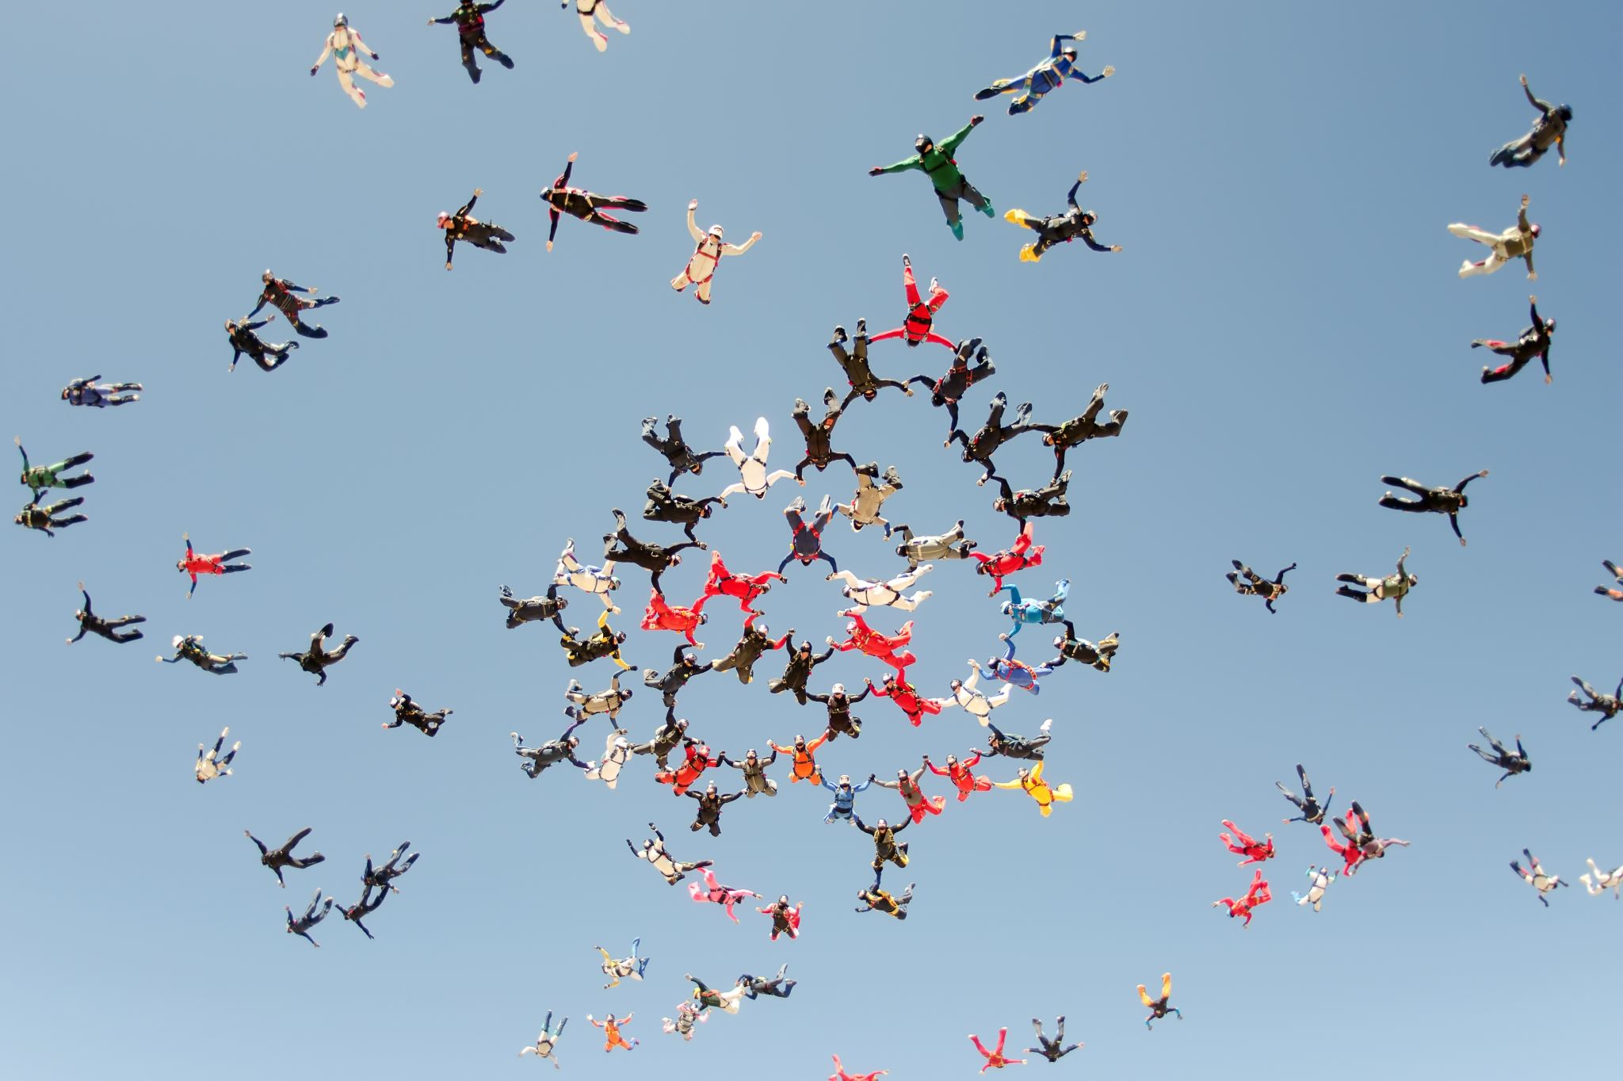
Indemnity vs Parametric Insurance (summary)
Indemnity insurance is the traditional form of insurance coverage that focuses on compensating policyholders for actual losses they incur.
Parametric insurance is a type of insurance coverage that pays out a predetermined amount based on the occurrence of a specific triggering event or parameter.

Slide 34
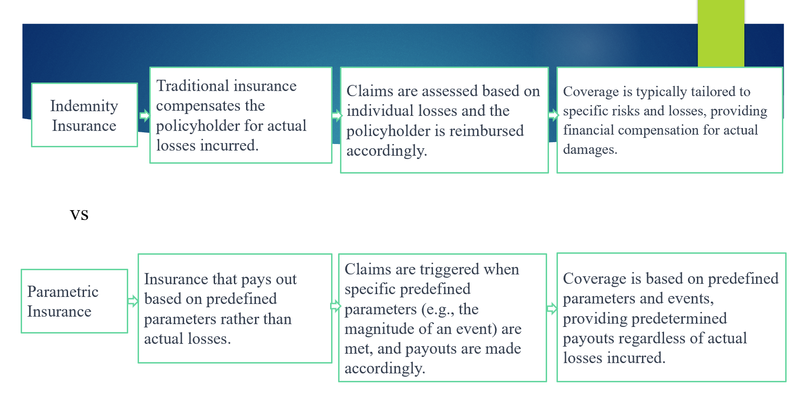
Indemnity vs Parametric Insurance Summary (continued)

Slide 35
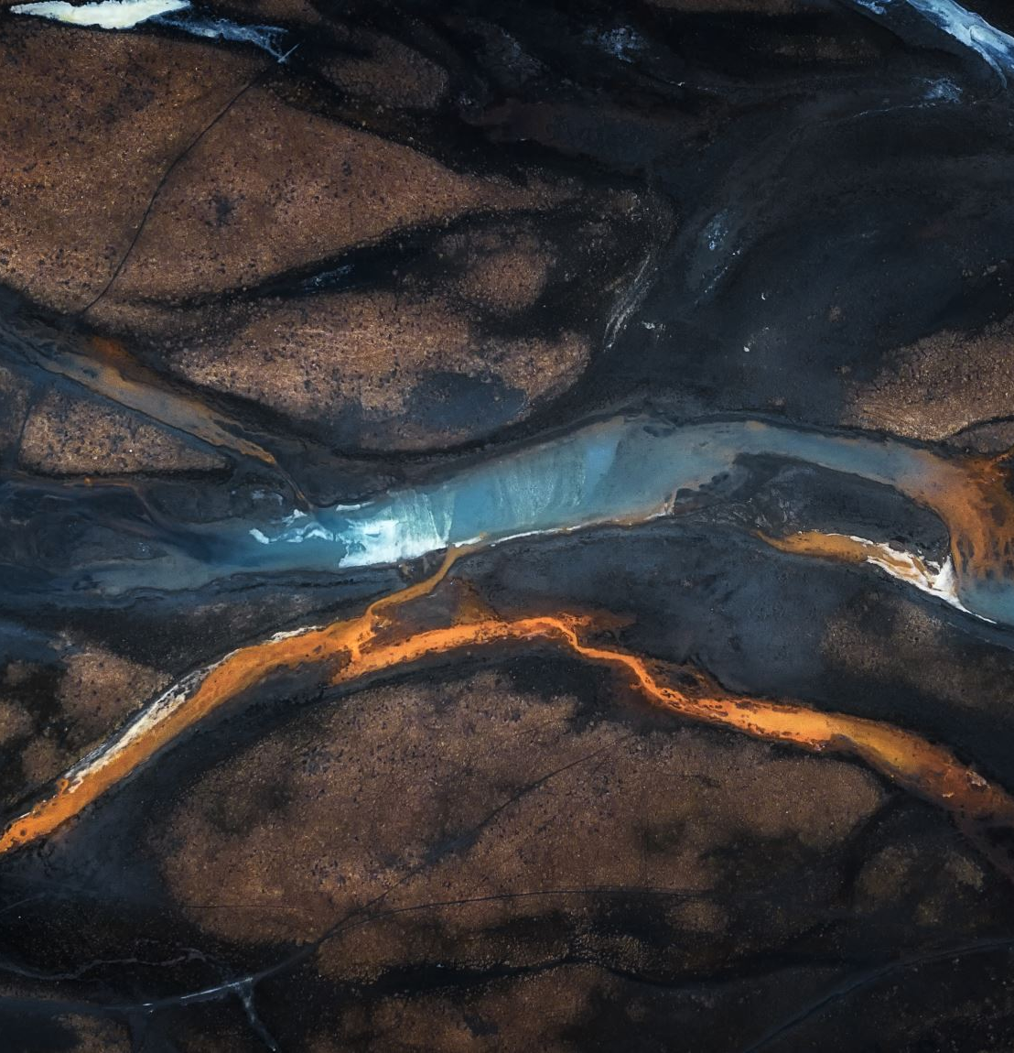
Specific Applications of Parametric Insurance
Parametric insurance can be especially useful in providing funding for losses caused by climate- related events, which are becoming more frequent.
The following slides are actual parametric insurance cases that have been used for climate-related events, such as droughts and floods, including river water level and wildfires.

Slide 36

Specific Applications of Parametric Insurance (continued)
Parametric Flood Insurance using IoT Sensors
Who is the first company to offer parametric flood insurance to small companies? What affordable technology does this company use?
How’s does the parametric flood insurance from FloodFlash work?
What is used to determine whether the flood triggers payment to the policyholder (PH)?
Why is this good for the insurer?
Why is this good for the PH?
Sources and more info:
https://aws.amazon.com/blogs/startups/floodflash-event-based-flood-insurance/
https://www.leadersedge.com/p-c/parametric-flood-cover-makes-its-mark
https://www.leadersedge.com/p-c/parametric-flood-cover-rolling-in
Notes:
The first company offering parametric flood coverage to small businesses was FloodFlash, which uses inexpensive technology, such as Internet of Things (IoT) smart sensors and Amazon Web Services (AWS).
The way that flood FloodFlash parametric insurance works is that the policyholder (PH) pays a premium then if flood water at the property reaches the pre-agreed depth, then FloodFlash pays a pre-agreed amount to the PH.
The smart sensor installed at the covered property determines whether the flood water at the property has reached the pre-agreed level to trigger the payment to the PH.
This is good for the insurer because the insurer knows exactly what they will need to pay to PH if the flood level reaches the pre-agreed level. This reduces uncertainty for the insurer compared to traditional indemnity insurance where an expensive claims adjust process has to be performed to determine how much the insurer needs to pay the PH, which can also lead to conflicts between the insurer and PH.
This is good for the PH because the PH knows exactly how much they receive when the flood level at their property reaches the pre-agreed level. Also, using smart sensors at the property reduces the basis risk for the PH, which is the problem with parametric insurance discussed earlier. And the PH will get paid much faster after the flood loss because the claims adjusting process is not necessary. Also, since it is cheaper for the insurer to offer this policy, it will be cheaper for the PH.

Slide 37
Specific Applications of Parametric Insurance (continued)
Parametric Flood Insurance using IoT Sensors
Click link above to watch the video, then answer the following questions:
What kind of company is FloodFlash, what does it combine, and who does it provide insurance for?
What is simple trigger for this parametric insurance and when does FloodFlash pay the client?
What are the two versions of the FloodFlash cover?
Why is parametric insurance perhaps insurance in its purest form?
Notes:
Link: https://www.youtube.com/watch?v=x-Gszl0tDeg
Delete answers below in student version.
What kind of company is FloodFlash, what does it combine, and who does it provide insurance for?
FloodFlash is an insurance technology company that
combines internet of things, catastrophe modeling, and cloud computing
to provide flood insurance for those that the market has left behind.
What is simple trigger for this parametric insurance and when does FloodFlash pay the client?
We provide parametric insurance with a simple trigger, flood depth,
when flooding reaches a pre-agreed depth, then we pay the client.
What are the two versions of the FloodFlash cover?
FloodFlash which is available to the mass market via all the top retail brokers such as Marsh, Gallagher, Aon, and Towergate
FloodFlash Plus, our service for larger and more complex risk that is arranged through the London Market.
Why is parametric insurance perhaps insurance in its purest form? Parametric insurance is perhaps insurance in its purest form, if this, then that. If an event happens, the policy pays out.

Slide 38
Specific Applications of Parametric Insurance (continued)
Parametric Flood Insurance using IoT Sensors (continued)
Click link above to continue watching the video, then answer the following questions: (continued)
What is parametric far simpler and more transparent than?
What is one of the issues raised with parametric insurance, what is that, and how does FloodFlash cover minimize that risk?
What three invaluable gifts does Lloyd’s Lab give to new and growing insurance technology companies?
Notes:
Link: https://www.youtube.com/watch?v=x-Gszl0tDeg
Delete answers below in student version.
What is parametric far simpler and more transparent than? Far simpler and more transparent than indemnity-based covers.
What is one of the issues raised with parametric insurance, what is that, and how does FloodFlash cover minimize that risk?
One of the issues raised with other parametric policies is the basis risk that comes with them.
That's the idea that a claim won't match the cost of damage.
Our cover minimizes the basis risk by placing a sensor right at the insured property and that way to trigger the depth of flooding correlates with the client's losses more tightly than using satellite data or other alternatives.
What three invaluable gifts does Lloyd’s Lab give to new and growing insurance technology companies?
Access to the biggest insurance market in the world.
Development support from market leaders who have navigated some of the same hurdles in the past
Lloyd's stamp of credibility amongst our peers and the brokers that distribute our product to their clients

Slide 39
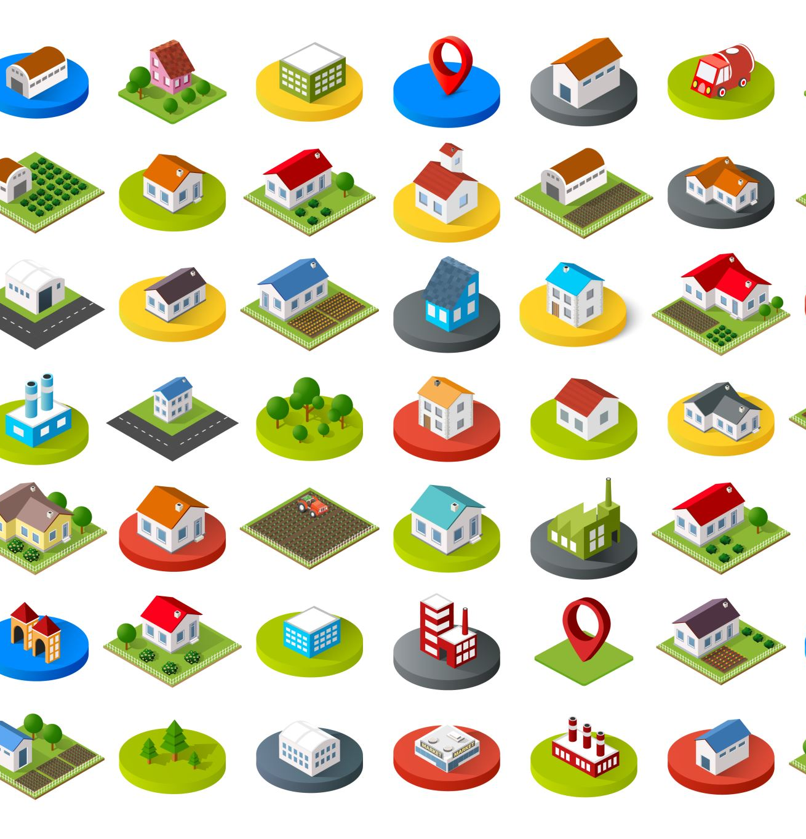
Specific Applications of Parametric Insurance (continued)
Parametric Insurance for Rhine River Water Levels
How does this insurance work?
Who would be interested in this type of insurance?
Why?
Sources and more information:
https://www.marshmclennan.com/insights/publications/2018/dec/parametric-insurance-tool-to-increase-climate-resilience.html
https://www.artemis.bm/news/rhine-river-level-falls-in-heatwave-bringing-parametric-triggers-into-focus/
Notes:
Payment from this parametric insurance is triggered when water levels in the Rhine River go below a set level, which is happening because of drought.
This would be of interest to shipping and transport companies whose business would be interrupted if river water levels go below a set level at specific points on the river because they would no longer be able to travel on the Rhine River. Can be thought of as “non-damage business interruption" cover.
It would also be of interest to companies who depend on receiving goods from the shipping companies that use the Rhine. So this insurance can be thought of as supply chain insurance.
These companies would be interested in this type of insurance because it can provide income when their business is interrupted because ships cannot operate on the Rhine because water levels are too low.
Traditional indemnity insurance cannot typically cover this type of loss. Why? Because traditional indemnity insurance can only cover business interruption loss when the loss is due to a covered peril causing physical damage. For example, if a fire destroys a restaurant so the restaurant cannot operate, the lost revenue of restaurant being closed (business interruption) can be covered because the restaurant suffered physical damage from a covered peril (fire).
In the case of low water levels, ships cannot navigate the river, but there is no physical damage to the ships.

Slide 40
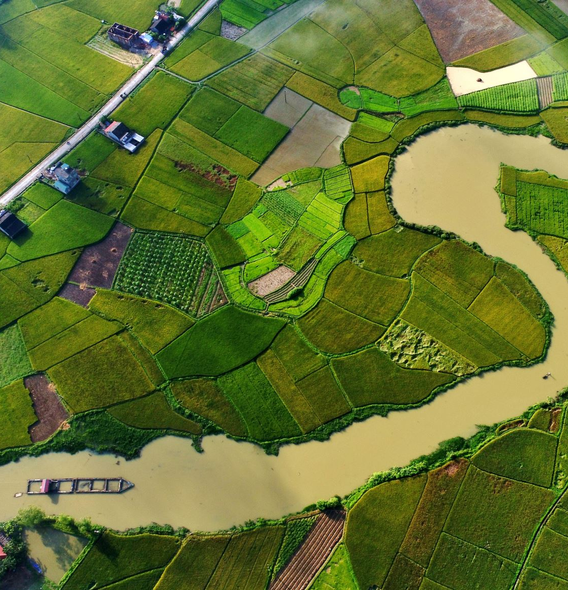
Specific Applications of Parametric Insurance (continued)
Who has mostly been uninsured for crop losses due to drought and flood and why?
In Mexico, in what sector have over 80% of economic losses from weather-related disasters occurred?
The next slide covers parametric insurance that has become available to small farmers in Mexico to provide payments when drought or flood occurs and affects their crops.
Notes:
Small farmers in developing nations have most been uninsured due to drought and flood because traditional indemnity insurance is not able to cover such farmers for reasons discussed previous.
In Mexico, over 80% of total economic losses from weather-related disasters in the last two decades occurred in the agricultural sector.

Slide 41
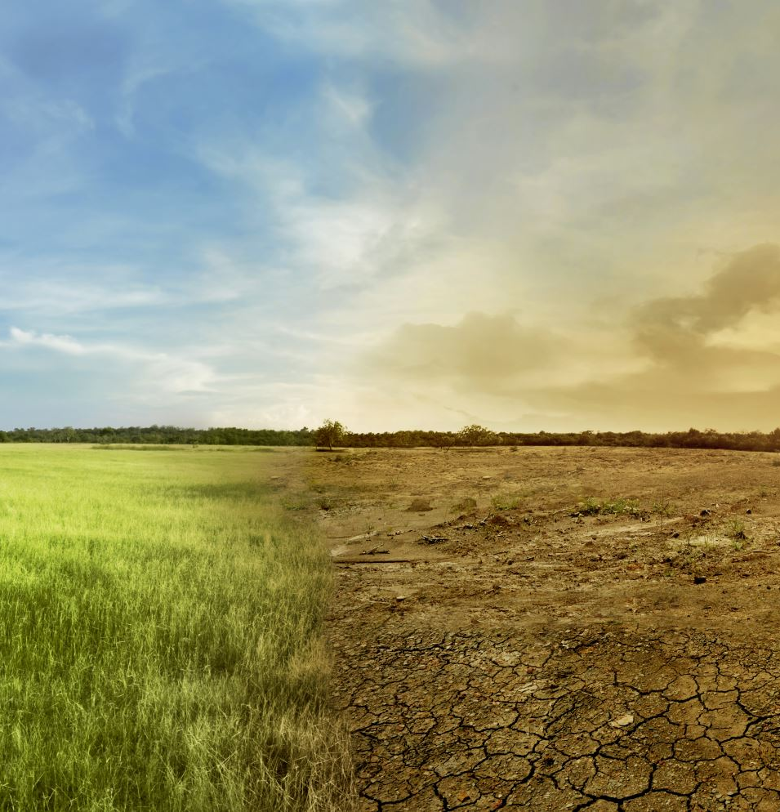
Specific Applications of Parametric Insurance (continued)
Who has mostly been uninsured for crop losses due to drought and flood and why?
In Mexico, in what sector have over 80% of economic losses from weather-related disasters occurred?
The next slide covers parametric insurance that has become available to small farmers in Mexico to provide payments when drought or flood occurs and affects their crops.
Notes:
More than 80% of the losses due to weather events in Mexcio between 2002 and 2022 have occurred in the agricultural sector with small farmers suffering the most.
The largest cause of loss for small farmers is too much or too little rain.
Very few small farmers have any insurance coverage for this because for traditional indemnity insurance the underwriting and claims process is difficult and would cause the insurance to cost more than the farmers could afford and take too long for famers to get paid after the loss.
The parametric insurance works as follows:
The rainfall data is collected using satellites.
The data is monitored daily by a third party to determine if the policy is triggered by too little of too much rain at the policyholders (PH’s) specific location.
The too much rain payment is triggered if the total rain over three days is greater than a pre-determined level.
The too little rain payment is triggered if the moving average over five days is less that a predetermined amount.
The benefit of parametric insurance to the small farmers is that it is much cheaper and can pay out much faster than traditional indemnity insurance.

Slide 42
Specific Applications of Parametric Insurance (continued)
Parametric Insurance for Mexican Farmers
Click link above read the document, then answer the following questions:
What did Guy Carpenter introduce with the aim of delivering affordable insurance to smallholder farmers in Mexico?
What has been built using rainfall data collected by satellite, how often will it be monitored, who will monitor it, and what will this provide?
For the excess rain cover, what triggers a claim payment for insured parcels and what will the payout depend on?
For drought, what will be considered a dry day, when will parcels be considered eligible for a payout, and what will the amount depend on?
Notes:
Link: https://www.guycarp.com/insights/2022/03/guy-carpenter-alfredo-honsberg-describes-parametric-program-for-mexican-farmers.html
Delete answers below in student version:
What did guy Carpenter introduce with the aim of delivering affordable insurance to smallholder farmers in Mexico? A parametric risk transfer initiative?
What has been built using rainfall data collected by satellite, how often will it be monitored, who will monitor it, and what will this provide? Both drought and excess rain indexes have been built using this rainfall data, and it will be monitored on a daily basis by an independent party to provide transparency to the claim process.
For the excess rain cover, what triggers a claim payment for insured parcels and what will the payout depend on? For the excess rain cover, if the accumulated rainfall during a three-day period exceeds the determined level on any given grid point, a claims payment is triggered for all insured parcels within it, and the payout will depend on the amount of accumulated rainfall recorded.
For drought, what will be considered a dry day, when will parcels be considered eligible for a payout, and what will the amount depend on?
A five-day moving average of rainfall will be estimated for each grid point, and if that value falls below 3mm, it will be considered a dry day.
If the number of dry days during the coverage period exceeds the predetermined level, then all parcels located within it will be eligible for a payout.
The amount will depend on the number of dry days

Slide 43
Specific Applications of Parametric Insurance (continued)
Parametric Insurance for Wildfires
Click link above, read the document, then answer the following questions:
What is making the incidence of wildfires more frequent?
What other important factors exacerbate the increasing risks of wildfires?
Between 2000 and 2020, how much has the annual number of acres burned in wildfires increased?
About what percent of catastrophic losses are uninsured?
Notes:
Link: https://www.brinknews.com/more-frequent-wildfires-could-drive-up-the-cost-of-insurance/
Delete answers below in Student Version.
What is making the incidence of wildfires more frequent? The world is getting hotter and dryer.
What other important factors exacerbate the increasing risks of wildfires? Population growth on the wildland-urban interface and insufficient or inappropriate management of state, federal and privately owned forests.
Between 2000 and 2020, how much has the annual number of acres burned in wildfires increased? More than doubled.
About what percent of catastrophic losses are uninsured? Approximately 75% of total economic losses.

Slide 44
Specific Applications of Parametric Insurance (continued)
Parametric Insurance for Wildfires (continued)
Click link above, read the document, then answer the following questions:
Why does wildfire lend itself well to parametric treatment?
Why have remote sensing approaches to provide information for parametric treatment advanced significantly over the last decades?
For wildfires, direct damages are often less concerning than what?
Compared to classical models, what do new models account for and what does this allow for?
Notes:
Link: https://www.brinknews.com/more-frequent-wildfires-could-drive-up-the-cost-of-insurance/
Delete answers below in Student Version.
Why does wildfire lend itself well to parametric treatment? Because the hazard location largely determines the loss outcome.
Why have remote sensing approaches to provide information for parametric treatment advanced significantly over the last decades? Thanks to more numerous satellites and better instrumentation.
For wildfires, direct damages are often less concerning than what? Financial damages incurred by the interruption of operations.
Compared to classical models, what do new models account for and what does this allow for? New models account for burned areas with update cycles that are much more frequent. This allows for more accurate and dynamic pricing of parametric solutions.

Slide 45
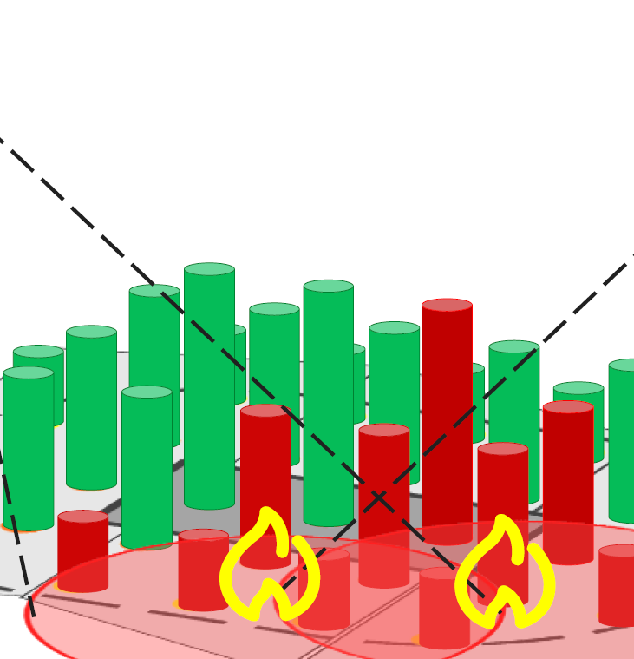
Specific Applications of Parametric Insurance (continued)
GC FireCell: Parametric Wildfire Coverage
Click link above, read the document, then answer the following questions:
What does Guy Carpenter (GC) FireCell provide, what is it based on, and what kind of model does it provide? G
What are the two steps that GC FireCell uses to determine payout related to wildfires?
GC Firecell uses a grid with a resolution of about how many meters to represent exposures with a set of what?
When are FIRMS satellite wildfire observations
approximately available?
Notes:
Link: https://www.marshmclennan.com/content/dam/mmc-web/insights/publications/2023/april/GC%20FireCell%20Product%20Sheet.pdf
Delete answers below in student version.
What does Guy Carpenter (GC) FireCell provide, what is it based on, and what kind of model does it provide? GC FireCell provides customized coverage based on wildfire information published in real time by NASA’s FIRMS1 using a high-resolution parametric model.
What are the two steps that GC FireCell uses to determine payout related to wildfires?
Guy Carpenter, or the agreed calculation agent, extracts the physical event parameters from the reporting agency in accordance with the GC FireCell contract.
Using the latitude and longitude of the event’s reported fire observations, we determine whether one or more virtual stations covered in the transaction have been affected. We calculate the payout by adding the limits assigned to the affected virtual stations.
GC Firecell uses a grid with a resolution of about how many meters to represent exposures with a set of what? Resolution of about 100 meters to represent exposures with a set of “virtual stations”.
When are FIRMS satellite wildfire observations approximately available? Within approximately 3 hours of data acquisition.

Slide 46
Specific Applications of Parametric Insurance (continued)
Click this link “Parametric Flood Insurance in Columbia”, then read the document to answer questions on the following slides.

Slide 47
Specific Applications of Parametric Insurance (continued)
Questions: Parametric Flood Insurance in Columbia
What enabled the world’s first at-scale parametric flood insurance product?
What is Cloud to Street (C2S) and what does it provide?
What is C2S powered by, who does its technology provide better data to, and what does that inform better decisions for?
What does C2S have a unique combination of and what can this produce and provide?
Notes:
Link: https://www.businesswire.com/news/home/20220607005115/en/Cloud-to-Street%E2%80%99s-Groundbreaking-Flood-Mapping-Technology-Enables-the-World%E2%80%99s-First-At-Scale-Parametric-Flood-Insurance-Product-Rolls-Out-In-Colombia
Delete answers below in student version.
What enabled the world’s first at-scale parametric flood insurance product? Cloud to Street’s groundbreaking flood mapping technology.
What is Cloud to Street (C2S) and what does it provide? C2S is a climate adaptation technology company that provides precise, near real-time data and analysis on flooding and flood risk.
What is C2S powered by, who does its technology provide better data to, and what does that inform better decisions for? Powered by 15 satellites, machine learning, and on-the-ground data, C2S’s technology provides better data to insurance companies and governments to inform better flood preparedness and recovery decisions.
What does C2S have a unique combination of and what can this produce and provide? C2S has a unique combination of satellite imagery, historical data, and modeling and can produce precise predictions of flood locations and severity to provide life-changing insurance products for the previously-uninsured as well as near-real-time measurements of flooding events to inform parametric policy payouts.

Slide 48
Specific Applications of Parametric Insurance (continued)
Questions: Parametric Flood Insurance in Columbia (continued)
What does Raincoat develop, in collaboration with who, and what is Raincoat’s aim?
What do parametric insurance policies insure a policyholder against, by paying what, instead of what?
Under the program in Colombia, what will insured farmers receive and what is it based on?
What does this parametric insurance allow to be covered and what is this largely due to?
Notes:
Link: https://www.businesswire.com/news/home/20220607005115/en/Cloud-to-Street%E2%80%99s-Groundbreaking-Flood-Mapping-Technology-Enables-the-World%E2%80%99s-First-At-Scale-Parametric-Flood-Insurance-Product-Rolls-Out-In-Colombia
Delete answers below in student version.
What does Raincoat develop, in collaboration with who, and what is Raincoat’s aim? Raincoat develops highly-scalable embedded climate insurance products in collaboration with insurers, financial institutions, and governments. Raincoat aims to democratize financial resilience in the face of natural disaster.
What do parametric insurance policies insure a policyholder against, by paying what, instead of what? Parametric insurance policies insure a policyholder against the occurrence of a specific event by paying a set amount based on the magnitude of the event instead of the physical damages incurred.
Under the program in Colombia, what will insured farmers receive and what is it based on? Insured farmers will receive loan relief based on the magnitude of floods that hinder their abilities to grow their crops and bring them to market.
What does this parametric insurance allow to be covered and what is this largely due to? Allows for previously uninsurable risk to be covered, and frictionless claims payments, largely due to the fact that they do not require physical inspection of damages by an adjuster to trigger a payout.

Slide 49
Specific Applications of Parametric Insurance (continued)
Questions: Parametric Flood Insurance in Columbia (continued)
As a country-wide parametric flood program, what will farmers in even the most remote parts of Colombia now receive?
What flood data streams does C2S include, what is applied to these data streams, and what does it deliver?
What does C2S provide insurers and disaster risk holders with and what does this allow to be done?
For the Colombian farmer’s program, what has CDS’s data enabled partners to do?
Using the data from C2S, Raincoat was able to provide a product and platform that allows what?
Notes:
Link: https://www.businesswire.com/news/home/20220607005115/en/Cloud-to-Street%E2%80%99s-Groundbreaking-Flood-Mapping-Technology-Enables-the-World%E2%80%99s-First-At-Scale-Parametric-Flood-Insurance-Product-Rolls-Out-In-Colombia
Delete answers below in student version.
As a country-wide parametric flood program, what will farmers in even the most remote parts of Colombia now receive? Will receive immediate financial relief following a flood disaster.
What flood data streams does C2S include, what is applied to these data streams, and what does it deliver? Include several flood data streams (optical and radar satellites, historical flood maps, and on-the-ground intelligence) and machine learning is applied to deliver vital and actionable intelligence about the extent and impact of ongoing flood events.
What does C2S provide insurers and disaster risk holders with and what does this allow to be done? C2S provides previously inaccessible data to insure new markets, respond to emergencies, and plan for future flood risk.
For the Colombian farmer’s program, what has C2S’s data enabled partners to do? Set the specific parameters for flood risk that made the creation of fair, comprehensive parametric policies possible.
Using the data from C2S, Raincoat was able to provide a product and platform that allows what? Payouts to insured farmers within days of a disaster, without them having to file a claim.

Slide 50
Specific Applications of Parametric Insurance (continued)
Click this link “Buffering Cyber Risk with Parametric Insurance”, then read the document to answer questions on the following slides.
Previous “Specific Applications for Parametric Insurance” were for climate related risk.
This document is about a cyber risk, which is human caused, and is difficult to get full coverage for using only traditional indemnity insurance.

Slide 51

Specific Applications of Parametric Insurance (continued)
Questions: Buffering Cyber Risk with Parametric Insurance
Parametric insurance is not a new product, but has never been used in what space?
What are parametric insurance solutions sometimes called, what are they designed to do, what are they measured with, and ideally what are used to define triggers?
What does a successful parametric solution do compared to traditional indemnity insurance?
What are examples of true economic costs that a parametric solution can consider and cover that traditional indemnity insurance typically does not cover?.
What are examples of spaces where parametric insurance has been around for a long time?
Notes:
Link: https://netdiligence.com/blog/2021/01/parametric-insurance/
Delete answers below in student version.
Parametric insurance is not a new product, but has never been used in what space? Cyber.
What are parametric insurance solutions sometimes called, what are they designed to do, what are they measured with, and ideally what are used to define triggers?
Sometimes called index insurance,
are designed to quickly trigger payment to an insured when a predefined event,
measured with some clear and objective criteria, occurs.
Ideally, objective third-party data sources are used to define trigger(s).
What does a successful parametric solution do compared to traditional indemnity insurance? Get money in the hands of the insured much quicker than a traditional indemnity insurance.
What are examples of true economic costs that a parametric solution can consider and cover that traditional indemnity insurance typically does not cover?. Considering things like downstream impacts, increased costs, reputational effects, and contractual liability.
What are examples of spaces where parametric insurance has been around for a long time? Energy, natural catastrophe, weather, and agricultural spaces.

Slide 52
Specific Applications of Parametric Insurance (continued)
Questions: Buffering Cyber Risk with Parametric Insurance (continued)
What does every parametric solution design involve defining, selecting or creating, and valuing?
How is a parametric solution is tweaked?
What does “Cyber” touch on and who can “Cyber” have knock-on effects for?
What are Web/technology industries very accustomed to monitoring and even guaranteeing, and dealing with what that make cyber an area where what can be quite intuitive?
Notes:
Link: https://netdiligence.com/blog/2021/01/parametric-insurance/
Delete answers below in student version.
What does every parametric solution design involve defining, selecting or creating, and valuing?
Defining an exposure and event,
selecting or creating an index, and
valuing the loss against thresholds or values of the index.
How is a parametric solution is tweaked? To fit the client need and budget.
What does “Cyber” touch on and who can “Cyber” have knock-on effects for?
Cyber touches on a broad universe of risks and
can have knock-on effects for both the insured and the insured’s own customers.
What are Web/technology industries very accustomed to monitoring and even guaranteeing, and dealing with what that make cyber an area where what can be quite intuitive?
Monitoring and even guaranteeing service uptime and
dealing with the upstream and downstream impacts including extra expenses, and this is an area where trigger definition can be quite intuitive.

Slide 53

Specific Applications of Parametric Insurance (continued)
Questions: Buffering Cyber Risk with Parametric Insurance (continued)
Going beyond business interruption for cyber parametric cover, what becomes less clear?
What talk has there been in the context of widespread malware/viruses impacting large swaths of the internet, and the ripple effects of major cloud infrastructure providers going temporarily offline?
What are four elements of having a clear process that are critical for creating parametric coverage for cyber-related risks?
In today’s world, what type of assets are more important for many firms and what are insurance solutions increasingly expected to cover?
Notes:
Link: https://netdiligence.com/blog/2021/01/parametric-insurance/
Delete below in student version.
Going beyond business interruption for cyber parametric cover, what becomes less clear? Becomes less clear how to measure and correlate objective indices to losses such as privacy liability, network security liability, and regulatory exposures.
What talk has there been in the context of widespread malware/viruses impacting large swaths of the internet, and the ripple effects of major cloud infrastructure providers going temporarily offline? Talk of “cyber CAT bonds”.
What are four elements of having a clear process that are critical for creating parametric coverage for cyber-related risks?
defining the exposure
defining the event
identifying reliable independent data sources
defining triggers that correlate to liquidity needs following a cyber event.
In today’s world, what type of assets are more important for many firms and what are insurance solutions increasingly expected to cover?
Intangible assets are more important than tangible assets for many firms.
Insurance solutions are increasingly expected to provide cover beyond physical damage and cover any economic interest arising out of an event.

Slide 54
Specific Applications of Parametric Insurance (continued)
Questions: Buffering Cyber Risk with Parametric Insurance (continued)
On the underwriting side of cyber parametric solutions, what is the challenge?
Parametric isn’t a substitute for traditional cyber offerings. For traditional indemnity insurance, what are the insurer and possibly the broker providing or facilitating? By contrast, what kind of cover is parametric and what does it not provide that indemnity-based solutions might provide?
As it evolves, what could parametric cyber start to play an important role in?
Notes:
Link: https://netdiligence.com/blog/2021/01/parametric-insurance/
Delete below in student version.
On the underwriting side of cyber parametric solutions, what is the challenge? The challenge is estimating the likelihood and drivers of that outage and to find a trusted third-party data source to prove it.
Parametric isn’t a substitute for traditional cyber offerings. For traditional indemnity insurance, what are the insurer and possibly the broker providing or facilitating? By contrast, what kind of cover is parametric and what does it not provide that indemnity-based solutions might provide?
For traditional indemnity insurance, the insurer and possibly the broker are providing or facilitating a wide array of critical response services encompassing security, investigation, and legal to name a few.
Parametric, by contrast, is a financial/economically oriented cover and does not provide post-event services that indemnity-based solutions might.
As it evolves, what could parametric cyber start to play an important role in? Enterprise risk management.

Slide 55
Specific Applications of Parametric Insurance (continued)
Parametric Cyber Insurance
What two companies have teamed up to offer the first parametric cyber insurance coverage?
What kind of company is Intangic and what approach does it bring to cyber risk management?
What does Intangic provide that allows real-time monitoring of the cyber risk activity affecting the policyholder?
Describe the two triggers for this parametric cyber insurance.
How does the timing of the claim payout compare to tranditional insurance?
Source and for more information:
Intangic MGA
AXA XL teams up with Intangic MGA to enhance cyber insurance offerings | Insurtech Insights
Notes:
Two companies have teamed up to offer the first parametric cyber insurance coverage: AXA XL, and Intangic, which is a managing general agent (MGA) that brings a data-science driving approach to cyber risk management. Companies that purchase this cyber insurance are provided with a dashboard that allows real-time monitoring of the cyber risk activity affecting the policyholder.
The parametric cyber insurance has two triggers:
Amount of malicious activity aimed at the company is the first trigger
After first trigger reaches a pre-determined level, the second trigger is loss in value.
When first trigger then second trigger are reached, there is a fast claim payout to the company of a pre-determined amount unlike the months it takes for traditional cyber insurance.

Slide 56
Specific Applications of Parametric Insurance (continued)
Parametric Cyber Insurance (continued)
What is this parametric cyber insurance different in assuming?
What can Intangic quantify about the company and why is Intangic able to do this?
What does this allow Intangic to help companies reduce?
What does Intangic allow cyber risk to be viewed as and who is this easier for?
Describe how Intangic's parametric cyber insurance is a complement to traditional cyber indemnity insurance in terms of deductibles and exclusion.
Source and for more information:
Intangic MGA
AXA XL teams up with Intangic MGA to enhance cyber insurance offerings | Insurtech Insights
Notes:
This parametric cyber insurance is different by assuming that cyber attacks are a high-frequency risk, meaning they are bascially continuous. Intangic can quantify how the company manages the cyber threats and the impact financially on the company's operations. Intangic is able to do this by their big data approach that has analyzed many cyber attacks on many thousand companies over many years.
This allows Intangic to help companies reduce the likelihood of their policyholders having impactful cyber-related losses, so is not just risk transfer but is also risk mitigation. Intangic allows cyber risk to be viewed as a business risk in language that is easier to understand for the C-suite and the board of directors.
Intangic's parametric cyber insurance policy is not meant to replace traditional indemnity cyber insurance but is a complement. Traditional cyber insurance typically excludes cyber attacks that are considered to be acts of war by state actors. This parametric insurance do not exclude those. This parametric insurance does not have a deductible, so can complement traditional cyber insurance, which typically has a deductible or if the company self-insures smaller cyber losses.

Slide 57
Specific Applications of Parametric Insurance (continued)
Parametric 3rd Party IT Downtime Insurance
https://www.youtube.com/watch?v=juCbFgNYjcs 1:40
Click link above to watch the video, then answer the questions on this and the following slide.
What are some examples of 3rd party services that a company's mission-critical IT infrastructure relies on?
If even one of these services goes down, what may you lose connection to for hours?
What does this expose your company to, what suffers, and who may never come back?
Traditional indemnity insurance completely excludes IT downtime losses or heavily restricts it. What is almost impossible to prove and what can take months and months to settle?
What first ever insurance product does Parametrix Insurance provide?
Notes:
Link: https://www.youtube.com/watch?v=juCbFgNYjcs
Delete answers below in student version.
What are some examples of 3rd party services that a company's mission-critical IT infrastructure relies on? Cloud computing, payment gateways, e-commerce platforms, internet providers, and more.
If even one of these services goes down, what may you lose connection to for hours? Your customers.
What does this expose your company to, what suffers, and who may never come back? Exposed to revenue losses, employee productivity suffers, and your customers may never come back.
Traditional indemnity insurance completely excludes IT downtime losses or heavily restricts it. What is almost impossible to prove and what can take months and months to settle? Proving loss is almost impossible and it can take months and months for claims to be settled.
What first ever insurance product does Parametrix Insurance provide? First ever IT downtime coverage.

Slide 58
Specific Applications of Parametric Insurance (continued)
Parametric 3rd Party IT Downtime Insurance (continued)
What does Parametrix coverage provide guarantees for and fully protect you from?
For this coverage, what can you simply adjust?
What does Parametrix monitor for your company and what can that detect?
Since Parametrix and your company preagreed on the terms ahead of time, what does Parametrix notify your company about then transfer?
For this Parametrix coverage, what process is not needed, and what can your company use the money payment to cover? Examples of what payment can cover?
Notes:
Link: https://www.youtube.com/watch?v=juCbFgNYjcs
Delete answers below in student version.
What does Parametrix coverage provide guarantees for and fully protect you from? Provides guaranteed fast payouts and hassle-free processes, fully protecting you from the financial fallout of IT downtime events.
For this coverage, what can you simply adjust? Can simply adjust coverage amount and waiting period to suit your business needs.
What does Parametrix monitor for your company and what can that detect? Monitors the IT services you use so Parametrix systems immediately detect any downtime events.
Since Parametrix and your company preagreed on the terms ahead of time, what does Parametrix notify your company about then transfer? Notifies when downtime occurs and then transfers the payment.
For this Parametrix coverage, what process is not needed, and what can your company use the money payment to cover? Examples of what payment can cover? No claims process needed. Can the money to cover any loss. Examples: pay for your recovery expenses, compensate your customers for lack of service, and secure your revenue stream

Slide 59


