Slide 1
Project Risk Management
Notes:
In this presentation, we will explore the concept of supply networks and cascading risk, its causes and consequences, some real-world examples, and some strategies to mitigate or prevent them.

Slide 2
Acknowledgment
This course module is made possible through a grant from FM Global
through the Spencer Educational Foundation.
FM Global is one of the world’s largest business property insurers (www.fmglobal.com). Their clients include more than one out of every three FORTUNE 1000-size companies in more than 130 countries. For nearly 200 years, clients have worked with FM Global to develop robust property insurance and engineering solutions to protect their business operations from fire, natural disasters, and other types of property risk.
The Spencer Educational Foundation is a 501(c)(3) nonprofit organization funding the education of tomorrow's risk management and insurance leaders through scholarships, grants, internship opportunities, on and off campus experiential learning, and support of risk management/insurance curricula. Since Spencer was founded in 1979, they have awarded over $9.5 million in scholarships and over $8 million in grants to universities and professional institutions impacting over 70,000 students through their programming. For more information, please visitwww.spencered.org.

Slide 3
Acknowledgment
Also supported by:
Insurance and Financial Services Center, Strome College of Business
Department of Engineering Management & Systems Engineering, Batten College of Engineering and Technology
Old Dominion University
College of Emergency Preparedness, Homeland Security, and Cybersecurity University at Albany
and
Engineering and Technology Management Program, Voiland College of Engineering and Architecture
Washington State University

Slide 4
This module contains the following sections:
What is a Project?
Project Risk Management
Using Quantitative Methods
Tornado Diagram
Monte Carlo Simulation

Slide 5
Learning Objectives
Understand what is a project and what is project risk management.
Identify and classify the sources and types of project risk.
Apply basic RM steps for project risk management.
Apply select quantitative methods for project risk management.

Slide 6
What is a project?

Slide 7







What is a Project?
Notes:
What is a project?
Here are a few examples.
……the development of the new car like the Tesla
Drug development is a project like the Covid vaccines from mRNA to shelf.
We might also think about a project that has to do with putting together a website, or a service online, like healthcare.gov.
A construction of a home or just a bathroom remodel
Some of us might also be thinking about mega projects, construction projects like the Sydney Opera House, or maybe the pyramids in Egypt.
How about events or festivals?
Like organizing something as complicated as the FIFA World Cup, or maybe, shooting a film, from script to cinema.
The production of a Broadway show or organizing a festival something like the Cannes Film Festival.
That's a project.
From personal projects, to new product development projects, to construction projects, or events and performances.
These are all projects!
So what do they all have in common? What features do they have in common
Why are they all considered to be projects?

Slide 8
What is a Project?
“A unique set of activities meant to produce a defined outcome within an established time framing specific allocation of resources.” (Harvard Business Review)
“A project is a temporary endeavor undertaken to create a unique product or service.” (Project Management Institute)
Create a specific and unique product or service (GOAL)
Temporary
Specific start and finish
Temporary organization
Require multi-disciplinary coordination
Constrained by time, cost or resources
Notes:
Projects have a specific and unique aim, a product or service that they are going to develop. This is typically the higher level goal.
Projects are temporary! They have a specific start date and an end date.
They have a temporary organization.
A temporary group of individuals who are engaged in that activity associated with that specific project.
They require multi-disciplinary coordination. Individuals with different set of expertise from different locations even.
All coming together for the purposes of that specific project.
Projects are also constrained by time, cost, and resources.
Now, What is NOT a project?
A few examples that are not projects.
Manufacturing….the manufacturing process of a new car, phone, computers or of some type of clothing. Those are not projects, those are seen as routine ongoing operations.
And so are the routine processing- of certain applications, such as insurance applications, or job applications, are not projects.
Services may not be projects- hospital services, restaurants, banking
They are not temporary and not unique
So the temporary nature and the uniqueness of the undertaking really makes a project.

Slide 9


Three Project Objectives
Scope
Time
Budget
Notes:
Project management gurus like to call this the Holy Trinity for projects-
the scope, the budget, and the time.
The time, as the name might imply, has to do with the duration. Over what kind of time frame are we talking about executing our project?
By when does it have to be finished?
The scope is usually a description of requirements, qualities, specifications of a product or deliverables, or outputs that are going to be eventually delivered.
And, the budget has everything to do with cost and resources that we have available to us for the purposes of this particular project.
Now, the reason it's called the Holy Trinity is because each one of these different objectives might pull in a different way.
If we're limited by time, and we really need to meet a certain deadline, we may need to think about giving up on one of the other two dimensions, or the other two objectives.
Either in scope, by reducing it, or by finding more money to support an accelerated schedule. They are very much INTERDEPENDENT!
When you mess with one, or change one of these, it will IMPACT the other!
And so, when we think about any project's three objectives, we always have to be thoughtful about the tradeoffs and the priorities among them.
===============
One way you might want to think about this is to define which of the three
objectives is constrained, is limited, we are definitely not able to exceed.
Another aspect of thinking about the three objectives is if it's not constrained,
maybe we want to optimize it.
We want to achieve a certain goal.
We want to minimize it, or maximize it.
And finally, where can we compromise?
While we might have a specific time, maybe we can compromise, and delay things.
And so, when we think about our three objectives, we want to map them out.
Which one are we going to be constrained by?
Which will we aim to optimize?
And, which can we compromise on?

Slide 10
Three Project Objectives
Deliver deliverables?
Does the outcome, at completion, satisfy the customer?
Scope
On time?
Time
Budget
Over or under budget? By how much?
Notes:
A key factor that we need to think about is how are we going to measure the success of our project?
And so we go back to our project objectives.
We're going to ask the questions. Was it on time, was it late? And by how much?
Was it over or under budget? And by how much?
Did it deliver its promised deliverables?
Were the customers satisfied at the time of the project completion?
Answering these questions will help us determine whether our projects are successful or not.
A successful project will be a project that is on time, on budget, and delivers the scope.

Slide 11
What is Project Risk?
What is project risk?
Notes:
So what is project risk?

Slide 12
Project Risks threaten objectives!
Recall, risk is defined as the effect of uncertainties on objectives (ISO 31000:2018)
Project risk is anything that could potentially impact your project's timeline, scope or budget.
Project risk management is the process of identifying, analyzing and responding to any risk that arises over the life cycle of a project to help the project remain on track and meet its goal and objectives.
Deliver deliverables?
Does the outcome, at completion, satisfy the customer?
Scope
RISKS
!
On time?
Time
Budget
Over or under budget? By how much?
Notes:
Recall that for ISO, risk is defined as the effect of uncertainties on objectives
So for projects, risk is anything that could potentially impact your project’s timeline, scope and budget.
This risk stems from the possibility or probability that the project will not turn out as planned.
BECAUSE here is s lot of uncertainty or unknowns associated with how the project will actually take place.
And so we need to think about what risks do we foresee in the execution of our project.
What can go wrong?
Here you can start thinking about, hazards and threats to project success, threats that negatively influences one or more project objectives of cost, quality, and schedule
So project risk is anything that could potentially impact your project's timeline, scope or budget, including positive risks.
Project risk management is the process of identifying, analyzing and responding to any risk that arises over the life cycle of a project to help the project remain on track and meet its goal and objectives. ...
WHY do we need to do project risk management?
So that we can plan for potential scenarios that may happen unexpectedly and if needed amend our plans accordingly in order to better face those risks as they manifest themselves!
========================
So in general, risk is defined as events or incidents that happen by chance with undesirable consequences!
So why after all that front end planning does a project not work out the way we planned it?
Things happen that are not in your control! Why do we say that something is not in your control. Like throwing dice, outcomes are uncertain.
There is variability, unpredictability to many of the events or conditions or behaviors that can negatively impact or affect the project.
Technically in risk nomenclature, we do differentiate between negative risk and positive risk. Positive risks are risk events that happen with positive outcomes.
The overall risk management process for positive risk is similar to negative risk except for the particular strategies employed lead to maximizing opportunities and potential benefits.

Slide 13
Project Lifecycle
Initiate
Establish organization
Project Charter and Definition
Plan
Identify Scope
Identify tasks, dependencies and schedule
Plan resources
Clarify trade- offs and decision making principles
Develop a risk management plan
Execute
Monitor
Communicate and report
Correct and control
Close
Sign off
Conduct a formal post- mortem
Notes:
Here is the project life-cycle, typically shown in four different stages.
We initiate, we plan, we execute and we close.
In the initiation, we think about the organization and we define the project charter and
Here we define the project itself, what is the goal and what are the objectives.
When we plan, we identify the scope, we identify the task and their dependencies, and we come up with a schedule.
We plan the resources that will be needed throughout the project, and we clarify different trade-offs among them,
how decisions are going to be made throughout the life cycle of the project.
As part of the plan, we come up with a risk management plan.
How are we going to face risks when they emerge and where are they most likely to emerge, which one’s has the most impact to our project?
To properly manage project risk, we need a risk management plan. This will all, allow us to identify the key drivers and the impacts and come up with a mitigation or solution to dealing with those risks throughout the execution of our project.
The execution stage of the project typically consists of monitoring how much progress is being made.
Communicating and reporting among ourselves on how well we're doing.
And correcting and controlling if problems come up => this is aided by our risk management plan
AND this step also includes monitoring the identified risks and risk levels; and scanning any emerging risks
And as know, the monitor, communicate and control, are going to be a cycle.
We're going to, on an on going basis, monitor our progress,
communicate amongst ourselves, and decide how to correct and control.
Finally, when all is said and done and we deliver our product, we will sign off with our customer, or with our final stakeholder, and we will conduct a formal post-mortem.
This stage is too often neglected and missed. What's so critical about a post-mortem is not only to list areas that might have gone badly, or what we did wrong.
But it's also to celebrate, and to document what went well. And what have we achieved, and what have we learned that was useful and successful throughout the life of this specific project.
Our risk register will show us, what risks actually happened and we can evaluate how good our risk responses were, if they adequately addressed the risk and we can look at how we can improve our risk responses for future projects.
===================
Now, it's not that these different stages are going to be equal length in every single project.
And in fact, different projects, and the nature of a different project, might imply a different balance between them.
So, if a new product development implies a certain time spent on planning and a different extent of time spent on execution.
For instance, if we're working on a construction project, we may, if it's a routine construction project, putting down a new rail line.
We might not need that much time spending on planning, because we've done similar projects before, but the execution may be lengthy because of the physical work that is implied.
An opposite example might be a wedding. We know that to plan a wedding takes a while, and we like to make it even longer. And so we will indulge and plan it over a long amount of time.
The execution of the wedding, the day itself is so short that it is a sliver of the length of time it took us to plan.
Not only do we need to be thoughtful and think about how our different project might influence the length of time of the, these different components.
But we also we might need to be aware of the fact that it could be an iterative process.
In some situations, we might plan and go back to our initiation and change our project definition.
We might start executing and realize that we've faced an uncertainty that we didn't anticipate. And go back and make corrections to our plan.
And so, by nature, the life cycle of a project could be iterative, and it's not that we're going to move sequentially between these segments.
Some organizations, many, new product development companies like to take a broader look and stand back and think about the execution of a project in the context of a Stage-Gate Process.
The Stage-Gate Process allows for reflection as we progress through the life cycle.
And as we progress in our development of our product. And so, we might have a gate, an opportunity to reflect, to deliver a piece of work and to have a decision made along the way.
And we formalize it and we control the flow of our project as it matures and as we gain clarity on the content and what the product will be doing.
Regardless of whether you use the StageGate Process, or whether you use a different process, identifying the life cycle and acknowledging the fact that you may need to iterate between the different stages.
And, taking into account, and taking time to reflect on a project when it's done, as part of your step of closing the project, are crucial in our evolution and our improvement of the execution of our projects.

Slide 14
Project Risk Management

Slide 15
Project Risk Management Process
The risk management process repeats throughout every phase of the project from Conception through Close-out
Identification
Assessment
Response Planning
Track and Control
Brainstorming, checklists, previous projects, experts
RBS
Risk Register
Impact
Likelihood
Prioritized Risk Register
Identify response strategy to each risk
Assign responsibilities
Update risk probabilities, risk levels
Execute planned strategy if events occur
Notes:
This will be familiar to you!
This is the general Risk Management Process for Projects. There are FOUR steps to come up with a risk management plan, Other books will have this slightly different with different nomenclatures/ different names for each step.
We're going to start with identification, identifying the risks,
Then assessing them, planning the response, and then monitoring, tracking and controlling during the actual execution of the project.
Now theses processes of course are repeated throughout every phase of the project from conception to close out.
For projects, it is critical to bring together all the different stakeholders or representatives of those groups, individuals with a lot of expertise that have done similar projects. This can facilitate a very detailed and thorough list of different risks that could occur throughout the life of our project.
We can look at historical data, and databases to come up with actual statistics associated with those risks.
Or we can consult with experts and learn from their experience.
Read post mortem reports,
The output here is to come up with a risk register, or a list of possible risks that could occur to our project.
These are the risks particularly associated with the scope, associated with the duration, or associated with the cost of our project.
A lot of focus is given to risks that affect the holy trinity of scope, duration, and cost
=========
In some books steps 3 and 4 fall under Manage risk, so you’ll see the risk management process as 3 distinct processes instead of 4.
Some will have even more steps in the process like 6+1 guiding questions which give more detail in each step.

Slide 16
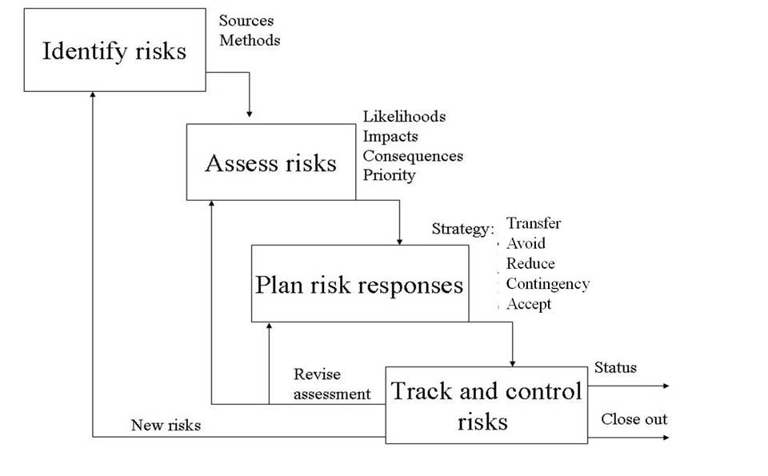
Risk Management Elements and Process
0th What should go right?
1st What can go wrong?
2nd What are the causes and consequences?
3rd What is the likelihood of occurrence?
4th What can be done?
5th What are the alternatives?
6th What are the effects beyond this particular time?
Notes:
I added here the 6+1 guiding questions for risk, so you see that it still generally follows the same thought process.
In projects, the 0th question is already outlined in the project plan. The project plan details all the things that need to happen for the project to successfully meet the three objectives of scope, time and budget. Everything that should go right for the project to be on time, within budget and scope.
Identify risk- what can go wrong, what are the causes and consequences, you can use any of the tools that we learned in class to identify project risk
Asses risk- what are the likelihood of occurrence, impacts, prioritization, again the tools and techniques we’ve learned is applicable
Plan risk responses- what can be done, what are the alternative, strategies are the same. Although we will talk more about contingency
Track and control.
***So we track and control risk for in the last step–We have to make sure that the recommended actions to address the risk are managed, delegated to specific people who are responsible for that risk, the status is monitored.
Tracking is not only making sure the recommended actions are implemented. Tracking also means regularly looking at the risks and making sure that risk levels have not changed. This is the reason we consider all risks, some risks that may have been considered medium may have changed and is now a high level risk.
This loop shown here is where the continuous assessment of risk levels take place.
How do risk levels change? Well, when there is any significant change in the operations of a system (new management process for example or new technology) or the system environment has evolved like new regulations, or new competitor, a risk assessment or re-assessment should be undertaken to relevant risk that may have been impacted.
Tracking is also looking at how effective responses are.
Sometimes the implemented actions may not have been as effective as we thought or maybe someone with experience reviewed current controls and recommended more or improved controls, and so we need to revise the risk response and this is now that loop shown here.
And lastly, there is what we call new or emerging risks that we may have missed or may have suddenly developed. With that we go back to the very first step in this loop and identifying and understanding those new risks. With those risks of course, we will need to go through all the steps.
So the risk management process is a continuous process that must be embedded in the project life cycle.
=====================
So now that we know what we want to happen, we can start with the first step-
1) Identify the risk- And so we ask the question, What can wrong?
Here we really want to understand the risk and get a complete picture, what are the causes and consequences of the risk. We can use diagrams like cause and effect or influence diagrams, or employ the 5Whys which means asking the question why 5 times, why am I late for my appointment? Because I was pulled over by the police for speeding? Why Because I was rushing? Why? Because I woke up late Why? Because my alarm clock didn’t go off. So getting at the ROOT is so important when identifying risk. You don’t want to just deal with symptoms. And you also want to know the steps of how the risk comes about.
Next Step2. Assess the risk- what is the likelihood of the risk? What are the likelihood of the impacts and consequences. Here at this step, what we really want to do is differentiate the HIGH CRITICAL RISKS by defining a risk level for each risk.
We want to be able to prioritize and address those risks that have a significantly high threat to the success of our project and those risk levels that are not acceptable. So risk prioritization is a result of the risk assessment step.
Step 3 Plan risk responses – We start thinking about what can be done, here we usually start looking at different strategies to address the risk. There are 4 basic strategies- we can transfer the risk, avoid, reduce, accept, particularly in projects, we use contingency.
Now sometimes it’s not just one solution and your done, most often than not we must address using a combination of solutions. And so there will have to be alternatives. Some alternatives will be expensive, some will not. Some alternatives will completely eliminate the risk, some will only reduce the risk. So we need to look at the cost-benefit-risk balance to get to a final recommended set of actions?
Once the decision has been made, the final recommendation will have risks with new risk levels depending on the selected risk responses.
Now before the next step, we really aught to answer the 6th question to complete the analysis. What are the effects beyond?
We consider the recommended actions and look for any secondary risk that might arise. These also need to accounted for and if needed, addressed as well or at the very least noted and monitored.

Slide 17
Identify Risk

Slide 18
Types of Risk
Internal Risks
Technical Risks
Business Risks
Organizational Risks
External Risks
Market Risks
Regulatory Risks
Environmental Risks
Project Specific Risks
Scope Creep
Resource Constraints
Budget Overruns
Notes:
Traditionally, risk was viewed only as hazard. meaning a negative view, for organizations and individuals. More recently, risk taking is also viewed as an opportunity, and as essential for growth. In other words, the goal of risk managers should be to reduce threats and take advantage of opportunities.

Slide 19
1. Identify Risks: Sources of Risk
INTERNAL
“Needs and Definition” Risk
Failure to correctly identify and define current or changing customer needs and requirements
“Technical” Risk
Failure of the end item. Risk due to nature of the end item or the process to create it:
High complexity
Low maturity
Low reliability, producibility, or testability
High concurrency and dependency
External
Internal
Environment
Project
Notes:
Let’s look at the steps in a little bit more detail.
Identifying sources of risk for projects
Through the systems perspective, we can define what is internal or external. What is the environment and what is the system or in this case the project.
Knowing what is internal and external is differentiated because we then have some indication of what we can or cannot control
We know that we have relatively more control with those that are internal compared to those that are external
The major risks that are internal to projects are needs and definition risk and technical risks.
Needs and definition risk is failing to do proper systems definition, needs analysis, and undertake proper requirements management. So this includes identifying AND managing the changing needs and requirements of the customer.
Another internal risk is technical risk
It is the potential failure of the end item or product or whatever deliverables that are needed
It could be performance shortfalls, with respect to achieving established or agreed upon performance requirements.
This can happen when systems are highly complex, many problems emerge come integration time. Things don’t fit!
Problems may occur when we employ new technology, when technology is not mature yet
Sometimes problems come from testing, implementing new testing procedures or the testing done may be inappropriate or not sufficient
These are all technical risk
One approach is to express technical risk by rating the project primary deliverable as being high, medium or low according to
Maturity, complexity, quality, concurrency or dependency
So a project where technical risk is high is when the project has high complexity, low maturity (new innovation, project team has no-little experience with this type), low reliability, producibility or testability, and high concurrency or dependency- to what extent do multiple dependent activities in the project overlap
=====================
Not sure what high concurrency is -
Too much overlap of resources between our project and another project
This is via negative, Abstractive knowledge
We have already worked that wonderful case that demonstrate what can go wrong when needs and requirements are not identified or correctly defined, Lavasoft. Many of the things that contributed to the problem was its internal processes. It was the project manager and

Slide 20
1. Identify Risks: Sources of Risk
EXTERNAL
Risks in the project environment
Market conditions
Government mandate
Physical environment (weather, geography, etc.)
Labor and other resource availability
Project priorities
Customer/supplier relationships
Exchange rates
External
Internal
Environment
Project
Notes:
External Risks come from the environment
These are things we may not have as much control with, BUT that does not mean we should ignore them. We still need to be prepared for these risks because they can still have a negative affect to our project.
These risks are shown here.
What are some examples of external risks to projects?
Market conditions – price changes of raw materials or subcontractor rates
Government mandates – new regulations, the new GDPR (General Data Protection Regulation- protection and rights with regard to our personal data) It’s coming and I am actually involved with a project that is creating a checklist, a risk checklist for businesses here.
Physical environment (weather, geography, etc.) – weather can affect supply delays
Labor and other resource availability – Union requirements, labor disputes
Project priorities – c-suite or board priorities
Customer/supplier relationships – supply chain issues
Covid- related is big, there is currently a lot of shortages and constriction of supply, especially exports
Covid definitely external!
Global risk like the supply chain and Exchange rates are risks that need to be identified, assessed and managed
AND continually monitored.
===========================
Interestingly, Toyota has had chip shortage as one of its identified risk, even prior to Covid and so when the supply of chips/ semiconductors for cars became scare, Toyota actually had built up stock and as a result have been less impacted by the shortage than other car manufacturers.
This is a good example of good risk management practice at work!
Our project may be lower priority in the company
Exchange rates in international markets, prices can change

Slide 21
1. Identify Risks: Tools
Historical Information or Analogy
Experience and documentation
Checklists
Experience and post-mortem reviews
WBS and work packages
Process flow charts
Brainstorming
Delphi Technique
Ishikawa/ Cause-Effect analysis
Notes:
We’ve talked about these tools and techniques in past sessions! Read slides.
Next slides will show examples as applied to project risk management
=======================
Many managers use intuitive reasoning (guessing) as the starting point. That’s not a bad place to start. However, truly effective managers will look beyond simple reasoning and experience. Even the most experienced project managers have not encountered every risk. There are some risks that they cannot imagine or that do not match their paradigm; and there are still others that managers just cannot predict.
So the first technique is Analogy
The simplest way to identify risk that may happen in the future is by looking back at the past with historical information that is well documented.
This is particularly useful for systems that are currently already operating or systems that have operated or existed in some form in the past
Histories of accidents, incidents, issues that have happened are usually documented. Hopefully your company has a treasure trove of documented issues and already documented risk. But if not, it is not too late to start one.
Now, there are instances when identifying risk events purely from past information may not be sufficient. One instance is when a system is yet to be built, those unique special one of a kind projects. Comparative analysis can be done. One we can do is extrapolate risk events that may not have occurred in a given system but have been observed in other similar systems. So when looking at the risk of the hyperloop for example, we may want to pull from past systems like the bullet train to analyze potential risk of this futuristic transporation. Elon Musk has yet to build one, it has cancelled plans for a prototype in LA and one in Saudi Arabia. Other ompanies looking at this inlude the Hyperloop Transportation Technologies a startup that signed an agreement in China to build a test track, Hardt Hyperloop in the Netherlands and TransPod, a Canadian company. It may not be too far off.
Checklist
Consider risk categories or risk classification- these can serve as starting points, they can serve as a map. Many books on risks, industry reports, they will all have some discussion of typical risks that occur. Here is an example where risks are classified by human, process, etc.
When exploring potential risk, you can go through the categories and identify risk that may be relevant to you,
Many companies will have checklists already ready to go- templates may already exist that are standard for your company.
Risk identification is very effective in a group environment. Brain storming can be done to enlist a wide variety of people, involve those who are intimate with the process, could be developers, QA, procurement, maintenance, sometimes consultants and experts are brought in. Some risks are so far outside any individual’s expectations or experience that those risks cannot possibly be considered without any external inputs.
Now you need to make good judgement here, you cannot just invite everybody to sit in a room and do this.
Choose wisely, select appropriate people.
Brainstorming may be done as a free for all sit down session or structured like a workshop.
Now Delphi is based on the principle that inputs from a structured group of individuals are more accurate than those from unstructured groups and done annonymously.^{[6]} In Delphi participants answer questionnaires in two or more rounds. After each round, a facilitator provides an anonymised summary of the inputs from the previous round as well as the reasons they provided for their judgments. Participants are encouraged to revise their earlier answers in light of the replies of other members.
Delphi is commonly used for risk assessment, for assessing or rating likelihood and impact. It eliminates the pressure of group think in a social environment by making it anonymous.
It is believed that during this process the range of the answers will decrease and the group will converge towards the "correct" answer.
=============================
(Finally, the process is stopped after a predefined stop criterion (e.g., number of rounds, achievement of consensus, stability of results), and the mean or median scores of the final rounds determine the results.)
The size will vary depending on the scope and also how the brainstorming process will be administered.

Slide 22
Risk Checklist
Element | Ref. | Risk | Likelihood (H, M or L) | Impact (H, M or L)
Project Management /authority | 1 | Project Manager's lack of Project Management experience
 | 2 | Difficulty in securing full funding. (e.g. if the funding is coming from more than one source there may be a greater risk in securing it at the same time)
 | 3 | Lack of understanding of project management standards by everyone in the project team.
Project Nature | 6 | Innovation or the introduction of new features.
 | 7 | The project is likely to need a large number of workdays. (e.g. low number of workdays = low risk, anything over six months =high risk)
 | 8 | Non-negotiable completion date.
Project Staff | 11 | The project team is inexperienced or lacking appropriate skills for the project.
 | 12 | The project team will be expected to support end-users after project completion. ( ongoing support = low risk, no support project beyond closure = high risk)
The Customer | 16 | Customer support expected to be part of the project.
 | 17 | The project will affect current operations.
 | 18 | The customer requirements will not be well documented. (e.g. poor documentation increases risk of delivered product being unsatisfactory)
Third Parties /External bodies | 22 | Third party suppliers are not well known to UEA.
Notes:
Here is an example of a project risk checklist-
You can already see risk categories here on the left, the risks are associated to project management, project nature, project staff, customer related risk and external parties.
Risks are described. This is very important in order to understand the nature of the risk in the project and it helps eventually in the assessment, as well as the development of risk responses.
And then you see that you can indicate here what is the likelihood of the risk and what is the impact to the project It can be a nominal assessment, but another column may be added to describe the impact.
Checklists can be as simple as this or it can be as complicated as the one made by SEI (the software engineering institute for software projects) or ones made by NASA for its projects. The one that I am involved with now, putting together a cyber security checklist based on the cybersecurity maturity mode. Literarily hundreds of pages with hundreds of items in the work breakdown structure and I am doing just a sliver of it. Function 6.4.2 and developing questions for the risks associated to that.
As always, a big downside with checklists is that it is easy to over rely on them. So many times whenever there is any new or emerging risks, THAT gets overlooked and then checklists can be SO DETAILED down to the minute-components, that big picture risks can also be overlooked.

Slide 23
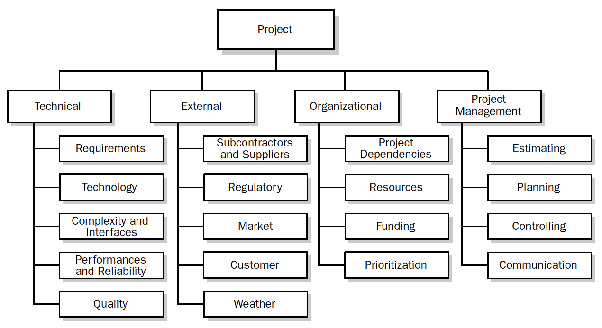
Risk Breakdown Structure (RBS)
Notes:
Here is one of the tools we discussed… hierarchical, taxonomy based risk identification.
The Risk Breakdown Structure (RBS) lists the categories and sub-categories within which risks may arise for a typical project. Different RBSs will be appropriate for different types of projects and different types of organizations.
One benefit of this approach is to remind participants in a risk identification exercise of the many sources from which project risk may arise.
The hierarchical structure allows for scanning risks logically and comprehensively in order to make sure that you are looking for as many risks as possible in all places.

Slide 24
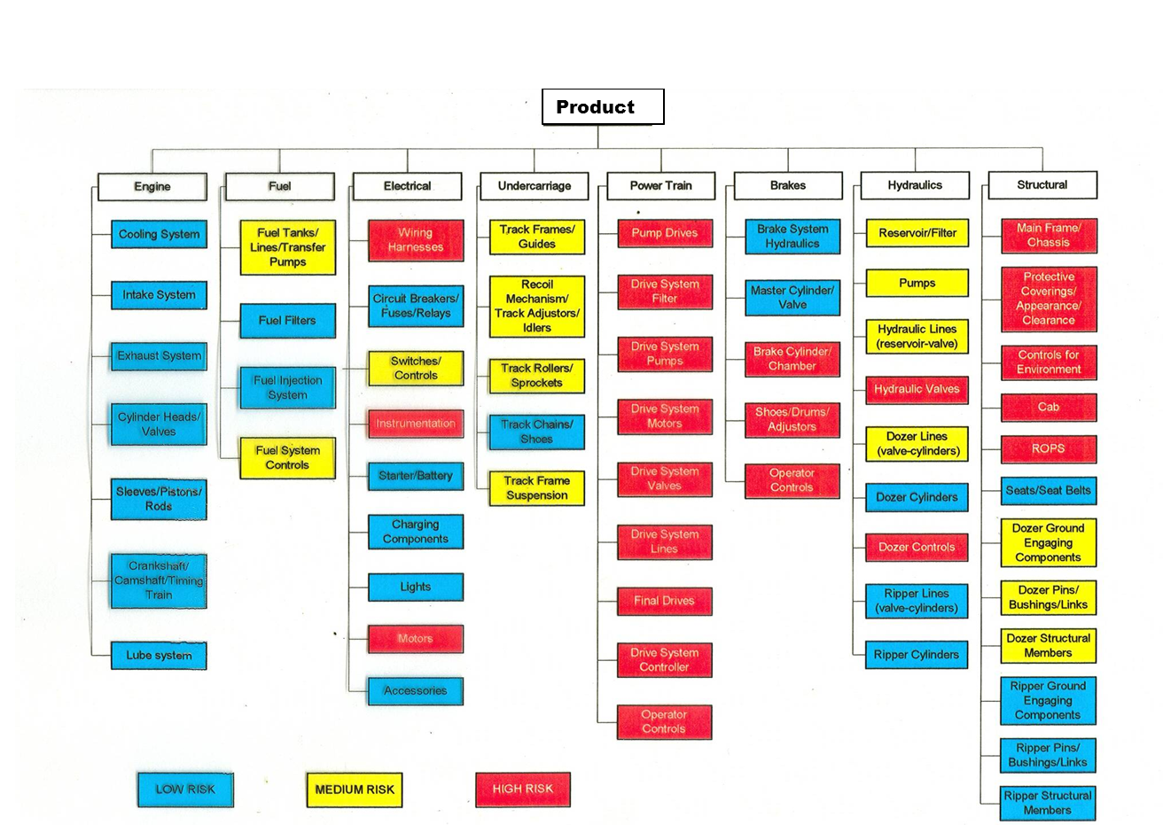
Product Development WBS
Notes:
Taxonomy based risk identification is really the use of hierarchical charts like the RBS or here the WBS as kind of like a comprehensive map to find risks.
With a WBS, you can look at each subsystem, components and work packages and identify what can go wrong for each one.
What the WBS does is it lets you go through every single part of the system in a methodical way and not miss anything. Of course the assumption there is that your WBS is comprehensive enough to encompass the scope sufficiently. Because if your WBS is missing anything, then that’s the risk right there. One of the shortcomings of this approach is that it won’t flag risks in areas that are ommitted.
You can see here that risks are color coded, High risks are in red, medium in yellow. Low risk in blue or sometimes we also use green.
Another shortcoming here is it doesn’t really show interrelated or cascading risks. For example. A yellow box may be low risk perhaps because the likelihood of it is low but impact is high. Now let’s say it’s output is critical to say 50% of the other work packages here. Sometimes those risks don’t get flagged.
Still this gives you a good visual of what risks need to be prioritized. Seeing this, WHICH subsystem seem to pose highest risk? POWERTRAIN
========================
Typically we use what we call negative scenario identification – this common strategy basically conceives different ways things can go wrong with respect to a risk
We try to imagine departures or deviations from the ideal (remember we think of what should go right first)
This strategy is also known as anti-goal, anti-objective
I mean, this is really natural to us humans, it is very easy to critique so looking for things that can go wrong should not be too difficult,

Slide 25
Ishikawa Diagram
HARDWARE
PEOPLE
Bought-in items may be delivered late
Key staff may be out of action
Welding may be defective
Material may be off-spec
Staff productivity may be lower than planned
Manufacture may not correspond with design
External agencies may delay
PRODUCT
DELIVERED
LATE
Procurement procedures may be ineffective
Import taxes may be raised
Design may have to be re-engineered
Fabricator may go bankrupt
Design specs may be changed
Cash flow may not be sufficient to pay bills
Design may not meet standards
FUNCTIONS
MONEY
Notes:
Another way to identify risk is cause and effect analysis. It is a good way of sorting things out risks based on categories-H ardware, people, functions, money
Again, like the WBS, and others, it let’s you look at risks in many places.
However, it still has that shortcoming of possibly omitting a risk
And also interactions are not shown, those interrelated or cascading risks between identified causes

Slide 26
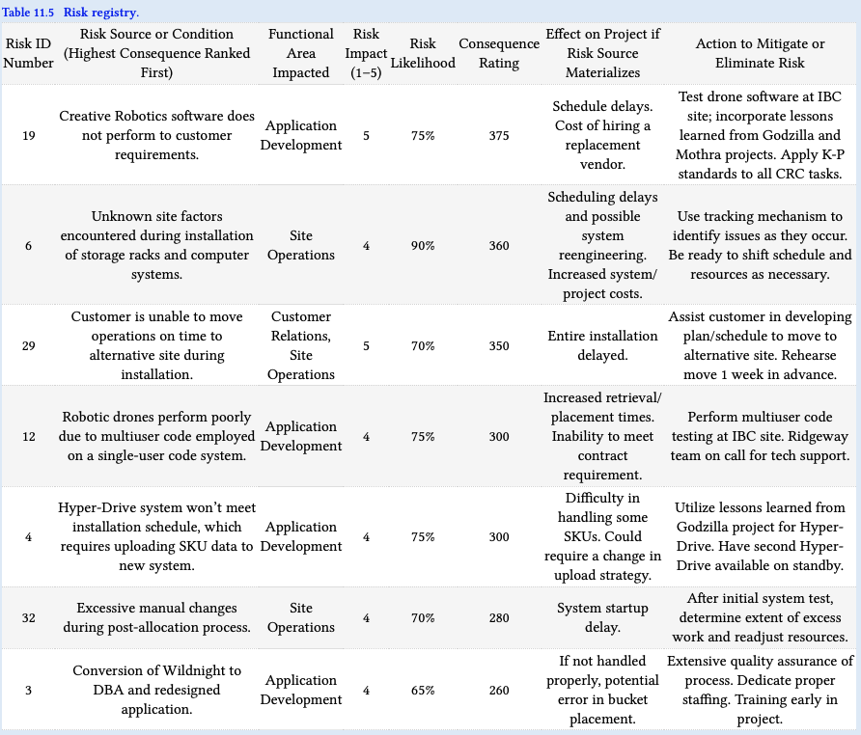
Risk Register
Notes:
And then the output of the Risk Identification process is the risk register!
It lists down all the identified risks, DOCUMENTs the RISKs and Keeps track of the risks
It could be a simple excel or sometimes there is a risk software application you can use
There should be a risk ID, risk description AND risk owner. Here it seems to be missing.
But the Risk Owner: The individual who is ultimately accountable for ensuring the risk is managed appropriately. There may be multiple personnel who have direct responsibility for, or oversight of, activities to manage each identified risk, and who collaborate with the accountable risk owner in his/her risk management efforts
=================
Ideally, the outputs from qualification and quantification will include a comprehensive, prioritized risk listing based on the composite risk score.

Slide 27
Analyze Risk

Slide 28
Recall– Risk Exposure
Risk Exposure is comprised of Risk Impact and Probability that the risk will materialize
The risk impact is the cost to the activity/project if the risk materializes.
The probability is the likelihood that it will materialize.
Risk Exposure = Impact X Probability
For Projects, Risk Exposure = RC = (the risk “consequence” or “exposure”)
Notes:
Recall from last meeting!
In projects, risk levels can be assessed by calculating risk exposure. In other books RC is used as a label for risk consequence. It’s the same thing, RC is calculated by multiplying the probability of the risk by the impact of the risk.
===================
You may have seen this term before, Risk Exposure. Risk exposure is defined as the quantified potential loss from business activities currently underway or planned. The level of exposure is usually calculated by multiplying the probability of a risk incident occ
Now that we have identified the risks, the next step is to assess the risk
Risk assessment is the determination of risk levels and evaluating its acceptability and prioritization of risk
Risks are analyzed to prioritize them on the basis of probability and impact.
It allows an organization/individual to set focus on priority risks.
When it comes to assessing risk, there are two types of approaches- quantitative risk analysis and qualitative risk analysis.
In quantitative analysis we seek to determine an actual value or level of the risk, how much is the risk, perhaps quantified in terms of money or in terms of time. It is a more detailed process to determine the value of that. Often involves mathematical and statistical techniques
Qualitative analysis using nominal values is easier however it tends to be very subjective
The most common approach to analyzing risk is the probability and impact matrix, also known as the risk matrix which we will see later.
Risk ratings are also commonly used, assessing a risk as high, medium or low.
In this slide is a formula for determining RC, risk consequence or risk exposure or risk level by multiplying probability and impact
Sometimes it is called the risk number or risk priority number
urring by the amount of its potential losses. So this is similarly based on the calculation of expected value. The impact is the cost to the activity or the project if the risk materializes. The probability is the likelihood that it will materialize.

Slide 29
2. Assess the Risk
Combining several independent risk sources
Composite likelihood factor,
CLF = (W1) MH + (W2) CH + (W3) MS + (W4) CS + (W5)D
where
MH , MS , CH , CS , and D are failure likelihoods risk sources; each has value 0 to 1.0
W1, W2, W3, W4, and W5 are weights for each factor, each has value 0 through 1.0 and together total 1.0.
Notes:
We can combine several independent risk sources into one composite score.
So for example, you can estimate the likelihood of a risk due to several risk sources or factors
By multiplying their likelihood by the weights for each factor
Weights are used if you feel one is a more significant source than the other
It is important to note that risk sources have to be independent. Interactions of join probabilities is not additive, more statistical sophistication is need to do this.
=============================
Also note here is that you CANNOT use CLF for ratings. Ratings will not reflect true probability values.

Slide 30
2. Assess the Risk
The ROSEBUD project involves the development of hardware and software with characteristics as follows-
The hardware is existing and of minor complexity
The software will be developed as a minor redesign of current software and is of moderate complexity
The performance of the overall system will depend on how well it can be integrated into another larger existing system.
What is the risk due to hardware and software maturity and complexity?
Notes:
Let’s have an example-
The four risks that they identified is hardware and software maturity and complexity

Slide 31
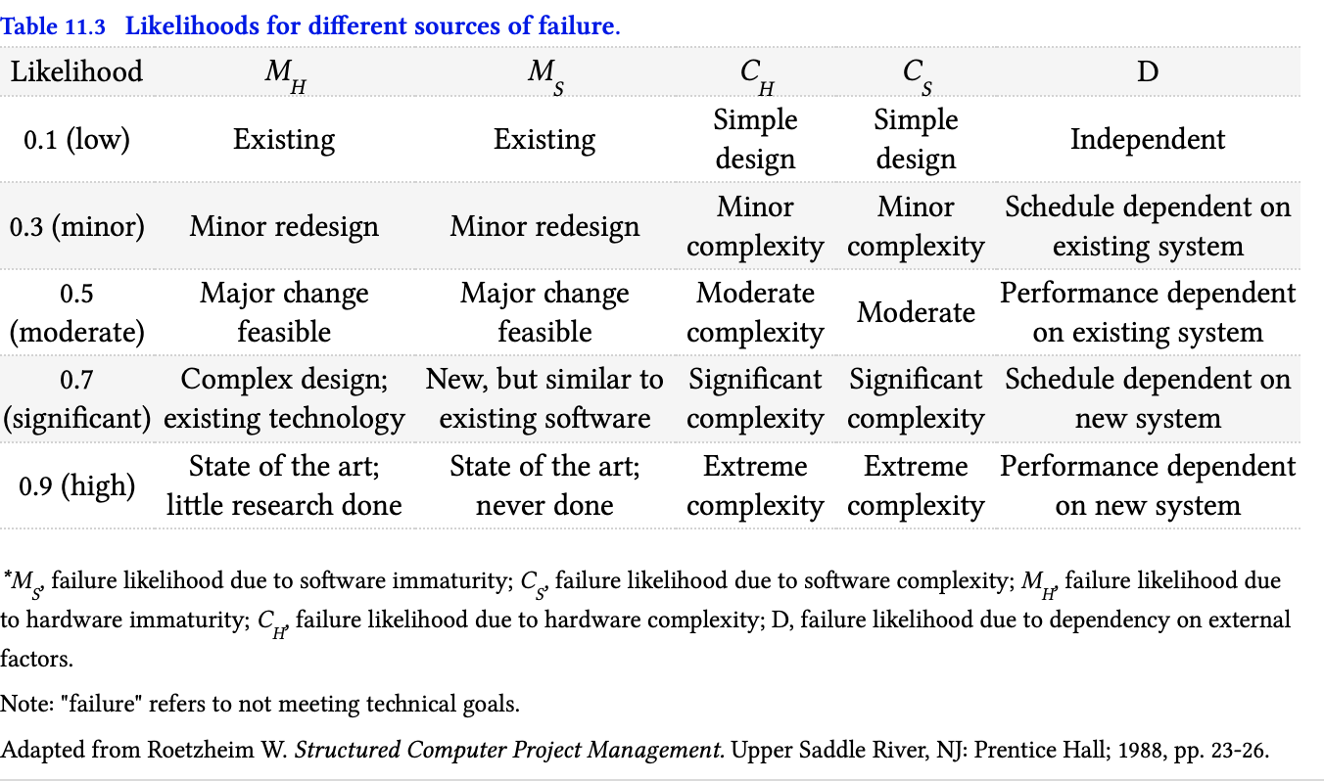
2. Assess the Risk
The hardware is existing and of minor complexity
M_{H} = ?
C_{H} = ?
Notes:
Here is the likelihood or probability table for Rosebud in terms of hardware and software maturity and complexity
First is- hardware is existing and of minor complexity
Mh = failure likelihood of hardware immaturity = 0.1
Ch = failure likelihood due to hardware complexity = 0.3

Slide 32
2. Assess the Risk
The hardware is existing and of minor complexity
M_{H} = 0.1
C_{H} = 0.3
Notes:
Here is the likelihood or probability table for Rosebud in terms of hardware and software maturity and complexity
First is- hardware is existing and of minor complexity
Mh = failure likelihood of hardware immaturity = 0.1
Ch = failure likelihood due to hardware complexity = 0.3

Slide 33
2. Assess the Risk
The software will be developed as a minor redesign of current software and is of moderate complexity
M_{S} = ?
C_{S} = ?
Notes:
Let’s look at the software
Ms = failure likelihood due to software immaturity = 0.3
Cs = failure likehood due to software complexity = 0.5

Slide 34
2. Assess the Risk
The software will be developed as a minor redesign of current software and is of moderate complexity
M_{S} = 0.3
C_{S} = 0.5
Notes:
Let’s look at the software
Ms = failure likelihood due to software immaturity = 0.3
Cs = failure likehood due to software complexity = 0.5

Slide 35
2. Assess the Risk
The performance of the overall system will depend on how well it can be integrated into another
larger existing system.
D = ?
Notes:
Existing system
D = failure likelihood due to dependency on external factors = 0.5

Slide 36
2. Assess the Risk
The performance of the overall system will depend on how well it can be integrated into another
larger existing system.
D = 0.5
Notes:
Existing system
D = failure likelihood due to dependency on external factors = 0.5

Slide 37
2. Assess the Risk
Combining several independent risk sources
Composite likelihood factor,
CLF = (W1) M_{H} + (W2) C_{H} + (W3) M_{S} + (W4) C_{S} + (W5)D
where
M_{H} , M_{S} , C_{H} , C_{S} , and D are failure likelihoods due to immaturity of hardware and software, complexity in hardware and software, and dependency on external factors, respectively; each has value 0 to 1.0
W1, W2, W3, W4, and W5 each has equal weights.
M_{H} =0.1, M_{S} =0.3, C_{H} = 0.3, C_{S} = 0.5, and D = 0.5
CLF = 0.2 (0.1) + 0.2 (0.3) + 0.2 (0.3) + 0.2 (0.5) + 0.2 (0.5) = 0.34
Notes:
You can combine the risks into one
This is the composite likelihood factor
Note that this is just likelihood. We have not accounted for impact.
=========================
Combining several independent risk sources
Here the likelihood of a risk due to several failure modes for example, immaturity and complexity of hardware and software, and dependency on external factors
Can all be lumped into one composite likelihood factor.
You can put weights for each one if you feel one is a more significant source than the other
It is important to note that risk sources have to be independent. Interactions of join probabilities is not additive, more statistical sophistication is need to do this.
=============================
Also note here is that you CANNOT use CLF for ratings. Ratings will not reflect true probability values.

Slide 38
2. Assess the Risk
Combining several independent risk sources
Composite impact factor,
CIF = (W1)TI + (W2)CI + (W3)SI
where
T1, C1, and S1 are impacts due to failure in technical performance, cost, and schedule, respectively; each has value 0 to 1.0
W1, W2, and W3 each has value 0 through 1.0 and together total 1.0.
Notes:
The same can be done with impact factors
Composite impact factor merge the impacts of the risk with respect to time, cost and technical performance or scope.
=====================
It still pains me a little bit though as a teacher of statistics, when I see mathematical operations performed on ratings because they may produce erroneous interpretations.
So for example, the CF of Subsystem A is composite impact factor of 3 and another subsystem B has a composite impact factor of 1. Can you say that risk of subsystem A is 3x more than subsystem B. The answer is no if a rating system is a scale from 1-5. The ratings on those scale may not reflect numerical magnitude and again can be highly subjective.

Slide 39
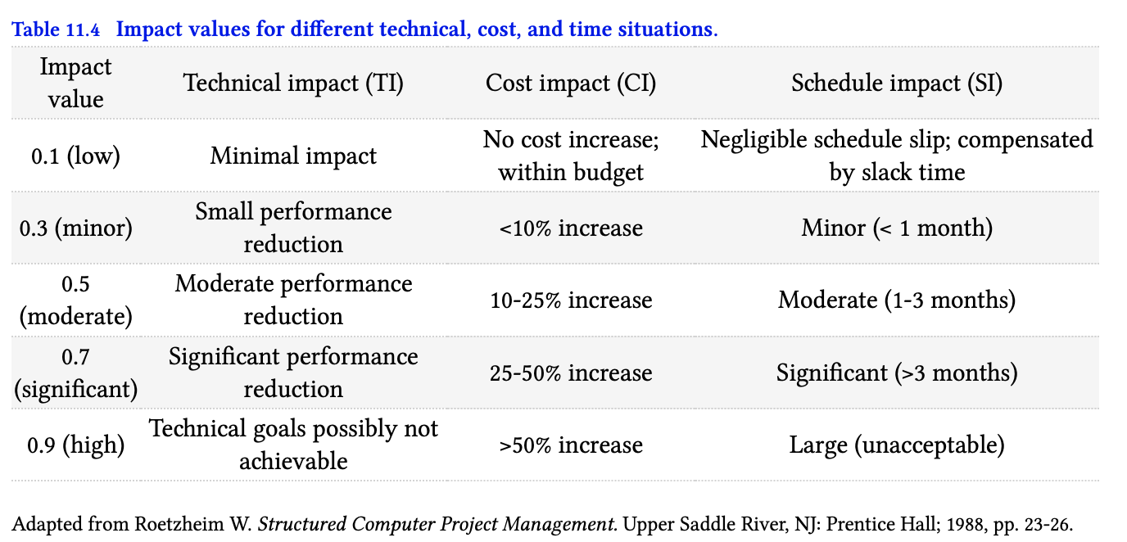
2. Assess the Risk
The ROSEBUD project involves the development of hardware and software. A particular failure arising from the identified sources of risk is expected to have-
Minimal impact on technical performance and can be corrected within 2 months at a cost of 20%
TI = ?
CI = ?
SI = ?
Notes:
Supposing now that a particular failure for the project has Minimal impact on technical performance and can be corrected within 2 months at a cost of 20%
TI=0.1
CI= 0.5
SI=0.5

Slide 40
2. Assess the Risk
The ROSEBUD project involves the development of hardware and software. A particular failure arising from the identified sources of risk is expected to have-
Minimal impact on technical performance and can be corrected within 2 months at a cost of 20%
TI = 0.1
CI = 0.5
SI = 0.5
Notes:
Supposing now that a particular failure for the project has Minimal impact on technical performance and can be corrected within 2 months at a cost of 20%
TI=0.1
CI= 0.5
SI=0.5

Slide 41
2. Assess the Risk
The ROSEBUD project involves the development of hardware and software. A particular failure to meet certain technical goals is expected to have-
Minimal impact on technical performance and can be corrected within 2 months at a cost of 20%
Suppose the most important factor is technical performance, followed by schedule, then cost and the weights assigned are 0.5, 0.3, 0.2 respectively.
Notes:
Suppose now the important factor is <read slide?

Slide 42
2. Assess the Risk
Combining several independent risk sources
Composite impact factor,
CIF = (W1)TI + (W2)CI + (W3)SI
where
T1, C1, and S1 are impacts due to failure in technical performance, cost, and schedule, respectively; each has value 0 to 1.0
W1, W2, and W3 each has value 0.5, 0.3, 0.2 respectively.
TI=0.1, CI= 0.5, SI=0.5
CIF = (0.5)0.1+ (0.3)0.5 + (0.2)0.5 = 0.22
Notes:
We can now calculate the composite impact factor! CIF
====================
The same can be done with impact factors
Composite impact factor merge the impacts of the risk with respect to time, cost and quality.
It still pains me a little bit though as a teacher of statistics, when I see mathematical operations performed on ratings because they may produce erroneous interpretations.
So for example, the CF of Subsystem A is composite impact factor of 3 and another subsystem B has a composite impact factor of 1. Can you say that risk of subsystem A is 3x more than subsystem B. The answer is no if a rating system is a scale from 1-5. The ratings on those scale may not reflect numerical magnitude and again can be highly subjective.

Slide 43
2. Assess the Risk
Risk Consequence Rating (RCR)
RC = probability x impact
RCR = CLF x CIF
RCR = 0.34 x 0.22 = 0.078
Notes:
The RC becomes RCR, risk consequence rating when composite scores are used.
= 0.078
A risk level of ____ doesn’t really mean anything by itself.
But given that RCR ranges between 0 and 1, then a value of 0.078 is relatively low.
But what is high, medium or low will depend on the organization’s risk tolerance, what they define as ALARP.
RC or risk levels are used only to COMPARE various risks.
RCs are compared relative to each other. You can identify which risks are higher or lower than each other.
But how much higher or how much lower, that again is a statistically precarious analysis.
So emphasize that these are RELATIVE LEVELS not absolute magnitudes.

Slide 44
2. Assess the Risk
When probability and impact are expressed as nominal values (e.g., VH, H, M, L,VL)
Example
RC = L x H = M (according to table)
Impact
 | VL | L | M | H | VH
VH | M | M | H | H | H
H | L | M | M | H | H
M | L | L | M | M | H
L | L | L | L | M | M
VL | L | L | L | L | M
Probability
RC for Subsystem B
Notes:
Just to remind you that
Risk levels or RC can also be determined together using nominal values or rating scales for both.
But instead of calculating a composite RC score.
And this is true that many people are not comfortable or confident in assigning actual numbers, others like to use nominal rating instead and a risk matrix to consolidate the ratings of probability and impact. Using this matrices also avoid the fallacy of mathematically manipulating ratings.
This is a simple mechanism to assist the assessment process.
So this probability and impact matrix defines the level of risk or the RC by considering the level of impact against the level of likelihood.
Here you see the rows that show the level of impact and the columns show the level of likelihood
So in risk assessment, you show this to whoever is assessing the risk and ask to fill this out.
For example Subsystem B, Impact of the risk for subsystem B is high and likelihood is low, so the overall risk of subsystem B is Medium

Slide 45
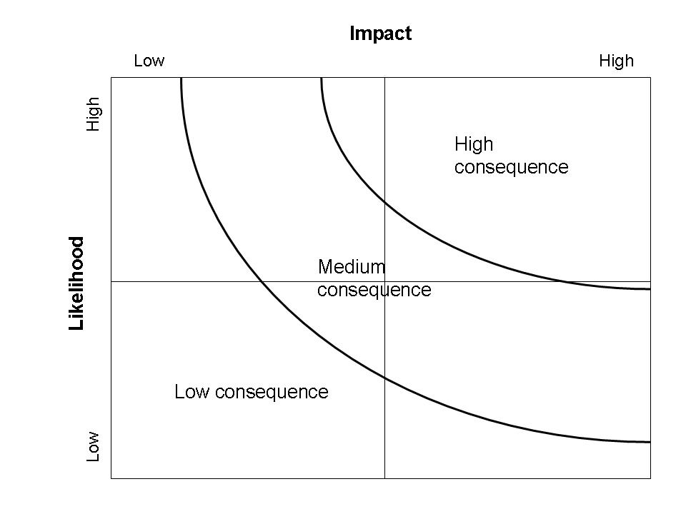
2. Assess the Risk
Subsystem A
Subsystem D
Subsystem C
Subsystem E
Subsystem B
Notes:
We can also PLOT risks IDs here plotting with respect to impact and likelihood
It avoids burying the values of likelihood and impact that is done with consolidating a composite score.
So the risk matrix is now divided into quadrants.
We tackle high risk elements first shown in the right most quadrant!

Slide 46
Risk Register
Notes:
The outputs for risk assessment is entered in the risk register will include a comprehensive, prioritized risk listing based on the composite risk score.
And then the output of the Risk Identification process is the risk register!
It lists down all the identified risks, DOCUMENTs the RISKs and Keeps track of the risks
It could be a simple excel or sometimes there is a risk software application you can use
There should be a risk ID, risk description AND risk owner. Here it seems to be missing.
But the Risk Owner: The individual who is ultimately accountable for ensuring the risk is managed appropriately. There may be multiple personnel who have direct responsibility for, or oversight of, activities to manage each identified risk, and who collaborate with the accountable risk owner in his/her risk management efforts
=================

Slide 47
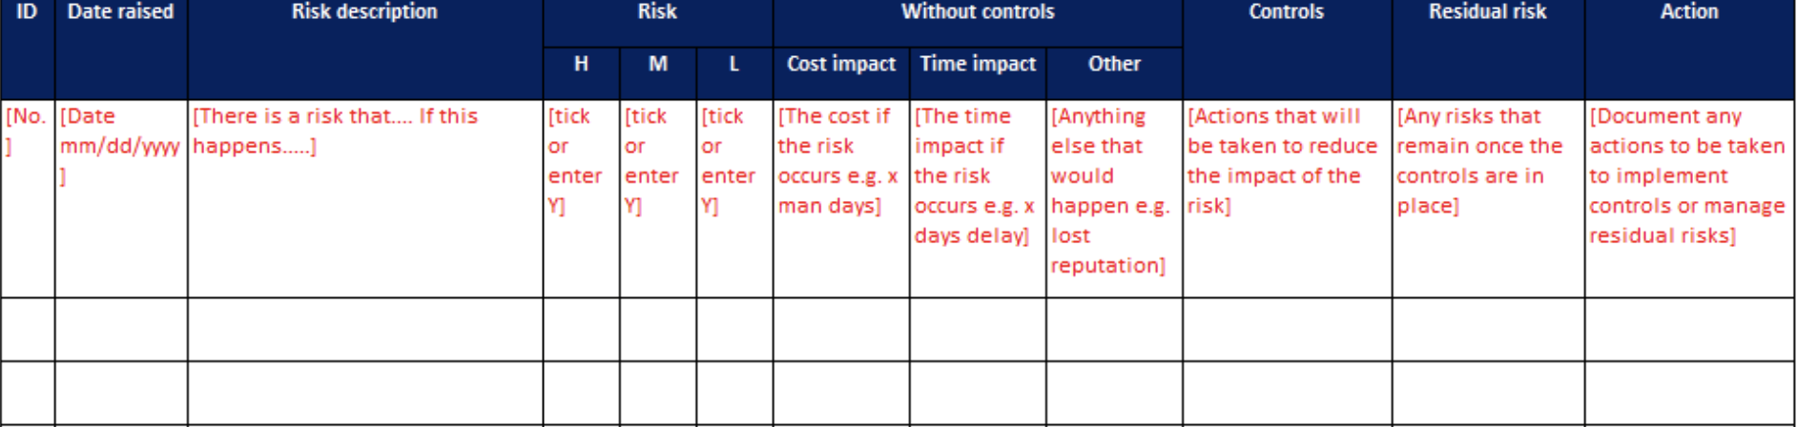
Project Risk Register
 | ID | Risk Description | Risk Type | Probability Level | Impact Level | Timeline | Risk Score | Risk Mitigation Plan/Owner
1 | OP01 |  | Schedule | 4 | 4 | 1 | 16
2 | W01 |  | Scope | 3 | 3 | 3 | 9
3 | E09 |  | Cost | 3 | 3 | 2 | 9
Notes:
And so a typical risk register would sometimes include a category with respect to the holy trinity!
Or it would actually have its own column, each risk identified are analyzed according to its impact on the cost, the timeline, scope, and others

Slide 48
Plan Risk Responses

Slide 49
Risk Management Elements and Process
0th What should go right?
1st What can go wrong?
2nd What are the causes and consequences?
3rd What is the likelihood of occurrence?
4th What can be done?
5th What are the alternatives?
6th What are the effects beyond this particular time?
Notes:
The strategies for risk responses in project include Transfer, avoid, reduce, contingency and accept.

Slide 50
3. Risk Response Strategies
Transfer risk
Insurance
Property damage or personal injury suffered as a consequence of the project
Damage to materials while in transit or in storage
Breakdown or damage of equipment
Theft of equipment and materials
Sickness or injury of workers, managers, and staff
Forward cover: insure against exchange rate fluctuations.
Contracts
Fixed-price
Cost-plus
Incentives and penalties
Warranties
Notes:
So we are going backwards here starting with transfer risk.
If reducing the risk is not possible, then we transfer the risk. The most common way that we are all familiar with is insurance.
For any business, we insure a lot of things, transport insurance, expensive equipment, workers, cyber. Insurance mitigates any loss that we may incur for unfortunate events that may happen with respect to our business. <read slide>
Now with projects we work with contracts or subcontract! This is typically done when you have work that you want hire someone else or hire another organization to do the work or part of the work. Contractors typically specialize on these specific work by having the specialized skill or specialized equipment. Contracting avoids having to invest to do these things.
Contracts are a way to transfer risk or share risk. However, there is also a risk of subcontracting work, relying on outsiders is you don’t have control. This increases the risk with quality control and scheduling.
In order to reduce these risks, you have some choices in the type of contract.
In a fixed price contracts the risk is on the contractor. Contractor commits to a contract price if the project ends up spending more than the agreed upon price, the contractor bears that added cost. So risk is essentially transferred to the contractor. The contractor assumes most of the risk of cost overrun.
Versus cost plus which guarantees profit for the contractor, stated in the contract that the contractor will be reimbursed for all costs and still generate a profit. The risk in terms of cost stays with the buyer or customer. (this is done when statement of work is now well defined or the potential for change is great).
You can also add incentives and/ or penalties for contractors finishing early and finishing late respectively.
But whatever contract you do, the customer will still incur damages and hardship should the project fall behind schedule due to the subcontract or worse, the contractor declare bankruptcy. (To avoid losses, a contractor may feel pressure to cut corners which increases the customer’s risk of receiving subpar quality end results).
Warranty or guarantee in contracts specifies the time or place at which the risk is transferred from one party to another. For instance, when an item is procured and shipped from abroad, the risk of damage usually remains with the seller while the item is being shipped, but as soon as it is hoisted over the rail of the ship, risk is transferred to the buyer.
=======================
Incentive/disincentive for early completion – this is a contract provision which compensates the contractor a certain amount of money for each day identified critical work is completed ahead of schedule and assesses a deduction for each day the contractor overruns the I/D time.
To be effective and accomplish the objectives of I/D provisions, the dollar amount must be of sufficient benefit to the contractor to encourage his/her interest, stimulateinnovative ideas, and increase the profitability of meeting tight schedules. If the incentive payment is not sufficient to cover the contractor's cost for the extra work, then there is little incentive to accelerate production, and the I/D provisions will not produce the intended results.
The simplest approach to incentivize the contractor is a basic bonus clause, typically set forth in the owner-contractor agreement. Construction contract bonuses are perhaps most common as a means of encouraging the contractor to complete the work earlier than the contract time for substantial completion. This may be accomplished as either a stipulated lump sum bonus for completing by a specified early completion date, or a stipulated amount-per-day that the work is completed early.
So risk transfer delegates risk to another party that may be better equipped at dealing with the risk or responding to it.
Often times, this is done with risks that cannot be avoided or that are rare but have a high impact.
Often times too, buying insurance seems to be a catch all strategy for risk treatment. But note here that buying insurance is a reactive measure. It dos not actually modify the risk, meaning you do not change the probability of the risk or necessarily reduce its effect by buying insurance. So it might have to be combined with a other treatments.

Slide 51
3. Risk Response Strategies
Avoid risk
Eliminate sources of risk
Avoid Micromanage
“A ship is safe in harbor,
but that’s not ships are for.”
Risks are… Effects of uncertainty on objectives
from ISO31000
Notes:
Risk can by avoided by such measures as increasing supervision, eliminating risky activities, minimizing system complexity, altering quality requirements, changing contractors or bringing work inhouse and incorporating redundancies. The answer typically for project means MORE CONTROL in the attempt to avoid risk which means innumerable management controls, monitoring systems, paperwork and red tap. It increases system complexity and perversely introduces even new sources of risk.
But avoidance does not mean paranoia so here’s a quote to keep us in check that in the end, we must keep our objectives in mind.
And a better definition of risk is looking at risk as effects of uncertainty on objectives.
So these risks and responses to risk must be evaluated against the project objectives.
Like for any system or for any project, we must not lose sight of the goal.
Be careful of micromanaging
==========================
In general risk avoidance is to ELIMINATE the possibility of a particular risk by never undertaking the activity, or stopping an activity if there is too much risk attached to the activity. For example some businesses have avoided supply chain risk by bringing operations back from China, avoiding supply chain risks from offshoring.
So avoidance is not performing the activity that may carry risk.

Slide 52
3. Risk Response Strategies
Reduce scope/ technical risk
Employ best workers
Use known and tested technology and tools
Use parallel efforts
Employ strong worker incentives
Increase frequency and severity of reviews and tests
Reduce system complexity
Use design margins
Reduce schedule risk
Create master project schedule and strive to stick to it
Schedule most risky tasks as early as possible
Shift risky tasks in project network from series to parallel
Monitor critical or near-critical activity
Put best workers on time-critical tasks
Insert project and feeding buffers
Notes:
Many times in project the size of the risk is proportional to the potential payoff, so rather than avoiding the risk, it is better to focus on reducing risk.
<read slide>
The latter two points deserve further explanation. In general, risk and uncertainty increase with system complexity, the more elements in a system and the more they are interconnected, the more likely an element or an interconnection will go wrong and impact other elements (lots of moving parts have to be synchronized). Thus minimizing complexity through reorganizing and modifying element in product design or project tasks reduces the risk. For example, decoupling of activities and subsystems, making them independent of one another prevents a failure in one activity or subsystem from spreading to others.
Incorporating design margins into design goals is another way to reduce risk associated with meeting technical requirements. A design margin is a quantified value that serves as a safety buffer held in reserve. In general a design margin is incorporated into a requirement by setting the target design value to be stiffer/ stricter than the design requirement. By striving to meet this stricter requirement, the risk of not meeting the requirement is reduced.
So if the max weight for a ship is 90 lbs, the design margin can be set at 10% or 9 lbs. Thus the target weight is 81 lbs.
While design margins help reduce the risk of not meeting requirements, they encourage designers to exceed requirements. For example, to design systems that weigh less than required but cost more. So the margins must be carefully set so as to reduce the risk while not increase the costs.
Why would you schedule most risky tasks early? In order to allow time for failure recovery if needed
===============
Risk Reduction is to modify the risk from occurring by reducing the likelihood that the risk can occur or reducing the effects or consequences of the risk.
For Risk reduction, unlike risk avoidance, we still undertake the activity that pose the risk, the risk source is not entirely eliminated.
This means that one develops mechanisms or procedures to ensure that the risk level goes down.
In construction, for instance, one makes sure that all employees wear protective gear to reduce the likelihood of bodily harm.
Preventive maintenance and training are also some of the most common risk reduction treatment.
Here are some other examples of how to reduce risk
=============
Modify the risk
Separation
Duplication
Recovery

Slide 53
3. Risk Response Strategies
Reduce budget/cost risk
Identify and monitor the key cost drivers
Use low-cost design alternatives
Verify system design and performance through reviews and assessment (gate-system)
Maximize usage of proven technologies and commercial off the shelf equipment
Provide contingency reserves in project budgets
Perform early breadboarding, prototype and testing on risk components
Notes:
This last bullet is especially powerful. Breadboards and prototypes that is test mockups and models, enable ideas to be tested experimentally so designs can be corrected early in the project. This greatly reduces the need for later design changes, which can be costly
A breadboard, or protoboard, is a construction base for prototyping of electronics.

Slide 54
Risk Register
Notes:
We round out the Risk register with a last column here that shows preventive actions to reduce risk.

Slide 55
Track and Control Risk

Slide 56
Risk Management Elements and Process
0th What should go right?
1st What can go wrong?
2nd What are the causes and consequences?
3rd What is the likelihood of occurrence?
4th What can be done?
5th What are the alternatives?
6th What are the effects beyond this particular time?
Notes:
Last step is track and control list

Slide 57
Set Risk Management Practices and Policies
Risk Management Plan
Specifies methods to identify, profile, assess, monitor, and handle risks
Names the risk officer
Contains a budget and schedule reserve
Risk Profile
The likelihood, impact, trigger symptoms, monitoring methods, and response strategy for each identified risk
Example, next slide
Notes:
Everything that we talked about, the risk management process and descriptions of inputs and outputs, and tools to use in the risk management process has to be put together in a Risk Management plan
Usually we have a risk management group or risk officer that is in charge of that
For projects, the risk management plan includes budget and schedule reserves.
When they have to get money to perform a risk response, it usually comes out of the reserve. And here you may need to send a request to the project manager
Risk Profile is the more detailed record of each identified risk. It includes information on risk identification and assessment and how the risk is being managed, monitoring and updates on implementation, status, etc.

Slide 58
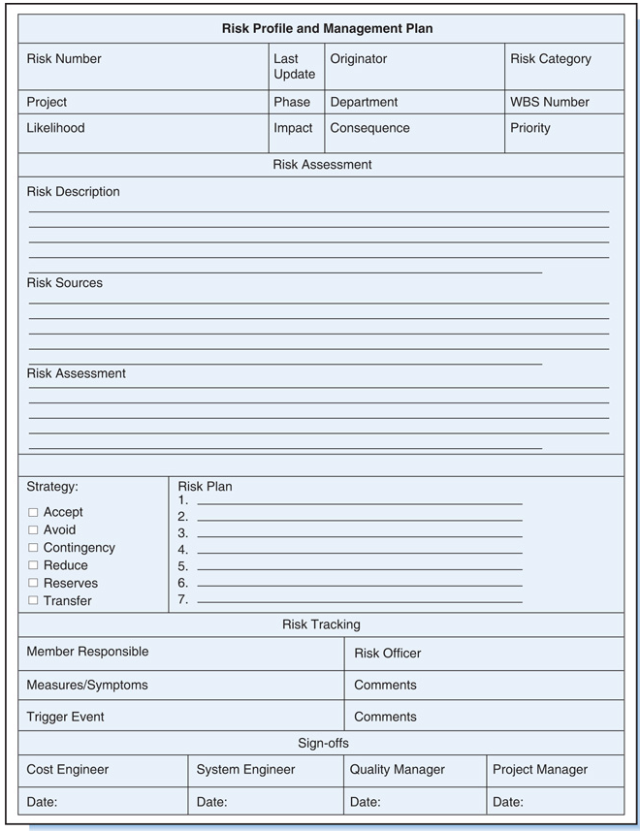
Notes:
Here is an example of a form that shows the risk profile of an identified risk
It is very detailed
You see here that the risk was identified from the WBS
Assessed
Response
Action Plan- decrease the likelihood of schedule slip
Evaluate later if risk was averted/ resolved

Slide 59
Risk Management Practices and Policies
Risk Officer
Person to oversee the identification, assessment, monitoring, and handling of project risks
devil’s advocate
usually not the project manager
Risk Schedule and Budget Reserve
Time and dollar amount in schedule and budget to cover risks
Notes:
Every group has a contrarian, someone who likes to poke holes in any idea or argument. These people would be great candidates for the risk officer who oversees the identification, assessment, monitoring and handling of project risk.
The project risk officer is not usually the project manager.
It allows the project manager to take on the role of cheerleader and have someone else be the devil’s advocate.
Risk officers help develop a risk schedule and budget reserve. So reserves are created to handle risks through cost or time buffers.
But Project managers control this reserve; they have full authority to use it whenever an identified risk occurs. They can also delegate this authority to a risk owner or the person responsible for managing the risk.
There is also the management reserve. It is the amount of the project budget reserved for unforeseen or unidentified risk (unknown unknowns) ( that is within the scope of the project.) This is on top of the project contingency reserve but it is separated and higher management, not the project manager has authority to release it.
===================
The project manager adds the management reserve to the cost baseline resulting in the total project budget.

Slide 60
Risk Management Practices and Policies
Communicate Risks
Polices, procedures, and culture to ensure project manager is always quickly informed about problems and risks
Standards and procedures for documenting the project
Good documentation (proposals, plans, work orders, change requests, reviews, and post-project summary reports) provides information necessary for identifying risks in future projects.
Helps to identify risks on current project and predict risks on future projects
Notes:
Communicating risk does not stop with policies, procedures and manuals.
It is important that management foster a culture open to risk!
And it is not easy, nobody wants to be the bearer of bad news or be the Debbie downer.
But we all know that if there is a serious problem, the quicker/ earlier we know about it the better!
There’s also another thing that needs to be said about culture, that is knowing a company’s risk appetite.
Risk appetite is a broad-based description of the desired level of risk is for a company, it’s like defining the risk taking culture of an organization.
Innovation-based/ technology companies will have a higher risk appetite than let’s say a company that produces salt or commodities. High fashion versus retail fashion. For organizations where Time to Market is competitive, they’d be more likely to have a high-risk appetite
Risk appetites will vary with industry, it will also vary depending on competition. A competitive environment spurs risk taking, you want to be the first to sell self-driving cars like Tesla bears a HUGE amount of risk for being the first BUT also garners HUGE benefit/ windfall in return.
So It is important that a company with higher risk appetite link its decisions, how it assesses and evaluate risks to its risk appetite. Of course the same is true if risk appetite is low.
Let’s take two types of contracts in construction, for example
A company with low risk appetite may prefer reimbursable cost plus contracts – we will do this job as much as it is required, for reimbursable, how much effort I put, I get reimbursed for it. So it is less risky.
Versus a company with high risk appetite may prefer fixed cost contract – doesn’t matter how much effort, you get paid the same (you can make a lot of money here too) – risky but could be rewarding as well. If you are able to control cost and work smart, you CAN MAKE more in a fixed cost contract.
Last bullet here is about documentation- GOOD standards and documentation are an important part of the risk management practice.
We always talk about losing critical knowledge especially when experts and experienced managers retire. Having the knowledge management system that captures these experiences as we go through projects develop a treasure trove of information to learn from and improve for future projects.
So assessing and documenting old risks and new risks, retiring obsolete risks, looking at the validity of risk assessments, identifying risks that came about and how risk controls and mitigation worked or not worked should be part of any project close out.

Slide 61
Quantitative Methods

Slide 62
Recall– Expected Value and Risk Exposure
The expected value of any outcome is the sum of the probability of each outcome times the value of that outcome.
Risk Exposure is comprised of Risk Impact and Probability that the risk will materialize
The risk impact is the cost to the activity/project if the risk materializes.
The probability is the likelihood that it will materialize.
Risk Exposure = Impact X Probability
E(X) = μ_{x} = Σ [ x_{i} * P(x_{i}) ]
Notes:
Calculation of risk outcome or consequence is based on expected value
Expected value is the weighted average of all the possible outcomes, where the weights are the likelihoods of the possible outcomes

Slide 63
Using Expected Value and Risk Exposure
The consequence of risk on project duration, called the risk time, RT, is the expected value of the estimated time to correct for risk
RT = (Corrective time) × (Likelihood)
The consequence of risk on project cost, called the risk cost, RC, is the expected value of the estimated cost to correct for the risk
RC = (Corrective cost) × (Likelihood)
RT and RC are the schedule reserve and project contingency (budget reserve), respectively.
Notes:
To calculate the impact of a risk on project duration, we calculated RT which is the expected value of the estimated time to correct the risk multiplied by likelihood of the risk
For cost, the impact of a risk on project cos is calculated as the expected value of the cost to correct the risk multiplied by the likelihood of the risk
We use these calculation to determine schedule reserve or project time buffer and project contingency or budget reserve

Slide 64
Expected Value
Example: baseline time estimate (BTE) for project completion is 26 weeks and the baseline cost estimate (BCE) is $71,000.
Assume risk likelihood for the project is 0.3; if the risk materializes, the project would be delayed by 5 weeks and cost $10,000 more.
Because the probability of the risk materializing is 0.3, the probability of it not materializing is 0.7. If the risk does not materialize, no corrective measures will be necessary and the corrective time and cost will be nil.
What is the expected project completion time?
What is the expected project cost?
Notes:
Here is an example
In practice EV is used to quantify the impact of each significant risk,
Once the risks are listed, the likelihood of each risk and the cost and time impacts, if risk happens, are calculated like the example for each one of the risks.
And so the contingencies are the sum total of the RTs and RCs of all significant risks.
Another way to do this, instead of using a single point cost impact estimate, a range of impact costs may be assessed. In this case, the probability and cost estimates are
replaced by distributions that are assigned. Also, meaningful correlations amongst risks and cost can also be incorporated into the analysis. Then a Monte Carlo or similar simulation program is run that uses these probability and cost distributions as its input. The
simulation’s output is a total cost distribution (along with other data designed to support the decision-making process.)
The contingency budget is then determined according to the desired level of confidence that the manager would like to have on the project.

Slide 65
Expected Value
Example: baseline time estimate (BTE) for project completion is 26 weeks and the baseline cost estimate (BCE) is $71,000.
Assume risk likelihood for the project is 0.3; if the risk materializes, the project would be delayed by 5 weeks and cost $10,000 more.
Because the probability of the risk materializing is 0.3, the probability of it not materializing is 0.7. If the risk does not materialize, no corrective measures will be necessary and the corrective time and cost will be nil.
What is the expected project completion time?
RT = (5)(0.3) + (0)(0.7) = 1.5 weeks
Accounting for risk time, expected project completion time, ET = BTE + RT = 26 + 1.5 = 27.5 weeks.
Notes:
Here is an example
In practice EV is used to quantify the impact of each significant risk,
Once the risks are listed, the likelihood of each risk and the cost and time impacts, if risk happens, are calculated like the example for each one of the risks.
And so the contingencies are the sum total of the RTs and RCs of all significant risks.
Another way to do this, instead of using a single point cost impact estimate, a range of impact costs may be assessed. In this case, the probability and cost estimates are
replaced by distributions that are assigned. Also, meaningful correlations amongst risks and cost can also be incorporated into the analysis. Then a Monte Carlo or similar simulation program is run that uses these probability and cost distributions as its input. The
simulation’s output is a total cost distribution (along with other data designed to support the decision-making process.)
The contingency budget is then determined according to the desired level of confidence that the manager would like to have on the project.

Slide 66
Expected Value
Example: baseline time estimate (BTE) for project completion is 26 weeks and the baseline cost estimate (BCE) is $71,000.
Assume risk likelihood for the project is 0.3; if the risk materializes, the project would be delayed by 5 weeks and cost $10,000 more.
Because the probability of the risk materializing is 0.3, the probability of it not materializing is 0.7. If the risk does not materialize, no corrective measures will be necessary and the corrective time and cost will be nil.
What is the expected project cost?
RC = ($10,000)(0.3) + (0)(0.7) = $3,000
Accounting for the risk cost, expected project completion cost, EC = BCE + RC = 71,000 + 3,000 = $74,000
Notes:
Here is an example
In practice EV is used to quantify the impact of each significant risk,
Once the risks are listed, the likelihood of each risk and the cost and time impacts, if risk happens, are calculated like the example for each one of the risks.
And so the contingencies are the sum total of the RTs and RCs of all significant risks.
Another way to do this, instead of using a single point cost impact estimate, a range of impact costs may be assessed. In this case, the probability and cost estimates are
replaced by distributions that are assigned. Also, meaningful correlations amongst risks and cost can also be incorporated into the analysis. Then a Monte Carlo or similar simulation program is run that uses these probability and cost distributions as its input. The
simulation’s output is a total cost distribution (along with other data designed to support the decision-making process.)
The contingency budget is then determined according to the desired level of confidence that the manager would like to have on the project.

Slide 67
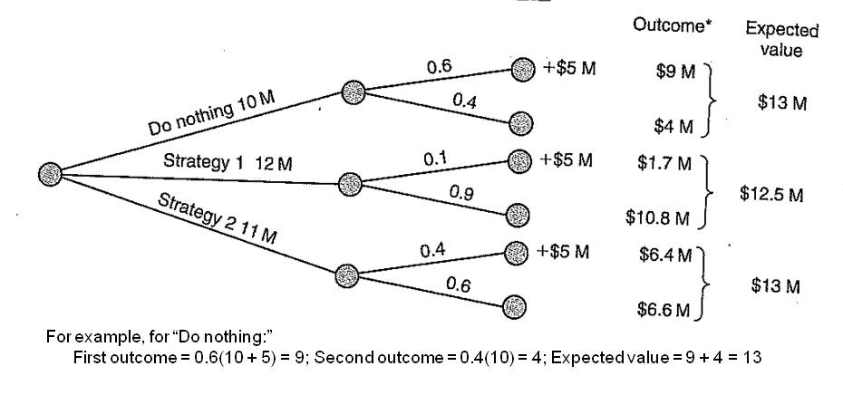
Recall– Decision Trees
Suppose project has a BCE of $10 million, risk failure likelihood of 0.6, and risk impact of $5 million. Two strategies are considered to reduce risk likelihood but not risk impact):
Strategy 1: cost $2 million and reduce failure likelihood to 0.1.
Strategy 2: cost $1 million and reduce failure likelihood to 0.4.
The decision tree and resultant expected project costs suggests Strategy 1 should be adopted because it has the lowest expected cost.
Notes:
Here is an example of how decision trees can be applied to projects-
=====================
Decision Trees are used in risk management too. This tool is also based on the concept of expected value to calculate expected outcomes of various alternatives.
The alternative with the best calculated expected outcome is selected.
A decision tree displays and analyzes the problem graphically.
The decision tree consists of nodes and branches.
A decision node, represented by a square □, indicates a decision to be made. The branches represent the possible decisions.
An event node, represented by a circle ○, indicates a random event. The branches represent the possible outcomes of the random event.
Consequences: The value of the consequences (outcomes) (e.g., payoff) is written at the end of each branch.
The tree is then solved from right to left, folding back. By calculating the expected value at a chance node and then selecting an alternative at an event node.
In the example we a project with 3 alternatives for risk responses
The likelihood of the risk is shown when you do nothing, reduced for strategy 2, and reduced for strategy 3. Note that the sum of the probabilities for branches have to equal to 1.
The consequences are shown here at the end of the branch., it shows risk impact and the resulting project cost if the risk impact happens and when it does not.
We solve from right to left, here is a chance node
Since the outcome here is cost, then the lowest expected value alternative is the best solution.
Note that sometimes outcomes may be expressed in profit so the highest alternative in that case is selected.

Slide 68
Tornado Diagram

Slide 69
Project Risks
Deliver deliverables?
Does the outcome, at completion, satisfy the customer?
Scope
RISKS
!
Time
Budget
On time?
Over or under budget? By how much?
Notes:
Of the three objectives, let’s now focus on time to show how the Tornado diagram works.
We know that there is going to be variability with respect to our project schedule, to the duration of our project.
VERY difficult to predict with any certainty exactly when our project will end because of the variability of the different tasks that feed into the project.
One main source of risk is task variability!
So let’s look at how these task variability affect our project duration.

Slide 70
Project Example
Activity # | Description | Predecessors | Duration (Weeks)
1 | Creative | - | 5
2 | Strategy | - | 2
3 | IT | - | 4
4 | Fundraising | 1 | 4
5 | Marketing | 1,2 | 2
6 | Sales | 1,2 | 5
7 | Finance | 5,6 | 2
8 | HR | 4,6 | 1
0 4
12 12
IT
4 wks
8 12
End
5 7
10 12
12 12
0 2
Strategy 2 wks
3 5
0 5
Marketing 2 wks
Finance 2 wks
0 0
8 10
10 12
Critical Path Analysis
Project Duration: 12 Weeks
Start
0 0
5 10
10 11
Sales 5 wks
HR
1 wks
Creative 5 wks
5 10
5 9
11 12
0 5
Fundraising 4 wks
7 11
Notes:
In order to do this let's look at an example
Here is a project example of a start up.
Let’s say, our work breakdown structure identified the eight tasks that are part of our project.
More than that we've come up with some initial estimations. We know which tasks precede which and we know an initial estimate for the duration for each task.
When we did this we are able to identify using our network diagram and perform a critical path analysis, we identified the overall expected project duration.
What is the most likely time that we think our project will be completed by
AND the critical path analysis tells us 12 weeks.
The critical path is the longest sequence of tasks that must be completed to complete a project. The tasks on the critical path are called critical activities because if they're delayed, the whole project completion will be delayed.
With the critical path as
START-> Creative -> Sales -> Finance-> End
But let’s look a little deeper….
what happens if my creative task, which is critical, takes longer? Say for instance seven weeks?
What if it finishes sooner, in three weeks?
What is the actual impact to my overall project duration?
And more than just the creative task, what about variability in the other tasks that I have in my project?
Each one might not be exact, they are my best guess, or my likely scenario.
It could be that it could go sooner, or it might take longer.
What impact does it have on the overall project duration?
Well, we can actually model this.
We can actually think about the ranges and try and
see what impact each one of the tasks have,
you know, optimistic scenario versus the pessimistic scenario.
What swing or what is the impact on the overall project duration?
So let’s take it further, in order to start,
we're going to come up, we're going to develop a list of minimum durations and
maximum durations for each one of our tasks.

Slide 71
Modeling Variability
Activity # | Description | Predecessors | Min Duration | Likely Duration | Max Duration
1 | Creative | - | 3 | 5 | 7
2 | Strategy | - | 1 | 2 | 6
3 | IT | - | 3 | 4 | 5
4 | Fundraising | 1 | 2 | 4 | 8
5 | Marketing | 1,2 | 1 | 2 | 6
6 | Sales | 1,2 | 1 | 5 | 7
7 | Finance | 5,6 | 1 | 2 | 7
8 | HR | 4,6 | 1 | 1 | 1
Notes:
So now we can have three estimates for the creative, might range from three all the way to seven weeks.
We think that perhaps our strategy is not going to be exactly two weeks , But we think that it might vary between one, all the way up to the pessimistic
case where it might take six weeks and so on and so forth.
We can identify for each one of our tasks what is the possible variability?
What is the possible variation in terms of the length of time it will take us to execute?
In some cases, for instance, in the case of the HR task, we might also believe that there is no variability whatsoever.
If this is a task that we are outsourcing for example, or if we are contracting a company to
deliver a specific piece of work for us, it might be that there is no variability in that task, and we know for certain that it's going to take one week to deliver.
Once we've come up with these estimates we can then explore, for each one of these tasks while holding the other at their most likely case.
What is the swing on our project duration? AAHHHH- sensitivity analysiis
And the best way to view it, and the best way to gain insight as to that impact,
Is to look at what is called a tornado diagram, or a tornado chart.

Slide 72
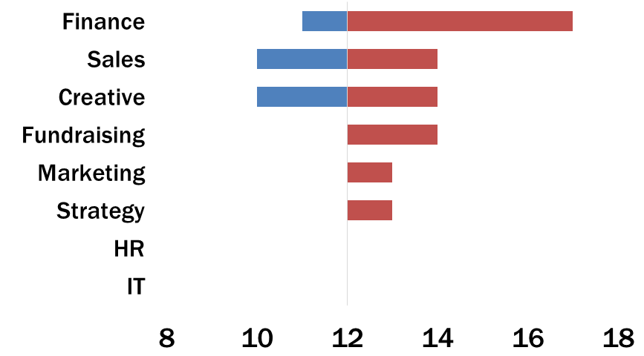
Tornado Diagram
Sales
Marketing
Project Duration
Notes:
A tool for sensitivity analysis is the tornado diagram.
The tornado diagram is a visual representation of the variability in the overall project duration when I change each one of my tasks from its minimum to its maximum duration.
Let’s take finance task which shows the swing with the blue side going down from my line in the middle which is on 12. If you recall, 12 is our initial estimate of the project duration, it is the most likely.
So for finance, it goes all the way down to 11. and it goes all the way up, in red, the most pessimistic or the, the worst case scenario, all the way up to 17.
This implies that when my finance task swings from its earliest completion time.
To its maximum completion time the impact on my project duration is, that total project duration can vary from 11 weeks to 17 weeks. There is a variability of six weeks
that is caused by the variability in the finance task itself.
The chart is called the tornado because typically it is ordered from largest all the way down to the smallest and that gives us an indication as to the biggest ring versus the smallest ring. We see our critical path up on top here- finance, sales, and creative! Which is not surprising, we will see the critical path tasks here as well as, we may also see tasks that have high variability.
As we can also see, the HR and the IT tasks do not have an impact on the overall product duration.
And so if we're trying to focus our attention on which tasks give us the most source of uncertainty, in terms of our overall project duration,
we can focus our attention at the top of the chart, or those tasks that are closer to the top, as supposed to those closer to the bottom.
Of course at this point, we can focus our risk identification on the critical path, on those with at the top of the tornado. Make sure that these tasks go as smoothly and as fast as possible. Target addressing the variability and eliminate their sources.
Another way, if we want to accept the variability is build it into your estimate.
So in the context of managing our project duration we can feel more comfortable with the deadline that we set to our project. So the first step associated with conducting a risk analysis, an in-depth risk analysis for our project schedule is to first ask and collect three estimates for each duration of each task. Ask for the minimum duration, ask for the maximum duration and try and identify the most likely. Then either reduce the variability or build it into your project estimate.

Slide 73
Modeling Variability
Scenario Identification
Elicit ranges or three point duration estimates.
Consider historical data.
Ask multiple opinions.
Start thinking of the overall project duration as a range not a single number.
Notes:
If you recall, we talked about scenario identification in risk ID.
So for projects, we now try to move away from one point estimates, but instead get at least a range!
Most common are 3-point estimates, a most likely, pessimistic and optimistic.
If you have a lot of data to work with, you can look at other distributions like the Beta, Normal, etc. You can perform a goodness of fit test.
BUT give caveat with all these estimations is that you are ASSUMING that the future project will perform like the past projects.
SO maybe your estimates may need to be adjusted, ask multiple opinions, get feedback, make adjustments when necessary!
And over all we want to start thinking about our project completion as a range and not as a specific point.
We know that our project is not likely to complete exactly in the 12 weeks was identified up front.
We know there's going to be a swing, it's going to be anywhere from maybe 11 to 17 weeks.
========
Sometimes it's useful to look at historical data to come up with that
information.
How quickly were tasks completed in the past when we've done something similar?
Or what was the maximum it ever took us to get some sense of the maximum
possible duration?
You could ask multiple individuals who have experience in that area,
how long did it take you in the past?
What was the quickest you were able to achieve a certain task?
Or how, what was the worst that ever happened to you?
Or, we could ask individuals from different departments,
with different expertise, to give us different perspectives and
put that information together and
combine it to come up with three points or three numbers to estimate a range.

Slide 74
Monte Carlo Simulation

Slide 75
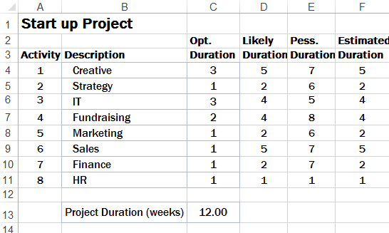
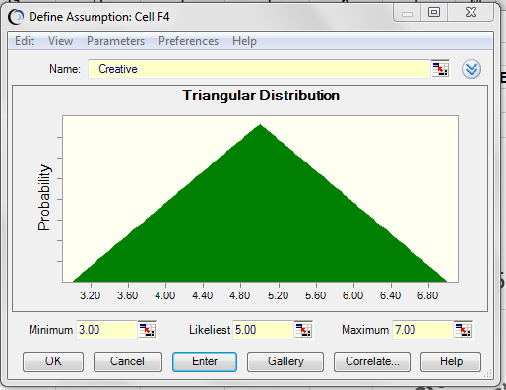
Simulation
Notes:
So we have our list of tasks. We have our eight tasks, and we have our three points, or our three data points of each task's estimate a duration.
We have the minimum duration it could be, the maximum duration it could be, and an estimate of the most likely duration as well.
Now we're going to allow our tasks to not only obtain their extreme durations, for instance, three or seven weeks for our Creative.
But we're going to allow for Creative to move anywhere between three and seven.
And we're also going to articulate something around how likely we believe it is that Creative will take a certain length of time.
We're going to do this for all our tasks.
And assign a probability distribution for each one of our task durations.
Allowing them all to vary simultaneously and preserving our precedence relationship will tell us something about the distribution of the overall project duration.
Because we have a 3 point estimate, so we can use the triangular distribution. There are many you can choose from. The triangular distribution is simple and intuitive. This is the probability distribution for creative. Which means that the duration for the creative task can vary between 3 and 7. The likelihood increases as you come closer to the most likely duration which is 5. You can see that it peaks at 5. This distribution gives a higher likelihood to the values in the middle, right around 5 and lower probabilities, less likely that it is farther away from 5, towards the tails here at 3 and 7. The probability of a task duration less than 3 and greater than 7 is ZERO!
I could assign this distribution to each one of my tasks separately.

Slide 76
Simulation
1
8
Trial1 = 14 weeks
Notes:
And when using @risk or crystal ball…. Whatever simulation software
When I press a button, I will see a different possible outcomes for my future project.
One outcome could be a simulated duration of 14 weeks
===============
Doing this 10,000, 100,000, even a million times,
will simulate a million possible realities that my project might face,
a million instances of my future project.
And if I look at the patterns that emerge,
I will be able to conclude what my average, or my expected duration would be.
And also,
I might be able to learn something about the likelihood of different values.

Slide 77
Simulation
1
8
Trial2 = 9 weeks
Notes:
And when using @risk or crystal ball…. Whatever simulation software
When I press a button, I will see a different possible outcomes for my future project.
One outcome could be a simulated duration of 9 weeks

Slide 78
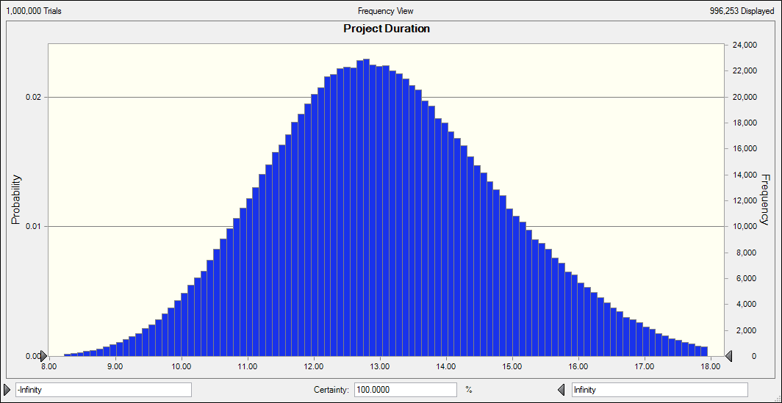
Project Duration Probability Distribution
Notes:
So if we plot many many may, like hundreds or thousands different simulations, we end up with a graph that looks like this.
Doing this 10,000, 100,000, many many trials
will simulate conceivably a million possible realities that my project might face,
a million instances of my future project.
And if I look at the patterns that emerge,
I will be able to conclude what my average, or my expected duration would be.
And also, I might be able to learn something about the likelihood of different values of duration
Project management softwares that can do this, will output the probability distribution of your project duration. You can see here that the most likely values of the project duration is somewhere in the middle here 12, 13, 14 weeks

Slide 79
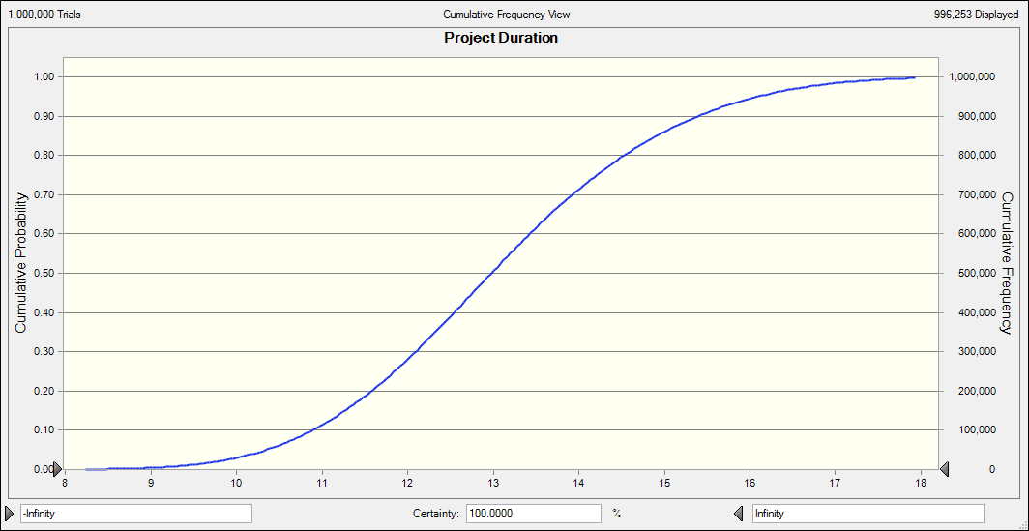
Project Duration Cumulative Distribution
Notes:
Sometimes more useful is the cumulative distribution
What this tells me is the likelihood that the overall project duration will be by a certain number of weeks.
For instance, the 12 weeks, which we initially calculated using our critical path analysis.
Well, I see that that there is somewhere around, say, 25% chance that the project will be completed by 12 weeks or earlier.
There is about 75% chance that it will take us longer.
Somewhere around 16 weeks, for instance, if I go all the way up. I estimate somewhere around 95% chance of completing this project within 16 weeks.
And so if I'm looking to set a completion date or to report how long it might take me to complete a project, I can choose a confidence level.
I can say, I am 95% certain that I will complete within approximately 16 weeks.
And I can be more accurate, given the information that I have and given the variability that I know that exists in my project.

Slide 80
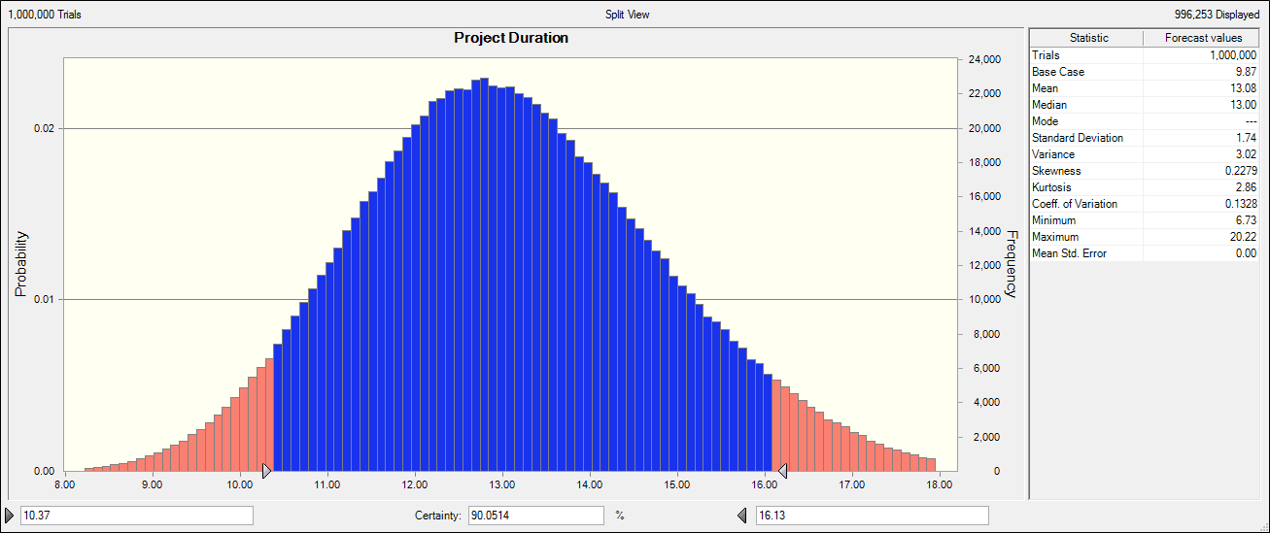
Project Duration Confidence Interval
Notes:
I can use the tool to come up with confidence ranges. In this case, I am 90% certain to finish
between 10.5 to somewhere in the region of just over 16 weeks.
I can convey my confidence level. I am 90% confidence that this is the range within which my project will be completed.

Slide 81
Changing Critical Path
As task durations changes, critical path might change.
We will no longer ask – which tasks are on the critical path?
But: How likely are tasks to be critical?
Notes:
Now let’s remind ourselves the fact that variability will occur and tasks, some of them will take shorter and some of them will take longer than our estimations.
And so we are going to see, or we could find ourselves on different critical paths.
We're no longer going to be talking about a specific single critical path.
And so we're no longer going to be asking which are the tasks that are on the critical path, because the critical path might vary in reality, and might vary as we move and progress through the project.
And so now that we have a tool that allows us to model the variability in each task, we can also ask the question, what is the chance, or how likely is it, that each one of our tasks is on the critical path? No longer certainty but a degree of likelihood, or some probabilistic statement.

Slide 82
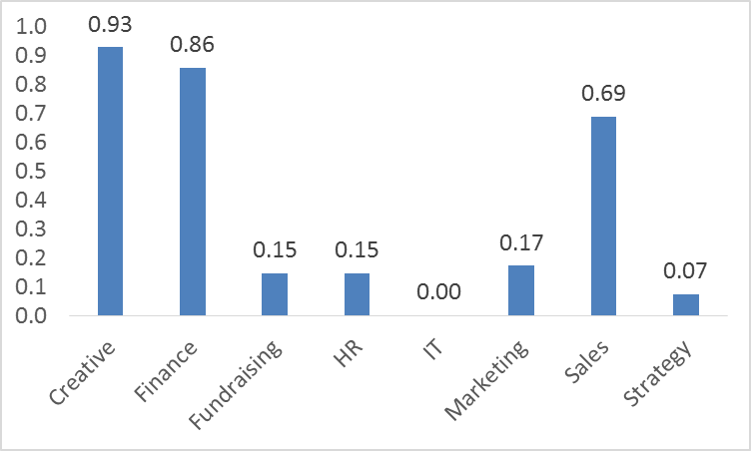
Criticality Index
Notes:
And so when we do this and we simulate it, we can see for instance, and we can obtain the following information.
We see here that the Creative task is 93% certain, or we're 93% chance that it will be on the critical path.
There is about a 70% chance that the Sales activity will be on the critical path, and there is virtually no chance that the IT will form part of our critical path.
And so again we can use our critical index, or the likely that our task is on the critical path, in order to prioritize our attention.
And to tell us where to focus, and which task and which resources might require our attention to make sure that
we complete our project within the range that we anticipate to complete it on.

Slide 83
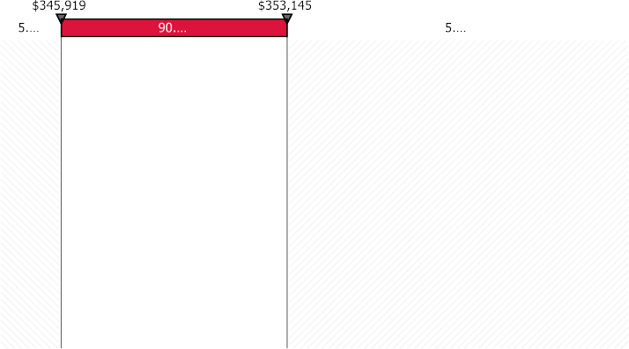

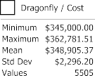
Project Cost Probability Distribution
Notes:
And so taking similar steps to the ones we took with the schedule, we can come up
with a probabilistic forecast for how much the project would cost us.
What is the budget that we need, and how comfortable or confident are we that we will actually meet that budget.
We can look at an entire distribution.
What is the likelihood our project costing so much?
We can talk about ranges.
In the figure that we see here on the screen, we're talking about a budget for
a project that can vary between $346,000 to somewhere just under $354,000.
This is our 90% confidence range.
We are 90% confident that our project budget will be somewhere within that range.
And therefore, we can choose our overall project budget, and
allow for extra contingency. Perhaps, we set it somewhere in the region of $350,000.
And we give ourselves 10 to 15% contingencies to make sure that we are highly confident that we are going to meet this project budget, and
not exceed it. Perhaps, we will come in under budget, but we know that we have the available resources if we need them

Slide 84
Excel Example

Slide 85
Monte Carlo Simulation Example for Project Scheduling
Creation of E-learning module
Tasks | Best-case estimate | Most likely estimate | Worst-case estimate
Writing content | 4 days | 6 days | 8 days
Creating graphics | 5 days | 7 days | 9 days
Multimedia integration | 2 days | 4 days | 6 days
Total duration | 11 days | 17 days | 23 days
Notes:
From the above table, we can see that the project can be completed anywhere between 11 to 23 days. When the Monte Carlo simulation runs are performed, we can analyze the percentage of times each duration outcome between 11 and 23 is obtained.

Slide 86
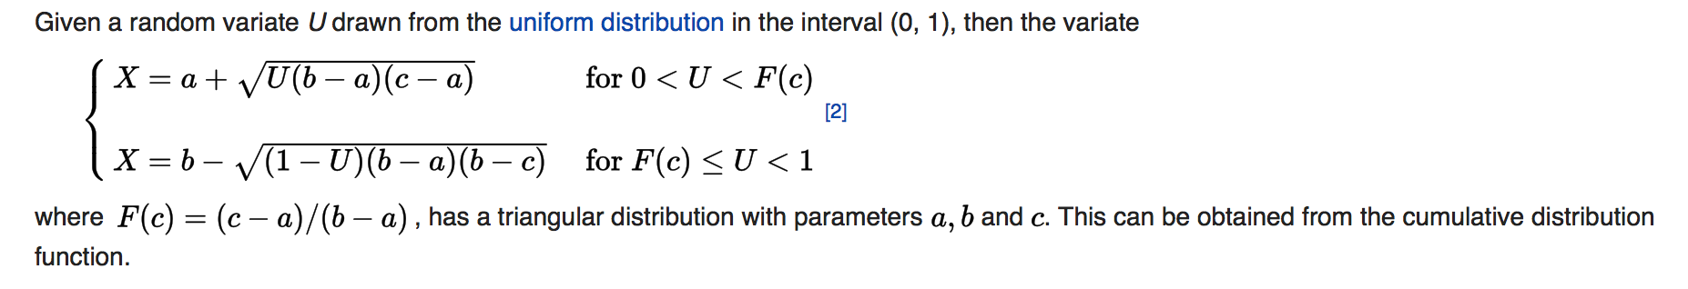
Estimation of Values
Triangular Distribution
Worst Case
Best Case
Most Likely
Notes:
Triangular distribution is commonly used for 3-point estimate

Slide 87
Monte Carlo Simulation Example for Project Schedule
Creation of E-learning module
Tasks | Best-case estimate | Most likely estimate | Worst-case estimate
Writing content | 4 days | 6 days | 8 days
Creating graphics | 5 days | 7 days | 9 days
Multimedia integration | 2 days | 4 days | 6 days
Total duration | 11 days | 17 days | 23 days
Notes:
From the above table, we can see that the project can be completed anywhere between 11 to 23 days. When the Monte Carlo simulation runs are performed, we can analyse the percentage of times each duration outcome between 11 and 23 is obtained.

Slide 88
Sample Monte Carlo Simulation EXERCISE
SEE EXCEL DEMO
Notes:
With the tornado diagram, we considered how much each task's variability affects the overall project duration when holding the others fixed, or constant at their most likely duration. It is a good sensitivity analysis tool because we can see which tasks the project duration is sensitive to.
But in reality, everything, all tasks to a certain extent are uncertain and will exhibit variability, and so task durations are going to move all over the place.
We're not going to have one source of variability with everything else staying constant.
So our next concept is to move beyond changing each task separately.
But we're going to throw all of our variability, and we're going to use very cool tool that we already know, monte carlo simulation
to conceptualize what the overall impact is going to be on our project duration.
Here we can account for different sources of variabilities that we have in our project,
As well as the interactions and the dependencies, the links between tasks.
We can incorporate probabilities and distributions and talk about how likely it is that we complete within a certain length of time.
How do we do that?

Slide 89
Sample Monte Carlo Simulation Results for Project Schedule
Total Project Duration | Number of times the simulation result was less than or equal to the Total Project Duration | Percentage of simulation runs where the result was less than or equal to the Total Project Duration
11 | 5 | 1%
12 | 20 | 4%
13 | 75 | 15%
14 | 90 | 18%
15 | 125 | 25%
16 | 140 | 28%
17 | 165 | 33%
18 | 275 | 55%
19 | 440 | 88%
20 | 475 | 95%
21 | 490 | 98%
22 | 495 | 99%
23 | 500 | 100%
Project Due Date

Slide 90
Sample Monte Carlo Simulation Results for Project Schedule – 500 simulations
Notes:
This is the graph version of the table.
Of course ideally you would want to do this prior to undertaking the project.
What the above table and chart suggest is, for example, that the likelihood of completing the project in 17 days or less is around 33%. Similarly, the likelihood of completing the project in 19 days or less is around 88%, etc. Note the importance of verifying the possibility of completing the project in 17 days, as this, according to the Most Likely estimates, was the time you would expect the project to take. Given the above analysis, it looks much more likely that the project will end up taking anywhere between 19 – 20 days.
You can schedule accordingly.
http://quantmleap.com/blog/2010/07/project-risk-management-and-the-application-of-monte-carlo-simulation/
=========================
When conducting a Monte Carlo simulation, correlation among input variables is an important factor to consider. If input random variables are treated as independent, when they are actually correlated, risk can be under or over estimated.
Let's think about how this occurs, when two input variables have positive correlation, the value for each should be relatively high in a given simulation iteration and both relatively low in another iteration. For negatively correlated inputs, one should be at the high end of possible values while the other should be at the low end for a given iteration.

Slide 91


