Slide 1
Supply Chain Networks and Cascading Risk
Notes:
In this presentation, we will explore the concept of supply networks and cascading risk, its causes and consequences, some real-world examples, and some strategies to mitigate or prevent them.

Slide 2
Acknowledgment
This course module is made possible through a grant from FM Global
through the Spencer Educational Foundation.
FM Global is one of the world’s largest business property insurers (www.fmglobal.com). Their clients include more than one out of every three FORTUNE 1000-size companies in more than 130 countries. For nearly 200 years, clients have worked with FM Global to develop robust property insurance and engineering solutions to protect their business operations from fire, natural disasters, and other types of property risk.
The Spencer Educational Foundation is a 501(c)(3) nonprofit organization funding the education of tomorrow's risk management and insurance leaders through scholarships, grants, internship opportunities, on and off campus experiential learning, and support of risk management/insurance curricula. Since Spencer was founded in 1979, they have awarded over $9.5 million in scholarships and over $8 million in grants to universities and professional institutions impacting over 70,000 students through their programming. For more information, please visitwww.spencered.org.

Slide 3
Acknowledgment
Also supported by:
Insurance and Financial Services Center, Strome College of Business
Department of Engineering Management & Systems Engineering, Batten College of Engineering and Technology
Old Dominion University
College of Emergency Preparedness, Homeland Security, and Cybersecurity
University at Albany
and
Engineering and Technology Management Program, Voiland College of Engineering and Architecture
Washington State University

Slide 4
This module contains the following sections:
Globalization and Supply Chain Networks
Definition and Examples of Cascading Risk
Supply Chain Risk Management Tools for –
  Risk Identification
  Risk Analysis
  Risk Mitigation and Response
Strategies and Best Practices

Slide 5
Learning Objectives
Identify and classify the sources and types of supply chain network disruptions and their potential impacts as cascading risk
Recognize and analyze examples of supply network cascading risk in real-world scenarios.
Apply the steps and tools of supply chain risk management to identify, assess, and mitigate supply chain network disruptions and cascading risks.
Know best practices for supply chain risk management.

Slide 6
Globalization and Supply Chain Network Disruptions

Slide 7
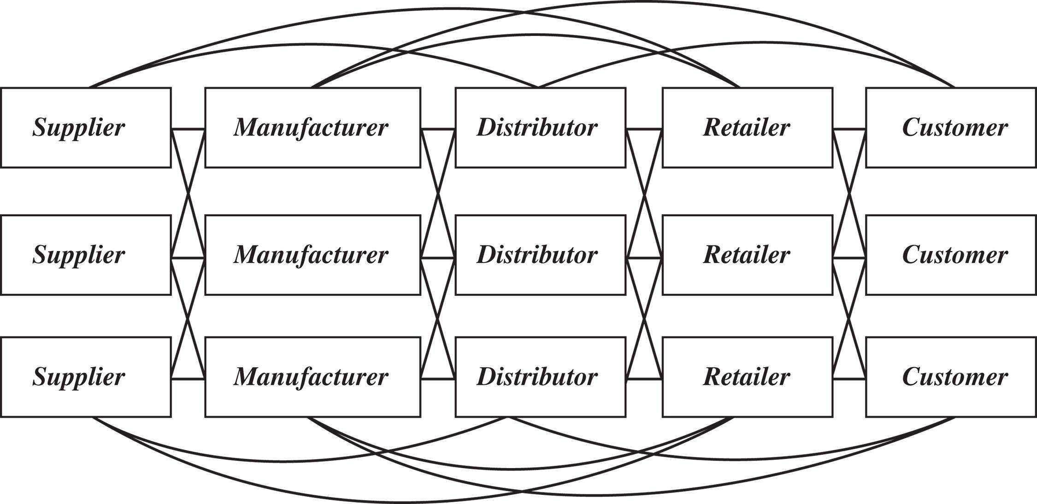

Basic Supply Chain Stages
Notes:
At this point you all should be familiar with the basic supply chain stages.
And the goal of the supply chain to make money/ make profit by satisfying customer demand. The customer is KING!
But it really goes beyond just satisfying the desires of customers, supply chains are extremely vital!
If we are talking about technology, that supply chain is vital for people staying connected and productive.
If we are talking about regional food supply chains, that supply chain is vital for the nourishment of people in communities.
If we are talking about public health, that supply chain is vital for the health and safety of people everywhere. During the pandemic, the overall aim of the vaccine supply chain was getting shots in arms!
And any disruption to these supply chains will have impacts. And we saw how closures in China affected the availability of PPEs for the US health care system and its ability to serve during the Covid19 pandemic. In general, the pandemic showed us the fragility of many global supply chain networks .

Slide 8
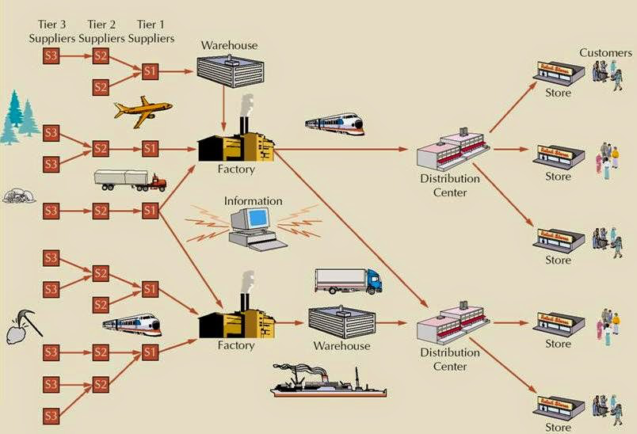
Supply Chain Network
Notes:
Now prior to the emergence of globalization, the aim for the supply chain network was to be owned by THE COMPANY, that’s what we called vertical integration! The premier example was Ford buying up rubber plantations for its tires and rail roads to move its raw materials to produce its automobile.
By the 1980s though, companies began building a different type of relationship with other businesses that they wanted or needed to work with.
They discovered that when they became experts in a few things instead of good in many things, the QUALITY of the product or service substantially improved. That is, performing well on cost and quality of the product simultaneously in all components and stages was very tough (impossible even)
So situations and opportunities arose where companies started doing business with other companies, the relationship can be described as very transactional in the beginning, mostly focused on maximizing profit (and in many cases, adversarial) but it was a marked shift from the vertical integration approach where companies started to specialize in a particular process or service.
So now we have one company doing the manufacturing and sourcing components from different companies. Transportation is usually done by another company. And retail/ distribution is done by another. So the supply chain network is made up of different entities responsible for a particular material or process in the chain with tier 1, 2, 3 or more suppliers with multimodal and omnichannel distribution to many different types of customers.
In reality, we know now that stages and processes of a supply chain are very complex. Managing the flow of material, information and money involve strategies, processes and methods that must cross over many different entities/ companies.

Slide 9
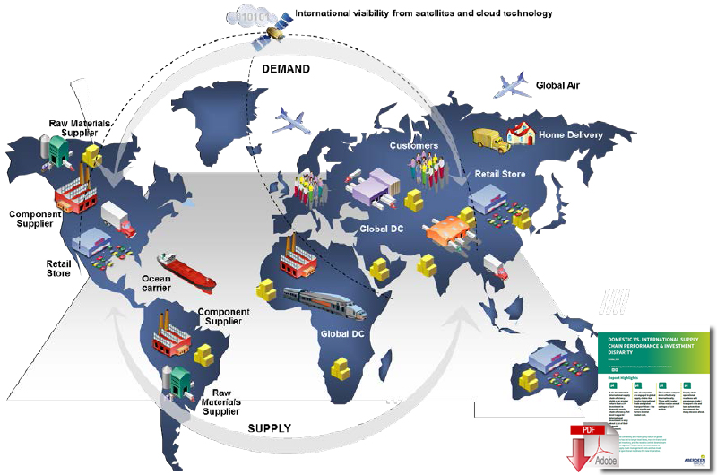
Impact of Globalization
Notes:
Further, the global landscape started to open with opportunities to simultaneously grow revenues and decrease costs.
Opportunities as new markets opened up, also offered the potential to take advantage of different cost structures in the different countries to lower cost; as well as localized knowledge and skills that benefitted companies.
Fast forward to after globalization, the internet, computers, and the emergence of highly sophisticated technologies, and so the supply chains were transformed.
The new supply chains gave rise to access to diverse and high quality skills, technologies, information, new markets, R&D, and much more.
So companies now establish relationships both domestically and internationally in an effort to build supply chains that are capable of getting things produced, moved, and consumed, according to whatever customers want around the world.
The auto industry can be used here as an example, as they became a trend setter for new types of relationships with other companies all over the globe.
Automotive companies manufactured in-country to gain new markets, but have also been able to take advantage of lower labor rates in certain countries and high capabilities/ expertise in others. Even Ford who a long time ago aspired to own every part of the supply chain, now gets its car components from all over the world/ from different companies.

Slide 10
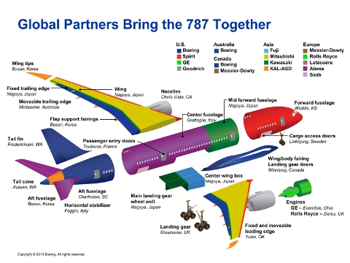

Slide 11
5,400 supplier factories, including sub-tier suppliers
+750 million components and assemblies need to be procured
+500,000 people are employed through the Boeing supply chain
Source: https://randy.newairplane.com/2013/02/21/our-supply-chain/

Slide 12
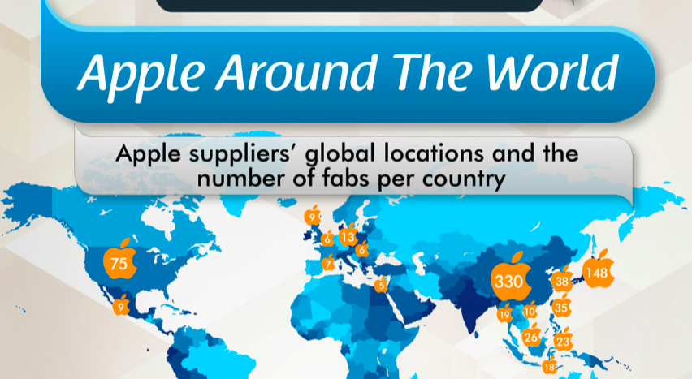
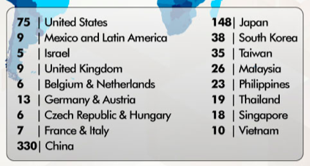

Slide 13
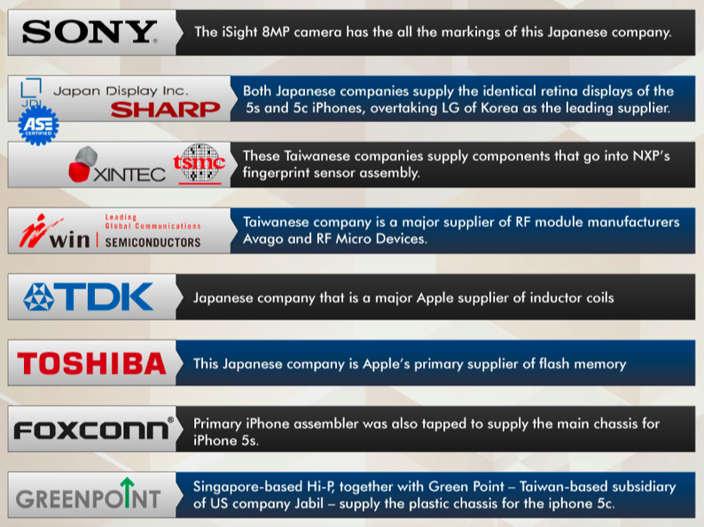

Slide 14
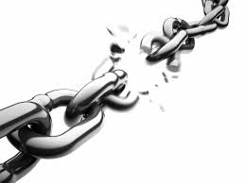

Impact of Globalization
Interdependence
🡻
Causal Chain of Events
Notes:
This strategy of outsourcing and/or offshoring is accompanied by significant additional risk!
The major impact of globalization IS…a longer supply chain, it takes longer for products to come when businesses are further away
AND the more entities/ partners/different companies involved means introducing more uncertainties AND more opportunities to break the chain.
That is… MORE opportunities for supply chain disruption that can ripple across many many chains, due largely to high interdependencies connecting the supply chain network. By virtue of the supply chain as interdependent links, it is vulnerable to causal chain of events. The difference between success and failure of a company often is the ability to incorporate suitable risk mitigation and responses to prepare for and weather any supply chain disruption that the supply chain network can conceivably experience.
The complexity of the mitigation will depend on the network. The bigger the network the more coordination and collaboration between parties is needed to predict and prevent a disruption, or to mitigate the negative impacts of a disruption if it occurs across the supply chain network. The bigger network that are geographical distant is characterized by different business environments, and this distance (and length of supply chain) have obvious effects on visibility, control, and complexity.

Slide 15
Definition and Examples of Cascading Risk

Slide 16
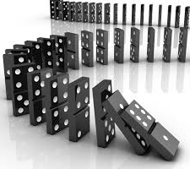
Cascading failure
Failure in a system of interconnected parts in which the failure of a part can trigger the failure of successive parts
Notes:
Supply network cascading risk is the chain of causality that emerges when risk and accumulated vulnerabilities connect to increase the chance of attack or failure in a supply network.
In simpler terms, it is the domino effect that occurs when one vendor or node in a supply chain fails or is compromised, and this affects the rest of the connected vendors or nodes, leading to widespread disruption and loss.

Slide 17


Cascading failure
Failure in a system of interconnected parts in which the failure of a part can trigger the failure of successive parts
Such a failure may happen in many types of systems:
  Power transmission (blackouts)
  Computer network (Dyn DDoS incident)
  Finance (mortgage crisis)
  Ecological systems (extinction of keystone species)
  Human bodily systems (stroke)
  Supply Chain Networks (raw material or component shortage)
Cascading failures usually begin when one part of the system fails
When this happens, nearby nodes must then take up the slack for the failed component
Notes:
Some common causes of supply network cascading risk are natural disasters, cyberattacks, human errors, sabotage, terrorism, etc.

Slide 18
Cascading failure, in general
Can you recall a recent event that disrupted the global supply chain?
Notes:
Begin the lesson by asking the students to recall a recent event that disrupted the global supply chain, such as the COVID-19 pandemic, the Suez Canal blockage, or the Texas winter storm. Ask them to share their thoughts on how these events affected the availability, quality, and price of goods and services around the world.
Explain that these events are examples of supply network cascading risk!
Then there was the stranded mega-container vessel in the Suez Canal, holding up an estimated $400 million an hour in trade!

Slide 19
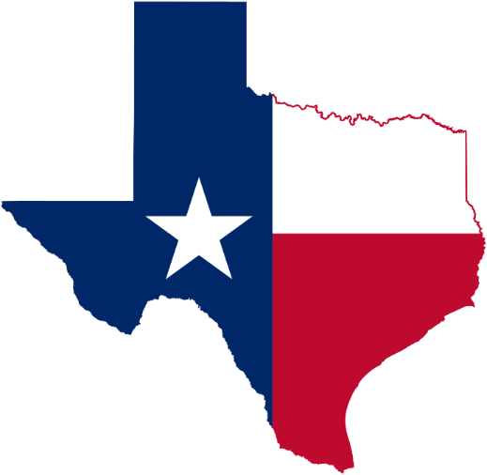
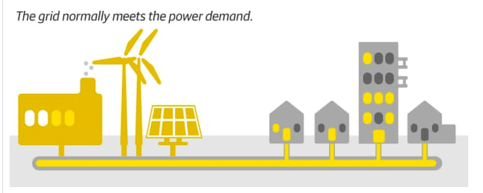
2021 Texas power outage

Slide 20
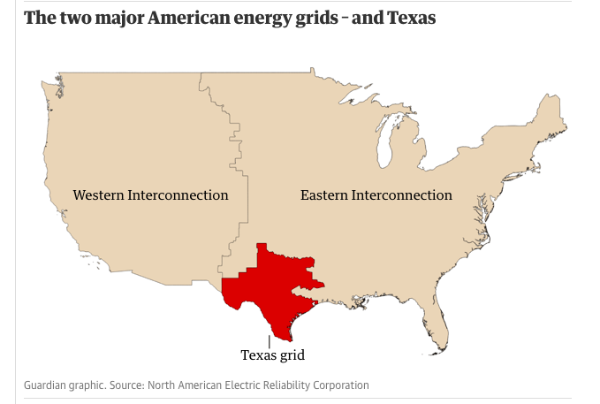
2021 Texas power outage: significant events
Winter storm that began on 13 February
Excessively high energy demand
Natural gas wells, wind turbines and coal piles froze
Texas grid not connected to the two bigger grids

Slide 21

2021 Texas power outage: Resulting to...
Texas grid not being able to produce as much power at a time when consumers were demanding more of it
Western and Eastern grids were not able to contribute towards satisfying the demand in Texas
Generators – which convert fuel into power – are designed to try to ramp up and keep up with demand...
...but [here comes good engineering] overloaded and automatically went offline as a precautionary measure against equipment damage

Slide 22
Exercise
Case 1: Japanese Earthquake and Tsunami
Case 2: Solar Winds
Case 3: Colonial Pipeline Ransomware Attack
For each case study, describe the trigger, the propagation, the consequences, and the responses of different stakeholders. You can also use graphs, charts, or tables to show the quantitative or qualitative data related to the case studies.

Slide 23
Case 1: Japan Earthquake and Tsunami (2011)
The 2011 Japan earthquake and tsunami was a devastating natural disaster that disrupted the global automotive and electronics industries.
The initial trigger was the earthquake that damaged many factories, roads, ports, power plants, etc. in Japan.
The propagation was the disruption of the supply of critical components and materials from Japan to other countries, such as microchips, batteries, LCD panels, etc.
The consequences were the shortage of products, the increase of prices, the delay of deliveries, the loss of sales, etc. for many companies around the world.
The responses were the activation of contingency plans, the diversification of suppliers, the relocation of production facilities, the innovation of new technologies, etc.
Notes:
Another example of disruption could be that multiple companies in the supply chain, due to some natural disaster or global health crisis, had to halt their sourcing, production, and delivery of materials and finished goods within the network.
The 9.0 earthquake and 45-foot wall of water that struck Japan in 2011 devastated local production and power generation, causing massive supply chain disruptions for companies all around the world. This was because about 22 percent of the world's wafer supply came from the Fukushima prefecture, and 60 percent of critical auto parts were also produced in the same area.

Slide 24
Case 2: SolarWinds Hack (2020)
The 2020 SolarWinds hack was a massive cyberattack that compromised government agencies and private companies across various sectors.
The initial trigger was the insertion of malicious code into a software update from SolarWinds, a provider of network management tools.
The propagation was the infection of thousands of customers who downloaded the compromised update, allowing hackers to access their systems and data.
The consequences were the breach of sensitive information, the disruption of operations, the damage of reputation, the exposure of vulnerabilities, etc. for many organizations around the world.
The responses were the investigation of the incident, the removal of the malware, the enhancement of security measures, the coordination of countermeasures, etc.

Slide 25
Case 3: Colonial Pipeline (2021)
The 2020 SolarWinds hack was a massive cyberattack that compromised government agencies and private companies across various sectors.
The initial trigger was by breaching an old Virtual Private Network that was not supposed to be in use. The primary target of the attack was the billing infrastructure of the company. This ransomware denied the company access to the billing network.
The propagation was the disruption of all operations. Colonial Pipeline reported that it shut down the pipeline as a precaution due to a concern that the hackers might have obtained information allowing them to carry out further attacks on vulnerable parts of the pipeline.
The consequences impacted fuel and gas distributors, airports, airlines, airline passengers and even common people (average fuel price hike).
The responses were the investigation of the incident, the removal of access of the breach, the enhancement of security measures, the coordination of countermeasures, etc.
Notes:
Which part of the Colonial Pipeline's company was directly infected by the ransomware?
Which part of the Colonial Pipeline's company was indirectly affected by the ransomware?
Describe how this indirect effect occurred.
Identify and describe how other companies or members of the society were indirectly affected by the ransomware?

Slide 26

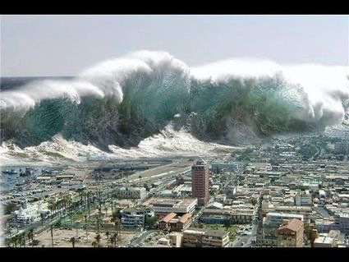
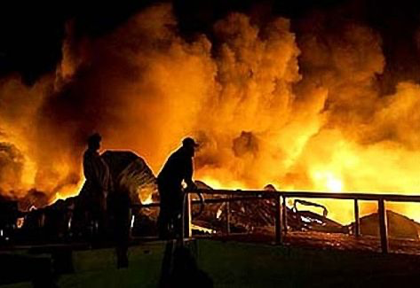
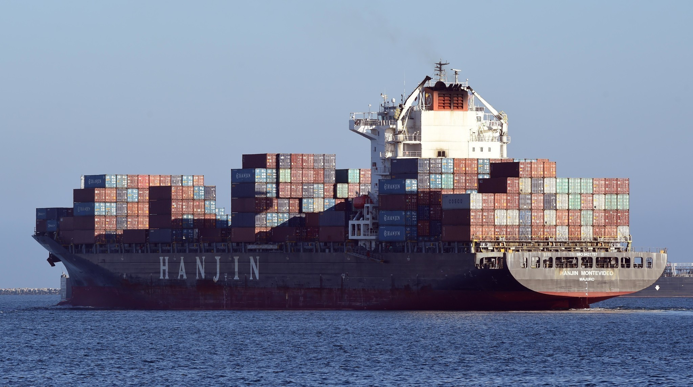
Supply Chain Network Disruption
Intentional or Unintentional Disruptions such as contamination of inventory, labor strikes, terrorist attacks. Examples-
  9-11 Terrorist Attack (2001)
  BREXIT
  Hanjin Shipping Co. failed to secure funding from the Korean Development bank (2016)
  Covid19 Pandemic!
Notes:
A supply chain disruption can be because of both intentional and unintentional causes. Intentional disruptions to the supply chain can be caused by contamination of inventory, labor strikes, terrorist attacks, etc.
For example, all air freight traffic and import stations between Canada and Mexico were immediately disrupted as a result of the 9/11 terrorist attacks. This situation causes inventory production and global distribution problems. US companies that had planned or had already scheduled for air freight of parts and product saw their distribution plans come to a halt, and they were forced to make new plans if they wanted to continue business.
On the other hand, unintentional disruptions can be caused by natural disasters, such as fires and tornadoes and hurricanes, tsunamis, and earthquakes.
Other examples of unintentional causes of supply chain disruption include supplier bankruptcy and pandemics.
These unintentional causes can be naturally or they can be man-made. For example, food industry supply chains have long suffered from disruptions due to unintentional contamination several times.
In some instances, the disruption may have taken place due to a plant shut down at a raw material supplier that is far upstream in the supply chain like the Philips plant fire in Albuquerque (2000). The flow of microchips from Philips was a crucial component in the mobile phones of Nokia and Ericsson and it suddenly stopped because of the fire and plant closure for several weeks. It cost Ericson billions of dollars and its shares plummeted and eventually it left the cell phone space.
Another example- the disruption may take place because a transportation or logistics service provider further downstream could not ship products to the customers.
Hanjin, the seventh-largest shipping company in the world, failed to secure funding from the Korean Development Bank, then abruptly ended services, leaving ships and crews stranded and billions of dollars worth of cargo in limbo.
AND then of course the pandemic, we’ve seen first hand the impact of this pandemic to the supply chain. From shortage of toilet paper, PPE and masks. To dumped milk by dairy farmers and vegetables left to rot as businesses, restaurants and schools closed. To microchips for cars, gaming consoles, appliances, credit cards, etc.

Slide 27


Survey on Supply Chain Disruptions
Risk Factors | Percentage of Supply Chains Affected
Natural disasters | 35
Shortage of skilled resources | 24
Geopolitical uncertainty | 20
Terrorist infiltration of cargo | 13
Volatility of fuel prices | 37
Currency fluctuation | 29
Port operations/custom delays | 23
Customer/consumer preference shifts | 23
Performance of supply chain partners | 38
Logistics capacity/complexity | 33
Forecasting/planning accuracy | 30
Supplier planning/communication issues | 27
Inflexible supply chain technology | 21
Notes:
Here was a survey done on supply chain disruptions. Gartner researches and tracks supply chain management across industries. They put out results of surveys regarding disruption events. (They also put out rankings on the top supply chain companies every year. )
Disclosure here (not sure when this particular survey was done, This was prior to the pandemic) So take the numbers here with a grain of salt.
BUT at that time, of those who experienced disruption, they indicated that it originated not from their own organization, but rather from somewhere else in the supply chain, particularly from those who are suppliers to their suppliers – those below tier one suppliers. So it begs the question, do you know who your suppliers’ suppliers are???
Also at the top here is natural disasters. With climate change, we know that more and more of our supply chains are affected by natural disasters and the ripple effects are far reaching!
Here are some sources of risk for your company to explore- geopolitical uncertainty (like Brexit, Ukranian war, Israel-Gaza), terrorism, volatility in fuel prices, currency fluctuations and port operation/ custom delays
Shortage of skilled resources would be probably go way up at the top now- the impending worker strikes that could shutdown the country’s freight railroads right in the middle of the holiday season. Have your company looked at how this could impact your company’s operations?
Interestingly a pandemic was not part of the risk factors that were identified!
But certainly now we know that it would be a ROOT CAUSE or a causal factor to many risk factors here. The pandemic caused the shortage of skilled resources, geopolitical uncertainty, volatility of fuel prices, poor operations and custom delays, consumer preference demand shifts and so forth.

Slide 28
Supply Chain Disruption Impact
Short Term
Material Flow
Information Flow
Financial Flow
Long Term
Shareholder concern
Damage to reputation
Increases in regulatory scrutiny
Notes:
Now when we think about supply chain disruption, the most obvious is the disruption of physical/ material flow.
However many things flow in the supply chain.
Recall, there are three primary flows that have the potential to be disrupted.
It includes information flow, yes, physical material flow, and financial flow.
Let's start with information flow. Information flow has been described as the lifeblood of the supply chain.
Without it, the supply chain would not be able to function. Every supply chain has a flow of information that accommodates the movement of material between supply chain partners. Typically, information flow is in the form of customer orders that flow upstream from customers to retailers, to manufacturers, and to the suppliers so that each company can know what to produce and when to produce it.
If the supply chain suffers a disruption, there are a couple of things that can happen.
One, is that supply chain partners will have different information, and therefore, it will be difficult for the supply chain to align decisions. If a major disruption occurs, organizations can't share critical demand information. There will be no purchase orders, no shipment notifications, and no coordinated marketing and sales efforts.
An example of a disruption of information flow was Maersk.
Maersk is a shipping company, responsible for around one fifth of the world’s cargo shipping. In 2017, Maersk, the shipping giant, became collateral damage of a nation state cyber attack known as NotPetya. The outage left Maersk unable to process shipping orders, freezing revenue from several of the company’s shipping container lines for weeks.
This obviously affected the physical material flow. Issues with the physical flow are the most obvious indicators of a supply chain problem during a disruption because it deals with the product not being available and/or delayed! The abrupt stoppage during the suez canal blockage or the Japanese tsunami or the pandemic shutdowns are all examples of material flow disruption.
The third flow is financial flow. This flow is about financial transactions that take place between supply chain partners. The most obvious financial flow is the movement of money that a buyer is supposed to pay a supplier in exchange for materials and product. As Maersk’s system was down due to the cyberattack, not only did they incur losses for downtime, business interruption- non-payment, non-processing, but also cost of cleaning virus, restoring backup systems, communicating to partners, etc.
Financial flow ensures the health of each organization in the supply chain and the entire system. Financial woes can become much worse if a disruption event takes place. During the shut down, many businesses experienced a sudden cash flow problem. No income was coming in, but many bills became due!
========
A power cut in Nigeria’s capital city salvaged Maersk’s network infrastructure during the NotPetya attack of 2017, the shipping conglomerate’s head of security has admitted.
Recounting the remarkable stroke of luck at the Black Hat Europe conference in London last week, Maersk CISO Andy Powell said the malware wiped out almost all online backups of the company’s Active Directory – save, mercifully, for a piece held in its powered-down Lagos office.

Slide 29
Supply Chain Disruption Impact
Supply network cascading risk can have serious consequences and impacts for different stakeholders, such as customers, suppliers, competitors, regulators, etc. Other possible consequences and impacts are:
Loss of revenue and profit
Loss of market share and reputation
Loss of customer satisfaction and loyalty
Loss of quality and safety
Loss of innovation and competitiveness
Legal and regulatory issues
Social and environmental issues

Slide 30
Supply Chain Risk Management

Slide 31
General guiding questions in risk management
0th What should go right?
1st What can go wrong?
2nd What are the causes and consequences?
3rd What is the likelihood of occurrence?
4th What can be done?
5th What are the alternatives?
6th What are the effects beyond this particular time?
Risk Identification
Risk Analysis
Risk Mitigation/ Response
Notes:
Here is the 1+6 general guiding questions in risk management. This is a good framework to use with any process or system. I teach this in my risk management class.
This framework can help identify supply chain risk. To ask the questions what should go right and what can go wrong in my supply chain.
It helps to look at causes and consequences. And Likelihood of these risks occurring.
And then what can be done, alternatives, and effects beyond.
In general risk management covers risk identification, risk analysis and risk mitigation/response

Slide 32
Risk Identification
Q1. What needs to go right?
Notes:
So the first question is about what we want to happen, or “go right” in our supply chain?

Slide 33
Risk Identification
Q1. What needs to go right?
Right products or services
Right quantities
Right quality level
Right documentation
Right location
Right time
Notes:
There happens to be what we call six rights of supply chain management for companies to think about!
One, that they are delivering the right products and services. We want to make sure that customers get what they have ordered in terms of product function and value.
#2, the customers have to receive the right quantities. We want to make sure that customers receive no more and no less than the amount that they have ordered.
#3, the products have to be at the right quality level, error-free, products and services should not have any defects.
#4, the products should always have the right documentation. Each product or service should come with paperwork that confirms what is in the order, the paperwork should include instructions to the customer of how to proceed with returning the item if need be.
#5, and it goes without saying, products have to be delivered to the right locations.
#6, products have to be delivered at the right time.
Ultimately, the supply chain is responsible for getting goods and services to the customers or consumers when they are needed.
Note again that while the rights of SCM we tend to associate with physical material flow. We must keep in mind of the other flows, that information flow and the financial flow also needs to go right!
I want my supply chain to be as efficient and effective to provide the highest possible value.
=====================
In business, time is of the essence. In supply chain management, we measure something called lead time.
Lead time represents the amount of time between when a customer places an order
and when a customer receives that order.

Slide 34
Risk Identification
Q2. What can go wrong?
Right products or services → wrong products
Right quantities → wrong quantities
Right quality level → poor quality
Right documentation → wrong documentation
Right location → wrong location
Right time → wrong time (delay)
Notes:
In risk identification, by logic, via negativa, we can determine the opposite to identify risks …. Getting the wrong products, wrong quantity…..
And already you can ask yourself, what are the conditions and scenarios that can contribute to these risks! What are the causes of risk!
And we have a bunch of tools we can use like process maps, cause maps, ishikawa for example, if we wanted to look at the causes of risk
Here it helps to invoke the notion of a systems view of the supply chain, looking at where the risks are in terms of the supply chain stages or supply chain network , the interdependencies and also looking at the interactions between the organizations involved. Perhaps risks in terms of not only threats to the physical flow of goods but vulnerabilities of information flow and financial flow.
Things that can disrupt my supply chain that will result to inefficiency and reduction in effectiveness

Slide 35
Risk Analysis
Q2. What are the causes and consequences?
Q3. What are chances of occurrence?
Notes:
In risk analysis, we look at questions 2 and 3
Things I know about disruptive events and their effects on my supply chain
Cause-and-effect sequence of physical disruptions
•Valuation of effects to the supply chain

Slide 36
Risk Analysis - Qualitative
Category | Risk Drivers
Disruptions | Natural disaster, war, terrorism Labor disputes Supplier bankruptcy
Delays | High capacity utilization at supply source Inflexibility of supply source Poor quality or yield at supply source
Systems risk | Information infrastructure breakdown System integration or extent of systems being networked
Forecast risk | Inaccurate forecasts due to long lead times, seasonality, product variety, short life cycles, small customer base Information distortion
Notes:
There are many disruptions that have already been well documented in the supply chain with examples we have already described.
Disruptions due to disaster, war, terrorism- Examples like the Japanese Fukushima Tsunami, 911 attack
Labor disputes- the California port strike
Bankruptcy – Hanjin shipping
There other types of supply chain risk are delays, systems risk and forecast risk.
Delays are typically caused by capacity and inventory issues within the supply chain. Many companies that suffer from delays see most risk events when they are operating at very high capacity utilization levels, and/or have a very efficient inventory management system.
When we say a company/ a supplier is operating at high capacity utilization levels, it means that the company does not have a lot of leftover time, materials, machines, and employees to continue producing products should it experience a sudden surge in demand. If at the same time the supply chain doesn't hold a lot of their end-product on hand, that exacerbates the situation, as there is no to little buffer for any disruption,
Other sources of delay are the inflexibility of supply source, this happens when you have no or little alternative sources. Thus any disruption of your current supplier or poor quality or yield with your supplier will substantially impact your operation.
============
Systems risk events are typically due to a breach of supply chain information technology infrastructures.
The rule of thumb to remember here is the following: On one hand, a more expansive technological infrastructure will provide more connections across a supply chain and can result in greater supply chain visibility, which will increase information sharing across the network and will greatly increase the supply chain's chances of getting products at the places that they're needed, especially for e-commerce. On the other hand, a more expansive network provides a greater chance that there will be a systems risk event to occur because there are more potential security breach points across the network.
This is a great example of how innovation and investments that are meant to boost efficiency across the network can also provide an opportunity for greater risk exposure.
Forecasting risk also known as demand risk, is present whenever supply and demand are not in balance. Forecasting is one of the most critical supply chain practices for any company because it helps the company ensure that the inventory is available whenever it is desired by the consumer.
Demand risk events always are an issue for every single business. This happens for a couple of reasons.
The first is because no company can ever predict demand with 100% accuracy. At best, companies strive to minimize their forecast error, which is the amount by which they overestimate and underestimate demand.
The second big reason is because every company has to figure out how to manage demand information distortions across their supply chains.
This is due to a phenomenon called the bullwhip effect that we have discussed.
============
Risk events can include suppliers operating at high capacity, supplier materials failing to meet quality targets, unreliable suppliers, and processes that are very time intensive, such as importing of foreign goods.
Another type of risk that is related to delays is capacity risk. This risk is similar to delay risk in that the root cause of the problem stem from capacity issues. The difference between the two is that capacity is many times the result of a purposeful strategic decision made by the decision makers within the organization, such as the choice to increase or decrease capacity.
What if, for example, the company decides to decrease capacity or invest in additional capacity too slowly?
One outcome could be not being able to meet customer needs if the customer orders more product. Another outcome could be failure to adequately compete against competitors who have newer machines.

Slide 37
Risk Analysis - Qualitative
Category | Risk Drivers
Intellectual property risk | Vertical integration of supply chain Global outsourcing and markets
Procurement risk | Exchange-rate risk Price of inputs Fraction purchased from a single source Industry-wide capacity utilization
Receivables risk | Number of customers Financial strength of customers
Inventory risk | Rate of product obsolescence Inventory holding cost Product value Demand and supply uncertainty
Capacity risk | Cost of capacity Capacity flexibility
Notes:
Here you see many other categories of supply chain risk. I won’t go through all of them. But suffice to know that in risk identification, historical information, categorized tables like this and taxonomy based information of risk are useful to start identifying risks that may impact your supply chain.
Look at risk drivers that have been already been identified as risks in your industry. Do these risks manifest itself in your company? Do they apply to your business??
================
Inventory risk is a function of demand risk and the errors made when trying to predict how many products that customers want to purchase.
Most oftentimes, inventory risk events deal with not having enough inventory on hand to satisfy customers

Slide 38
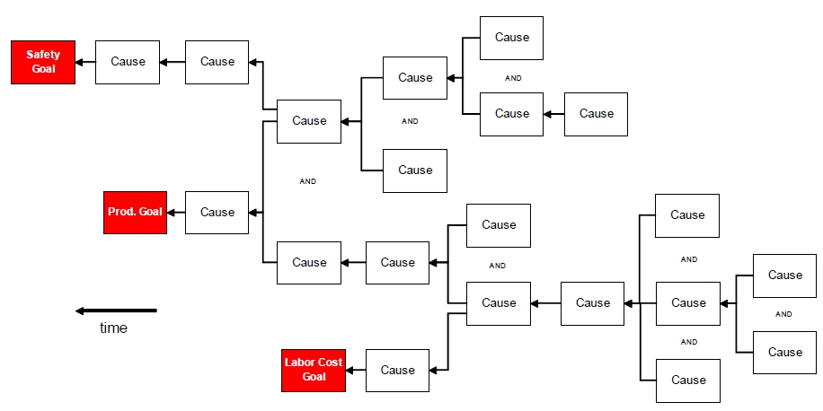
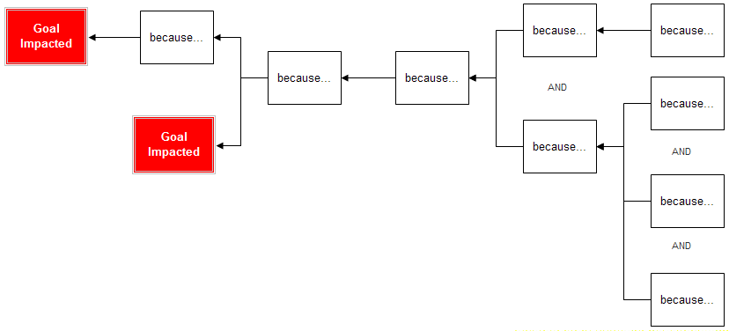
Risk Analysis – Cause Maps
Notes:
Qualitative
Cause map is an extension of 5 Why’s
Cause Maps and 5 why’s Focus on Cause-and-Effect, not Categories like the fishbone diagram
Cause Mapping defines problems within the context of an organization's overall goals (0th question what should go right), for which everyone within the group developing the cause map should share the same perspective.
For instance, a company may have a risk that involves safety, production and labor costs-
The team doing the risk ID needs to know these three objectives. Defining a risk by how it deviates from these goals provides common ground for the start to any investigation.
Many times people often disagree over how to define the problem but you can get alignment when the problem is defined by the impact to the goals.
Cause Maps are read Left to Right
Fishbone on the other hand is read right to left, the fishbone starts with a problem on the right and builds across the page moving left.
since the traditional Japanese language reads right to left across a page, it seems to follow that.
A Cause map starts on the left and reads right. At every point in both the fishbone and Cause Map, investigators ask the "why" questions that move backward through time, studying effects and finding their causes. analyzing a risk involves breaking it down into specific cause-and-effect relationships.
Now to emphasize unlike fishbone, the relationship between causes is more important than the category that the causes fit within. A Cause Map should reflect the actual incident as it evolves through time.
=======================
(This distinguishes the Cause Map from the process map, which moves forward through time with arrows pointing left to right (the process involves performing step one, then step two, etc.)

Slide 39
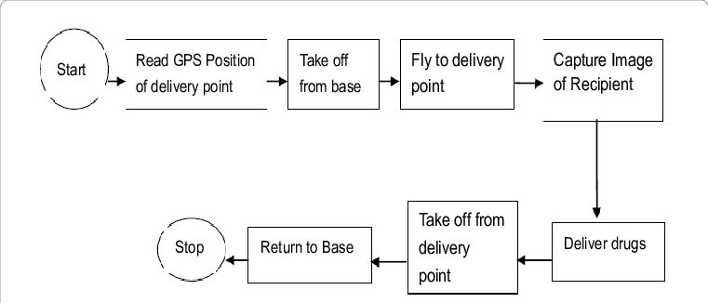
Risk Analysis – Cause Maps
Flowchart for drug delivery using UAV
Cause map
UAV Crash
Battery drained
Did not replace Battery
UAV does not reach delivery point
UAV Lost
Wrong coordinates
GPS malfunction
Notes:
Flow diagrams can give us insight for the 0th question- what we want to go right.
Here is a flowchart for the drug delivery using a UAV.
You can use a cause map for each step!
So going through each step of the process helps identify risks.

Slide 40
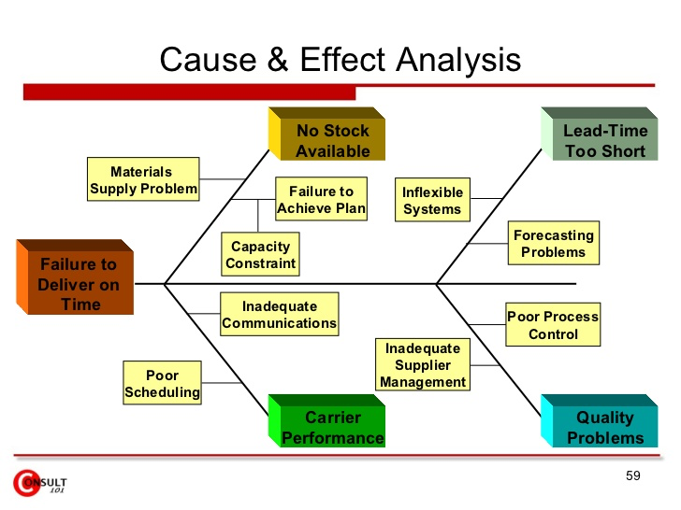
Risk Analysis – Cause & Effect Analysis
Q2. What are the causes and consequences?
Notes:
Qualitative
And then you can ask yourself, what are the conditions and scenarios and causes that can contribute to these risks in my company!
We can come up with these using some risk tools
Like Cause maps, Ishikawa, process diagrams, etc.
Here is an example of a cause and effect for failure to deliver on time. Two main sources have been identified-
Failure to deliver on time due to no stock available, lead time required is too short, poor carrier performance and quality problems.
As you go into the details of what are the root causes, one can start thinking about which ones of these causes are the higher risks
===============
Based on Things I know about disruptive events and their effects on my supply chain.

Slide 41
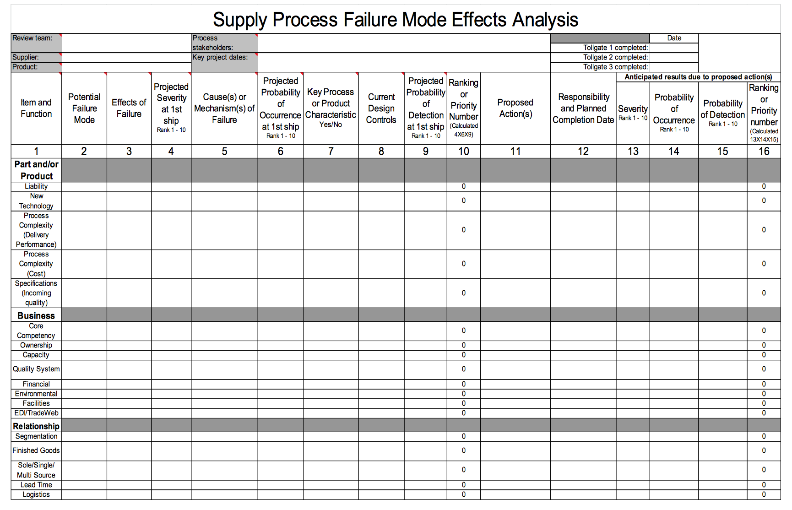
Risk Analysis - Quantitative
Q2. What are the causes and consequences?
Q3. What are chances of occurrence?
Notes:
Quantitative
Here is another example of a supply process FMEA
Where you can determine potential failure modes for the supply process, identify current controls and probabilities and perform a ranking of high risk areas in your supply process.

Slide 42
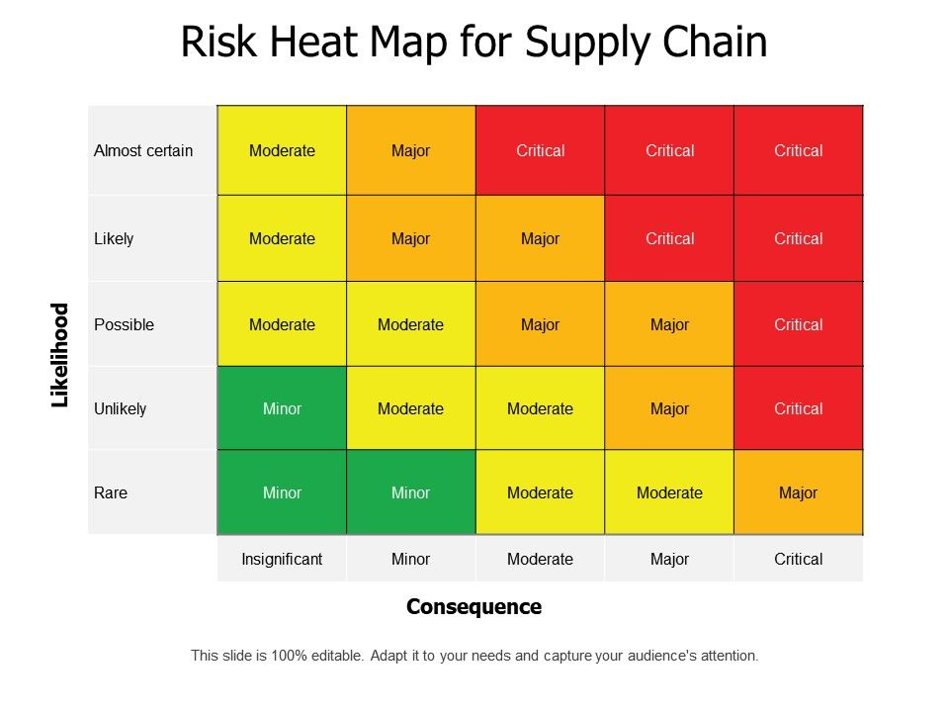
Risk Analysis - Quantitative
Q3. What are chances of occurrence?
Notes:
Obviously you may end up with a really long list of risks in your supply chain.
What helps prioritize is what we call a risk heat map.
You can prioritize those that are high priority risk, those with critical consequence and high likelihood
Those with cascading risks will typically land in the red.

Slide 43
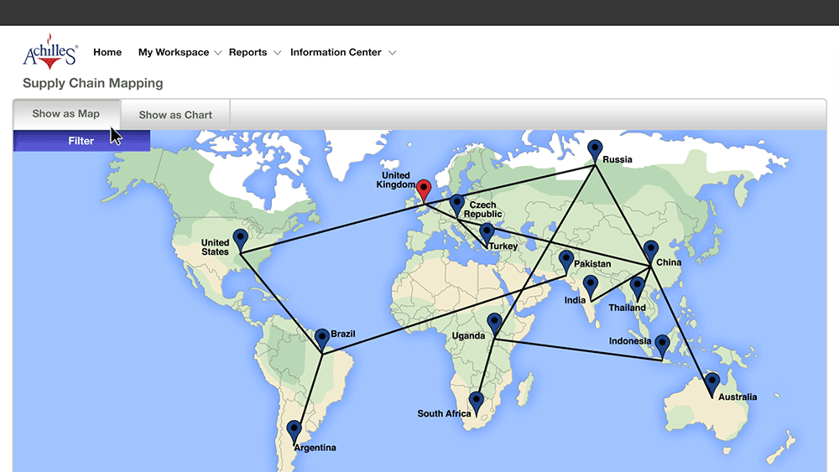
Risk Analysis – Geographic Information
Notes:
Here is something unique for supply chains- Supply chain mapping or source maps
The source map helps organizations gain insights into the end-to-end supply chain and tracks critical flows of material/goods, physical, information and financial flows.
Mapping your supply chain helps you see what your supply chain looks like geographically, know your tiered supply chain (identify and monitor direct and indirect supplier). And use geo-analytics (geographic information) in your decision making and risk assessment.

Slide 44
Risk Mitigation and Response
Q4. What can be done
Q5 What are the options?
Q6. What are the effects beyond this particular time?
Notes:
Based on our knowledge of the disruptive events and the mechanics of their occurrence and how they may actually result to disruptions, we can start generating some options to prevent the occurrence and/or reduce the disruptions if they do occur.
Things I can do to prevent and reduce disruptions
Let me expand my analysis beyond the obvious.

Slide 45
Risk Mitigation and Response
Detection
Treatment
  Avoid
  Reduce
    Modify the risk
    Separation
    Duplication
    Recovery
  Transfer or share the consequences
  Acceptance
    Recovery
Notes:
Fundamental strategies- Detection and Treatment
Risk Avoidance is to ELIMINATE the possibility of a particular risk by never undertaking the activity,
Avoidance also includes stopping an activity if there is too much risk attached. If a risk has a very high likelihood or has a serious financial impact or leads to severe harm to humans, it's wise to ensure that it cannot materialize at all. For example, expanding the business to a new market in a new country provides huge benefits to a company. But if there is much corruption and instability in the country, the decision may be to avoid.
Risk REDUCTION is to prevent or reduce the risk from occurring by reducing the likelihood that the risk can occur or reducing the effects or consequences of the risk.
Risk TRANSFER is to delegated risk to another party that may be better equipped at dealing with the risk or responding to it.
Often times, this is done with risks that cannot be avoided and that are rare but have a high impact.
Often times too, buying insurance seems to be a catch all strategy for risk treatment. But note here that buying insurance is a reactive measure. It dos not actually modify the risk, meaning you change the probability of an undesirable event occurring or necessarily reduce its effect by buying insurance. So it must be combined with a other treatments.
And then risk ACCEPTANCE. Where we accept the risk and don’t act to change the nature of the risk. We don’t modify the risk.
Note that for Avoidance we DO NOT undertake or we stop doing the activity that poses the risk. For reduce, transfer, and accept we actually still proceed to undertake the activity.
For example, if we want to avoid getting into a fender bender or dying from a car crash, what would be an example of a risk treatment under avoidance? Don’t drive/ don’t get into a car.
And as we make a decision to drive, we can employ treatments or controls to reduce, transfer, and/or accept the risk of actually driving.
Also note that like Transfer, in Avoidance, and Acceptance, we do NOT do anything to actually change the nature, condition, context, environment, elements of the risk, in other words we don’t modify the risk either.

Slide 46
Watch Video
Interview Echo Global Logistics
Look for types of risk (disruption, delay, systems, forecast)
Look for risk responses used to address the pandemic!
https://mediaspace.illinois.edu/media/t/1_0y34fbdu
Notes:
What were your key takeaways!
What were the types of risks described.
Disruption event due to the pandemic. Some customers stopped delivering (physical flow stopped).
Delay event due to the pandemic- Some carriers had to deal with capacity issues (maybe some drivers were affected by Covid) and additional protocols (longer process)
Systems risk? Didn’t talk about it directly but information is key. To know what industries were affected, demand decreased and on the other hand where demand increased!
POSITIVE RISK- also connected to forecast risk. One of the strategies for systems risk and forecast risk that we didn’t talk about was supply chain visibility
Supply chain visibility (SCV) is the ability of parts, components or products in transit to be tracked from the manufacturer to their final destination. This improves and strengthens the supply chain by making data readily available to all stakeholders.
In this case, Echo Global was able to take the information and make decisions about where capacity should go, as well as in some cases, add capacity by pulling from their network of partners.
What are the risk responses described

Slide 47
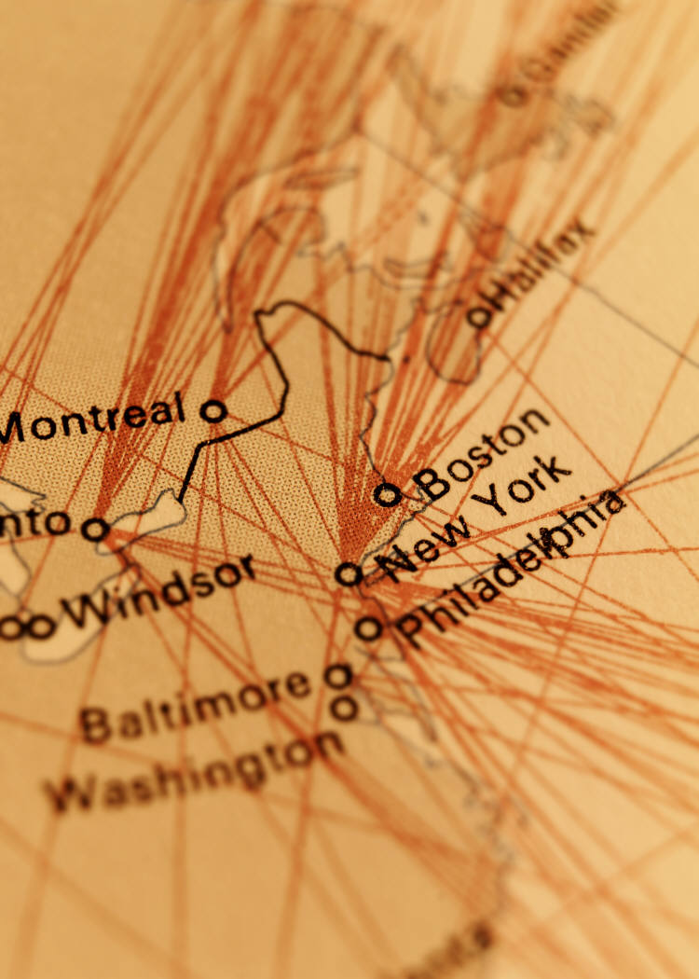
Risk Response – Reduction
Separation/ Duplication – locate functionally-similar facilities among varied locations or structures
Notes:
Separation- This 3PL operated many carriers, had a network of carriers
They also talked about alternating between ports as an example of geographic redundancy. If one route goes down, they have another route alternative!
Duplication- BACKUP! extra capacity, they were part of carrier network of shippers,
They could also outsource to others if needed.
================
Multiple suppliers that are geographically diverse
Nokia and Chiquita
Duplication – plan for a backup facility that can provide similar functions
Similar as separation but rember “cold”

Slide 48

Risk Response – Transfer
Transfer or delegate risk to another party that may be better equipped at dealing with the risk or responding to it
Notes:
Encourages redundancy. Think maybe about outsourcing some part of your transportation.
TRANSFER- partner with someone with redundancies (many shippers, many carriers)

Slide 49
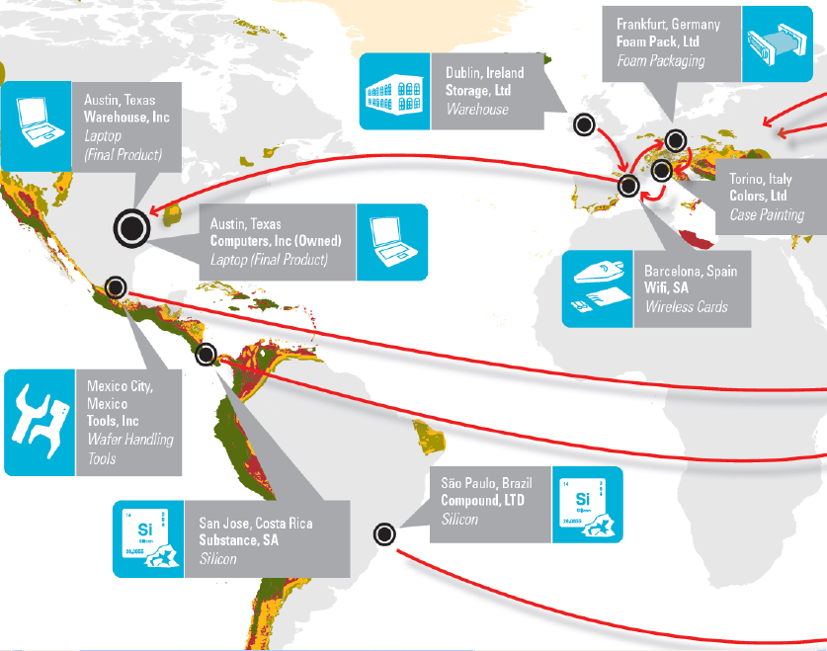
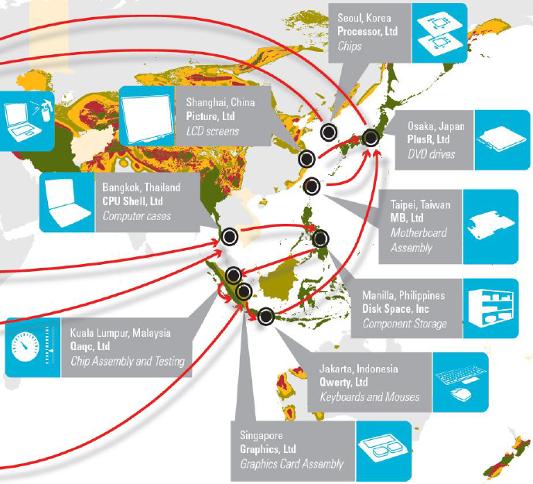

Geographic Risk
Supply Chain Footprint: Complex Path for Basic Laptop Computer
with Earthquake Zones Highlighted
Notes:
One of the key themes underscored in the interview is geographic redundancy.
Connections within your group of companies, or purchasing specifications generated internally, or decisions made at board level can all lead you to operate in certain countries, with higher associated risks than other countries.
How does this come about.
Almost all industries tend to become concentrated in specific geographic regions, such as finance in New York or auto manufacturing in Detroit. High-tech in Silicon Valley,
Abroad the tech industry is concentrated in the southeast coast of Japan, central and northern Taiwan, the Philippines, greater Seoul, the southern coast of China, and southern Thailand, for example. Many suppliers choose to 'cluster' because of the proximity of raw materials, or geographic advantage e.g. a port.
There are many advantages to this concentration (referred to by economists as agglomeration) such as the network effect of increased density of human expertise and resources, as well as reduced logistics costs and cycle times. However, there is a price to pay which is increased risk like from a disruption event. Such is the impact we saw in the 2011 tsunami in Japan impacting both high-tech and automotive production.
A key part of the answer to this is understanding where the over-concentration vulnerabilities exist. The most obvious type of over-concentration is over-reliance on a single supplier. But increasingly the risk includes having too many suppliers clustered in the same geographic region. To understand risks of geographic concentration, supply chains need visibility not just into whom they are buying from, but where production is happening throughout multiple tiers of the supply chain.
Here we see a geographic mapping of a supply chain that shows where different components of a laptop comes from.
So, first you would realize that parts of a laptop computer may be coming not only from various manufacturers, but also from various parts of the world.
The earthquake zones are highlighted.
You could intuitively sense possible effects of an Earthquake to the supply chain. Is there any geographic concentration you see?
What would be an example of avoidance strategy.
What would be an example of reduction strategy.
===============
Restrictions on commodities or materials leading to loss of supply, climate-related problems or delays (occasionally with devastating effect), and difficulties in moving goods to or from a particular region, are all potential operational risks.
Financial
Operational challenges in distant regions are expensive to rectify from afar, especially if a quick solution is required.
Reputational
If publicly scrutinised, would your decision to buy from a particular region provide any reputational challenges? Could your involvement in a region be interpreted as exploitative?
==================

Slide 50
Risk of Natural Disaster - Avoidance
Supply Chain Footprint: Complex Path for Basic Laptop Computer
with Earthquake Zones Highlighted
Avoidance – locate facilities in places with no to minimal occurrence of earthquakes

Slide 51
Risk of Natural Disaster - Reduction
Supply Chain Footprint: Complex Path for Basic Laptop Computer
with Earthquake Zones Highlighted
Reduction – locate facilities in places that know how to deal with earthquakes
Notes:
Japan, Taiwan, Hongkong have infrastructure such as earthquake-proof buildings

Slide 52
Risk of Natural Disaster - Separation
Supply Chain Footprint: Complex Path for Basic Laptop Computer
with Earthquake Zones Highlighted
Separation – locate multiple facilities in several geographic locations
Notes:
SEPARATION, if one goes down, the other holds up….. Diversity, akin to diverse portfolio
Japan, Taiwan, Hongkong have infrastructure such as earthquake-proof buildings
======
Make sure to set up backup IT systems and invest in IT security and supply chain risk management technologies

Slide 53
Other Risk Mitigation Strategies for Supply Chain Networks
Risk Mitigation Strategy | Tailored Strategies
Increase inventory | Decentralize inventory of predictable, lower value products. Centralize inventory of less predictable, higher value products.
Increase flexibility | Favor cost over flexibility for predictable, high-volume products. Favor flexibility for unpredictable, low-volume products. Centralize flexibility in a few locations if it is expensive.
Pool or aggregate demand | Increase aggregation as unpredictability grows.
Increase source capability | Prefer capability over cost for high-value, high-risk products. Favor cost over capability for low-value commodity products. Centralize high capability in flexible source if possible.
TABLE 6-4
Notes:
Examples of reduction techniques

Slide 54
Other Risk Mitigation Strategies for Supply Chain Networks
Risk Mitigation Strategy | Tailored Strategies
Increase capacity | Focus on low-cost, decentralized capacity for predictable demand. Build centralized capacity for unpredictable demand. Increase decentralization as cost of capacity drops.
Get redundant suppliers | More redundant supply for high-volume products, less redundancy for low-volume products. Centralize redundancy for low-volume products in a few flexible suppliers.
Increase responsiveness | Favor cost over responsiveness for commodity products. Favor responsiveness over cost for short–life cycle products.
TABLE 6-4
Notes:
Risk Mitigation Strategies
1st tier, several tiers for the variable demand and/or backup. Having multiple supplier also create a competitive atmosphere for suppliers.
TOC 60% best supplier 35% second best 5% third best

Slide 55

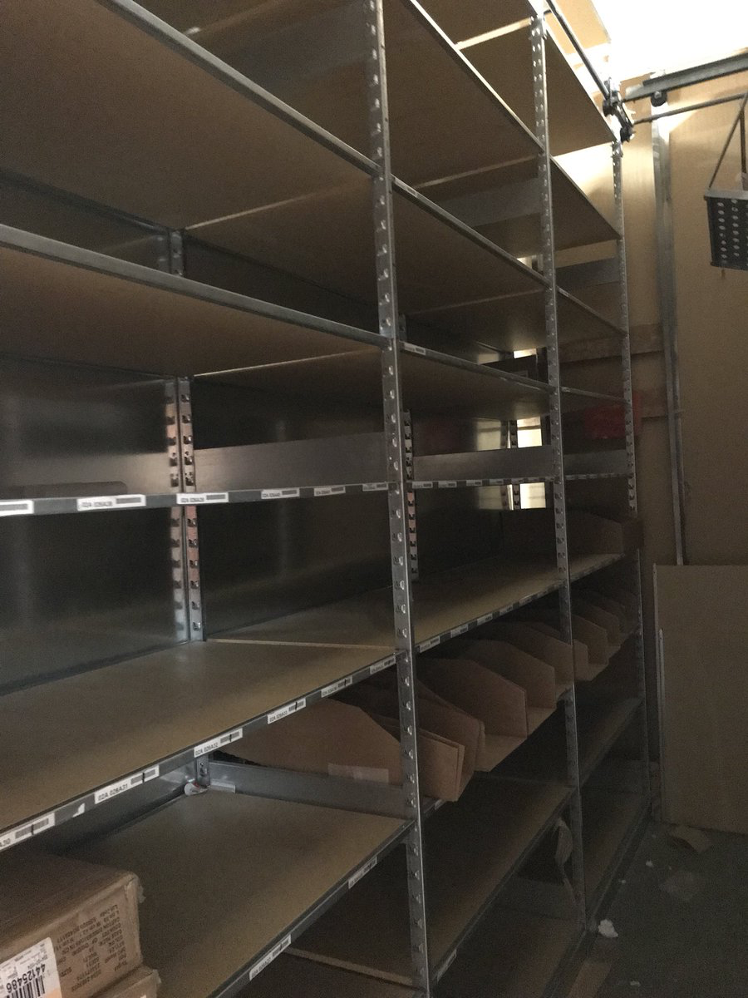
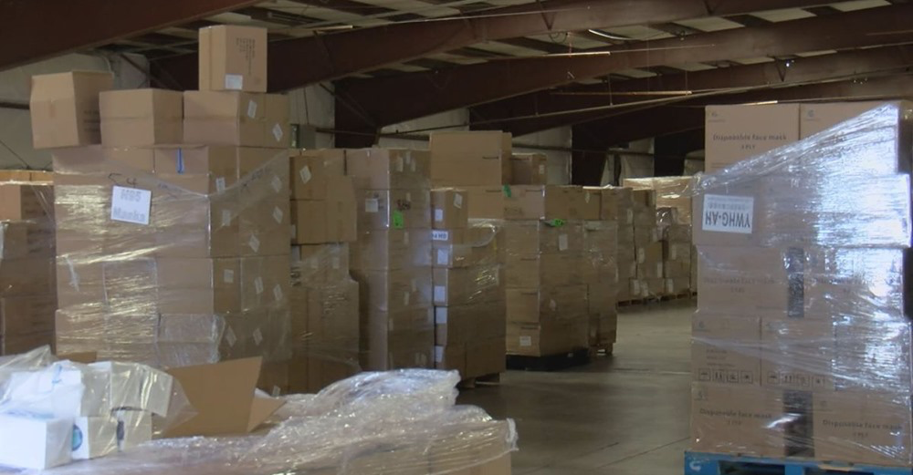
Example – PPE Risk Response
Inventory buffer is a risk response
Notes:
At the start of the pandemic, the US sourced 95 percent of its surgical masks and 70 percent of its respirator materials from other countries.
A fairly large percentage of this comes from a single geographic location. China is one of the well known PPE economic clusters in the world, along with Germany and the United States.
In addition, China is the world's largest producer and exporter of masks, gowns, and other PPE items.
So when Covid19 pandemic hit China, manufacturing stopped in late Jan/ Feb.… but it wasn’t until April that we really faced shortages here in the US.
There was actually some buffer/ some inventory until April, however, there was NOWHERE to procure PPEs as China had all but monopolized this space.
Inventory buffers are needed as insurance or security. It is a risk mitigation response to disruption. But the 1-2 month worth was not enough.
Everyone else was looking for PPE, including the countries that manufactured the product needed this critical product!
==========================
SO TWO things, being EFFICIENT and LEAN has its RISK!
Lean is great but it doesn’t do well during a supply chain disruption. Inventory buffers are needed as insurance or security, as risk mitigation response to disruption. AND WATCH OUT for geographic concentrations.
And then number two, supplier relationships are awesome, but it’s not wise to rely on only one partner or one geographic cluster.
SO addressing risk may mean you are not as efficient or as lean.
=============================
Another sourcing related factor is the emergence of counterfeit PPE suppliers that have popped up during the pandemic, and after they saw a trend of PPE price gouging that was taking place.
Specifically, the healthcare supply chains at the hospital and the group purchasing organization level in New Jersey, New York, and other states have all been a target.
So how does this happen, especially considering how hospitals are receiving the PPE directly from legitimate distributors and individual customers are ordering directly on legitimate company websites?
First, supply chain disruption creates an opportunity during a time of worry and panic for bad actors. In the frenzy of trying to secure more PPE, counterfeit suppliers were able to negotiate actual deals with legitimate companies to serve as a PPE supplier. They would then proceed by making or ordering fake PPE that looked authentic and looked authorized for use.
Second, because supply chains are complex, the more complex they are, the easier it will be for counterfeiters to exploit weaknesses in the chain.
AND because of the increase in e-commerce and something called commingled inventory. When we say commingled inventory, It means that e-commerce warehouses may not keep some of its inventory separated by seller. Instead, it combines inventory of multiple sellers. So basically counterfeits were buried and mixed amongst legitimate products.
===================
This was certainly no different for companies relying on single-source occasions that weren't even operating.
To have flexible sourcing during a disruption means that the organization has an efficient process for ordering and receiving PPE, checking the quality, and authorizing payment to a new or non-recurring supplier.

Slide 56








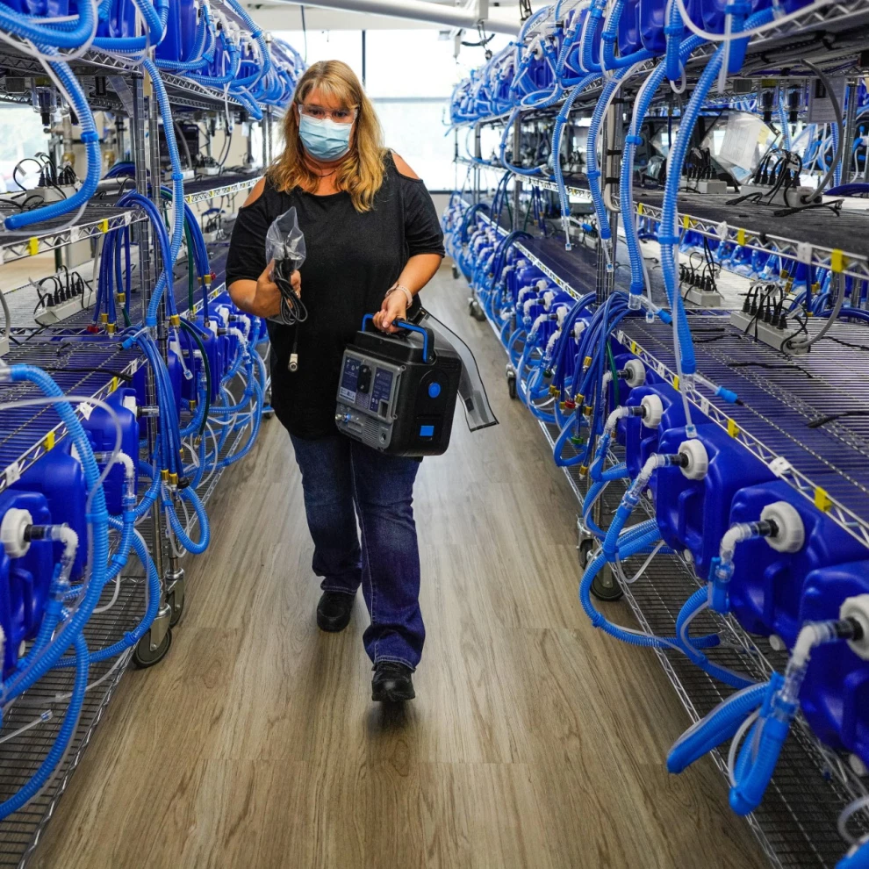
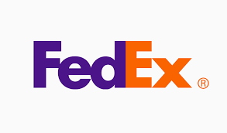
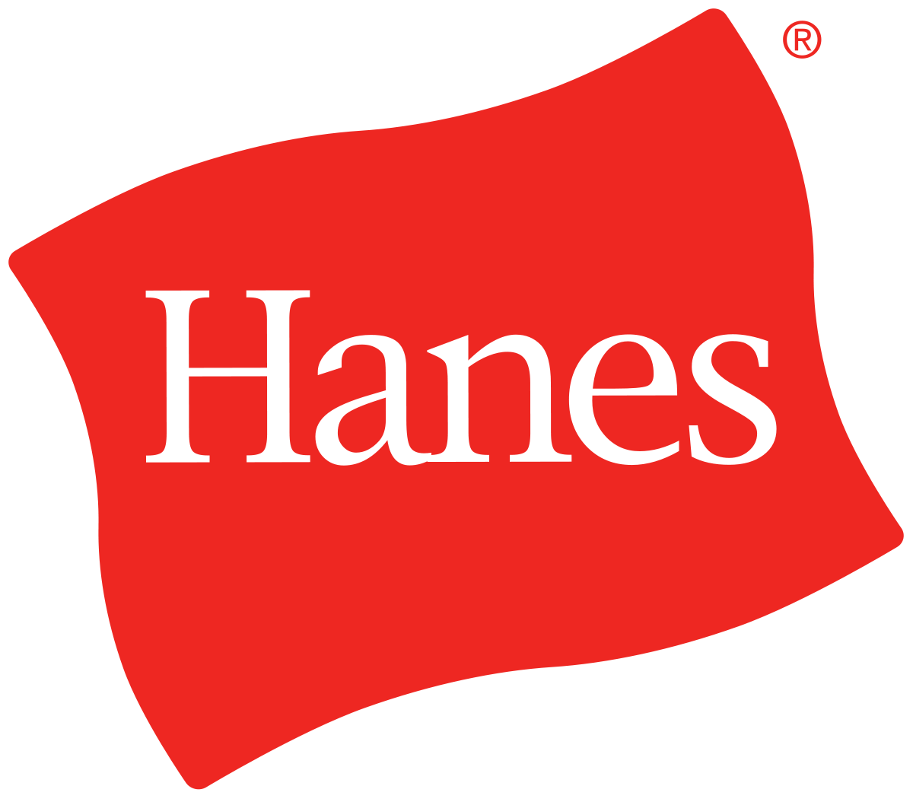
Example – PPE Risk Response
https://getusppe.org/
Capacity buffer is a risk response
Notes:
It took awhile but these are a few of the companies that retrofitted, retooled their manufacturing to respond to the domestic supply chain demand for PPE.
Ford, in partnership with United Auto Workers, has produced tens of millions of pieces of personal protective equipment to meet the enormous demand. Altogether, this amounts to:
More than 19 million face shields and 42 million face masks, 1.6 million washable isolation gowns
50,000 patient ventilators in partnership with GE Health
More than 32,000 powered air-purifying respirators in collaboration with 3M
General Motors partnered with Ventec to retool its Kokomo, Indiana, plant to produce ventilators. GM converted its Warren, Michigan, facility to produce face masks in less than seven days. to churn out an estimated 1.5 million masks a month
Honeywell ramped up production of its N95 respirator masks, andl temporarily shifted operations at two chemical manufacturing plants to produce hand sanitizer
Hanes clothing company retrofitted factories to make mask at 1.5 million masks weekly, and the consortium of companies it has joined, led by Parkdale Mills America, is expected to ramp up to production of 5 million to 6 million masks weekly
In partnership with Dow, SC Johnson converted a line at its largest manufacturing facility in Wisconsin to produce 75,000 bottles of hand sanitizer per month.
At the end of March, Brooks Brothers transitioned its three U.S. factories from producing shirts and ties to surgical masks and medical gowns. 150,000 masks the company plans to make per day.
Bacardi shifted its operations at eight of its distilleries in the continental U.S., Puerto Rico, Mexico, France, England, Italy and Scotland to make the ethanol needed to manufacture hand sanitizer.
FedEx used its air shipping network to transport more than 450,000 protective suits and 7 million face masks, along with other critical healthcare supplies, to the U.S. over the past two weeks. The logistics giant is looking to ship more than 500,000 suits per week
Also want to note, that there were also demand side strategies to limit the use of PPE during a shortage. CDC’s put out guidelines and strategies to optimize personal protective equipment (PPE) supplies in healthcare settings
Including for example, selectively canceling all elective and non-urgent procedures and appointments for which PPE is typically used by HCP
Decrease length of hospital stay for medically stable patients with an infectious diagnosis for whom PPE use is recommended
Use of N95 respirators beyond the manufacturer-designated shelf life for training and fit testing
Extending the use of N95 respirators by wearing the same N95 for repeated close contact encounters with several different patients
GETUS PPE New supply/demand matching technology to equitably distribute PPE and vaccine using algorithms to transparently optimizes efficiency and equity to prioritize distributions of donated PPE to the highest-need recipients. Similar to Uber's rider/driver matching software, this tool could be used by states and the federal government to distribute PPE from the Strategic National Stockpile.
Establish an online marketplace for PPE approved by the National Institute for Occupational Safety and Health. Since counterfeit PPE is pervasive and difficult to distinguish from medical-grade PPE, frontline workers need a trusted place to source safe equipment vetted by experts
Use the Defense Production Act to boost supply of personal protective equipment. building new American factories, with the goal of producing 1 billion gloves per month by the end of 2021. Now gloves still one of the scarcest item in the market.
SO as we journey towards the end of this Covid19 pandemic risk event. Let’s not forget to take stock and figure out what we’ve learned, so that we can be better prepared when the next pandemic comes.
============
GM and Ford didn’t go it alone. Both automakers partnered with companies to accelerate the ramp-up from 0 to thousands of ventilators within five months. GM partnered with Ventec Life Systems to produce ventilators at its engine plant in Kokomo, Indiana, using about 1,000 workers. The GM-Ventec partnership grew out of StopTheSpread.org, a coordinated effort of private companies to respond to COVID-19.
Meanwhile, Ford teamed up with GE Healthcare to produce ventilators at the automaker’s Rawsonville Road plant in Michigan.
Both efforts stretched and showcased the capabilities of the automakers to convert portions of factories used to assemble vehicles and parts into facilities cranking out medical devices.

Slide 57
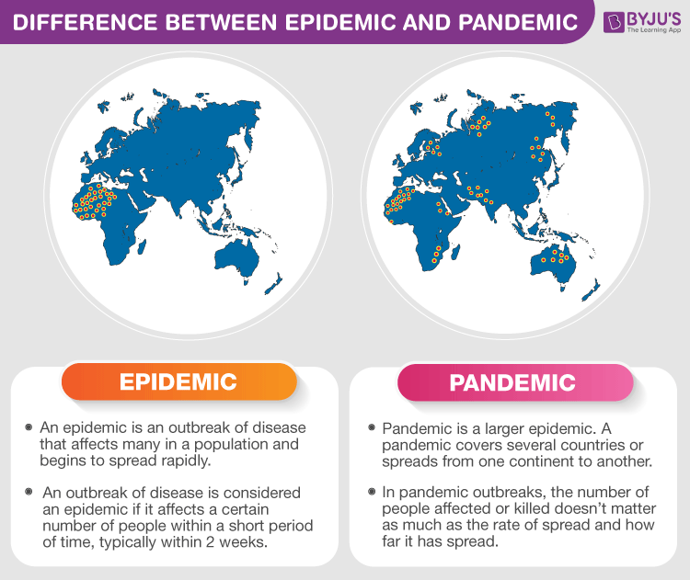

Slide 58
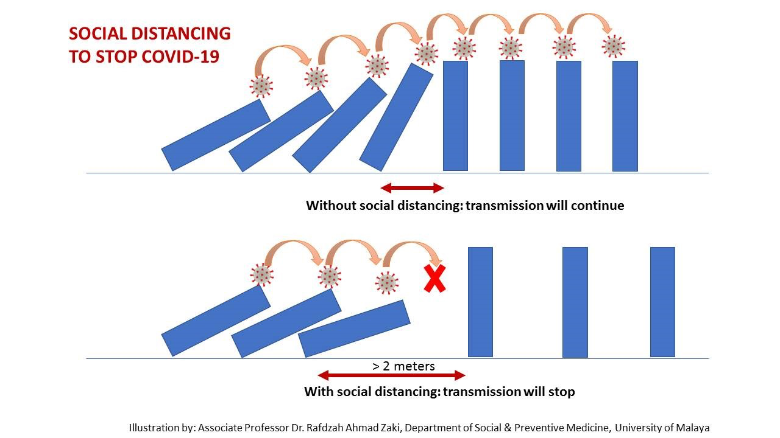
Mechanics of failure
Primary supply chain resources affected are the Humans
Cascades to other resources and processes

Slide 59
Cause-and-effect sequence
One is infected
Infection spreads geometrically
Infected stops work
Operations slow down or stops
Products and services not delivered to customers
Disruption to the supply chain

Slide 60
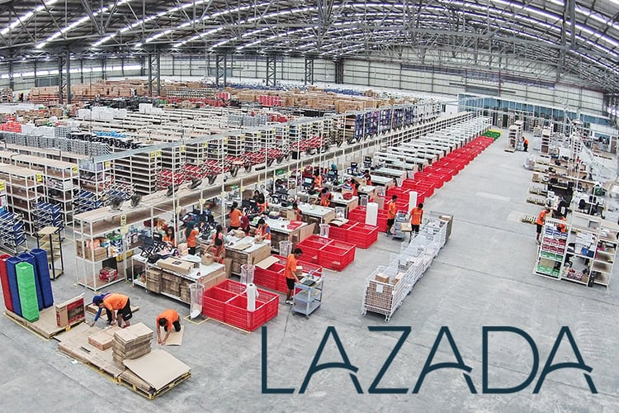
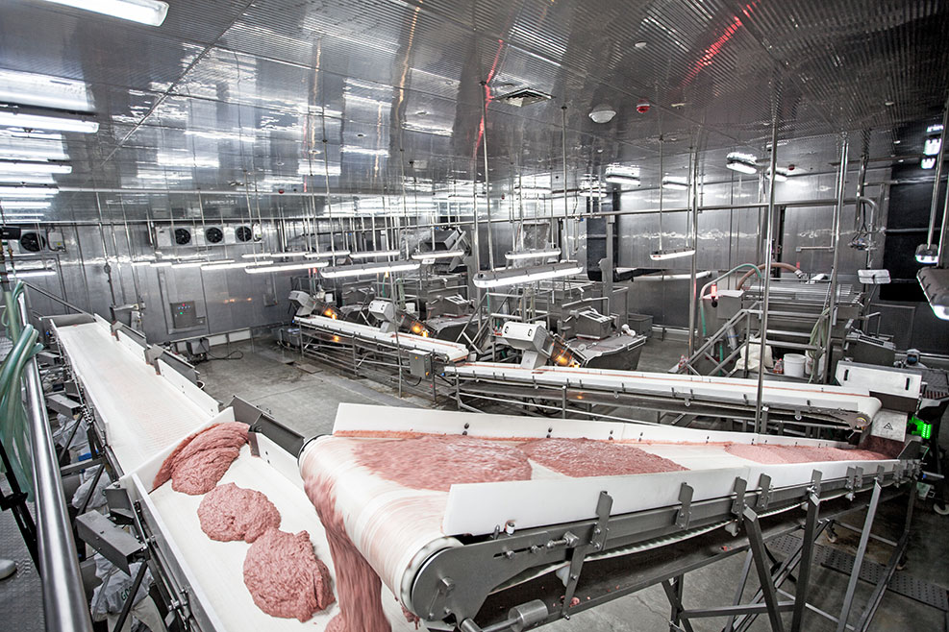
Epidemic & Pandemic : Loss control strategies
Avoidance – automate processes, or minimal need for roles of human

Slide 61
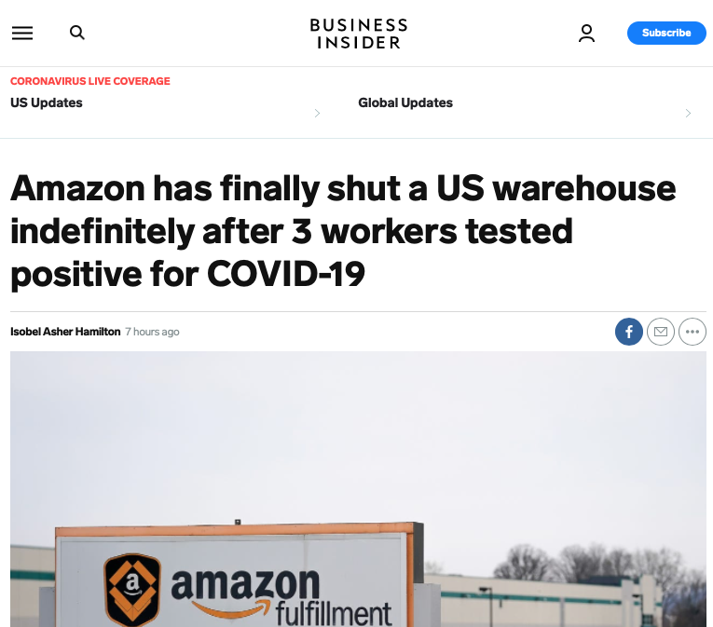
Epidemic & Pandemic : Loss control strategies
Avoidance – automate processes, or minimal need for roles of human

Slide 62
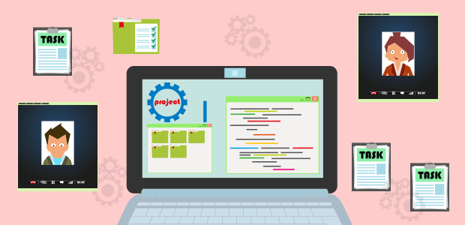
Epidemic & Pandemic: Loss control strategies
Separation – locate functionally-similar facilities among varied locations or structures

Slide 63


Epidemic & Pandemic: Loss control strategies
Duplication – plan for a backup facility that can provide similar functions

Slide 64
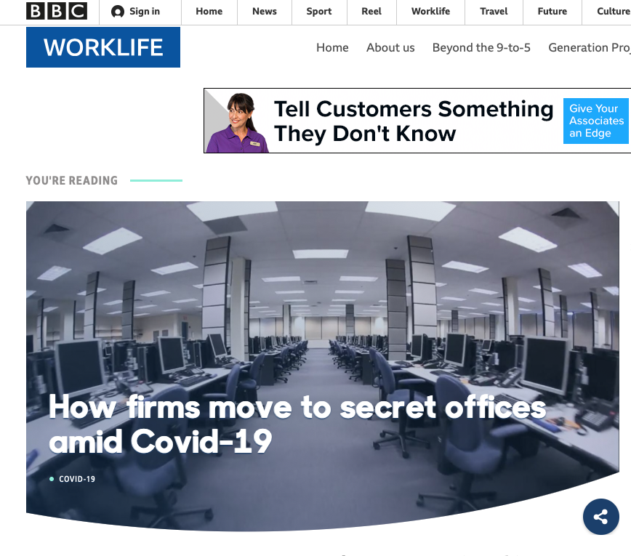
Epidemic & Pandemic: Loss control strategies
Duplication – plan for a backup facility that can provide similar functions

Slide 65
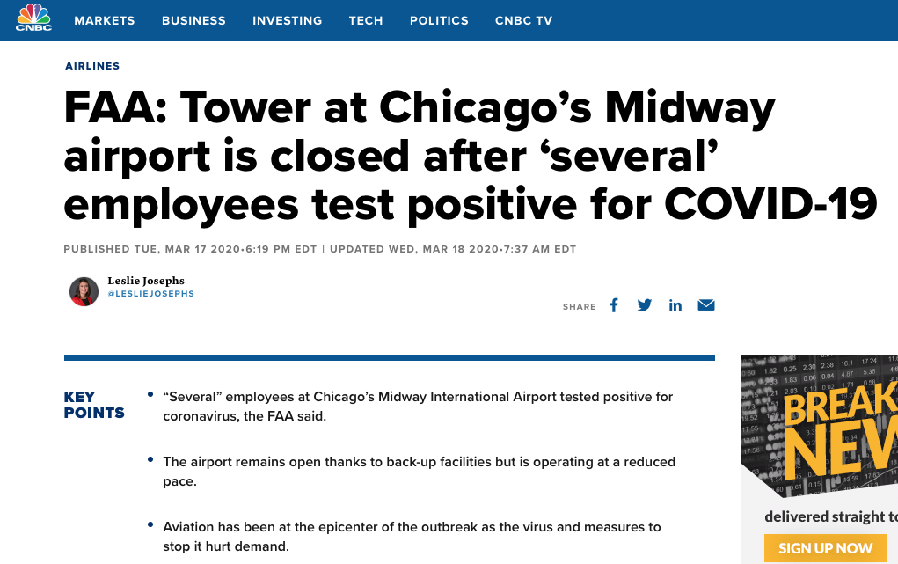
Epidemic & Pandemic: Loss control strategies
Duplication – plan for a backup facility that can provide similar functions

Slide 66

Risk Mitigation and Response
Q6. What are the possible unintended effects?
Let me expand the analysis beyond the obvious.
Notes:
Finally, hallmark of a great analyst is the foresight to describe aspects of the situation beyond the obvious.
HOW can we recognizes ripples of decisions and actions- systems perspective will help us.
As you may have all appreciated by now. Supply chain system is complex, there are a lot of moving parts. (some parts like tier 3 or tier4 suppliers, we may not even be aware of) The processes are fraught with uncertainty and on top of that very much linked and interdependent.

Slide 67
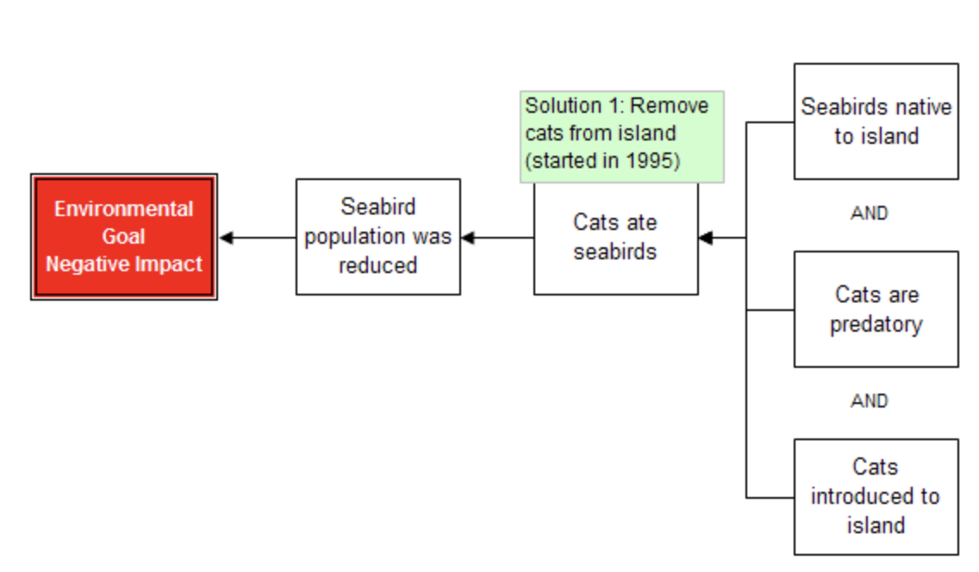
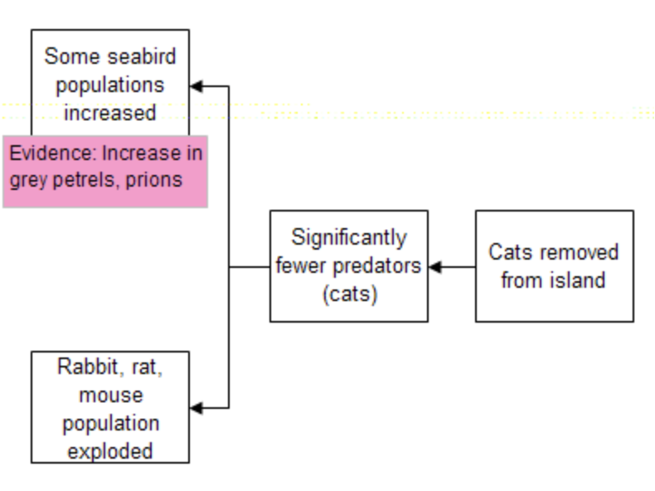
Unintended Effects
Iterative Root Cause Analysis (5th question: What are the effects beyond)
Notes:
Macquarie Island, located about halfway between Australia and Antarctica (part of Tasmania), is a UNESCO World Heritage site. A spectacular breeding ground for aquatic wildlife, especially elephant seals and royal penguins.
The island has also been made a classic study of what happens when an ecological balance is disrupted. With the arrival of the Europeans, the island’s seals and penguins, which had until then lived without natural predators, were hunted for their blubber and fur; by 1919 they were near extinct. But it was the rats and mice that jumped from the arriving ships that started the problem.
So feral cats were introduced to curb the rats and the mice population, but they also attacked birds. As a result, a devastating 60,000 seabird deaths per year. Go to root cause analysis…..
The solution was to remove the cats from the island!
Now with fewer predatory cats, the rabbit population exploded. The rabbits consumed an estimated 40% of the island’s vegetation, creating an ecosystem crisis larger than the cat problem. The remediation required to restore the ecosystem, to the tune of over 16 million dollars, which was a good chunk of change in 2008.
The solution now becomes removing also the rabbits, rats, and mice–the foreign animal species that wreaked havoc on an environment that was not equipped to keep them in check. Had the cats and rabbits been removed at the same time, in fact, this issue would have been avoided.
https://www.thinkreliability.com/case_studies/rats-cats-and-rabbits-on-macquarie-island-root-cause-analysis-of-unintended-consequences/

Slide 68
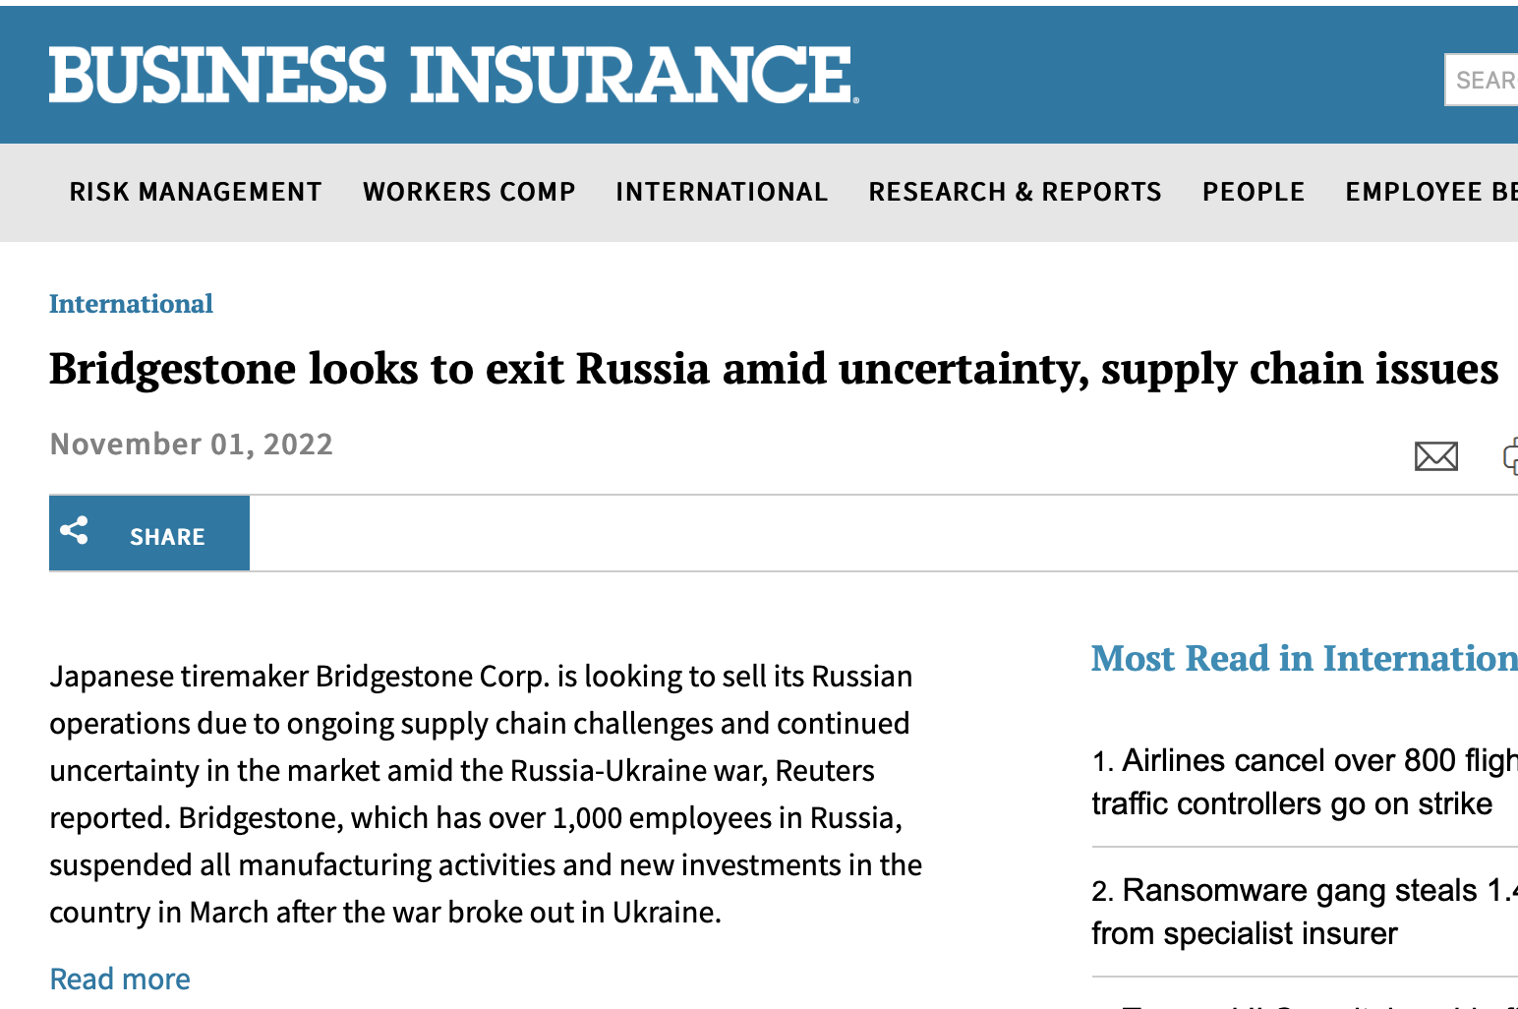

Slide 69
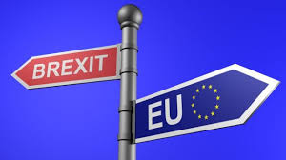
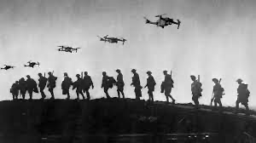
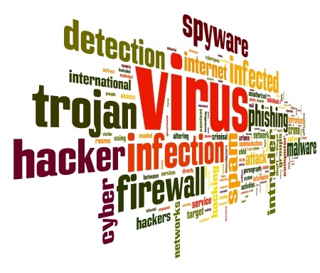



Beyond the obvious
Driven by both familiar and unfamiliar
Notes:
THE RM process should really be driven by some extension of the imagination- scenarios, both familiar and unfamiliar.
We draw on experiences of what has happened before! Not only ours, but also from our partner’s experiences, our competitors experiences, our industries’ experience or other industries for that matter. BUT we also need to look at the unfamiliar, what hasn’t happened yet.
THINK ABOUT IT! What are the scenarios we may be facing in the supply chain future,,,, with new technologies like self-driving trucks, block chain, privacy/ cybersecurity like GDPR, pandemic and post pandemic scenarios. Scanning these potential changes perhaps even trying to identify black swan events, allow us to prepare now.
Have any of you watched World War Z. Remember the analyst that had to look at the most unlikely scenario> 10th man
The Tenth Man strategy essentially says that if nine people agree on a particular course, the tenth person must, in the context of this strategy, take a contrary approach, be the contrarian so that all alternatives can be considered. In business, this process can help break “groupthink” and ensure that a business considers all options and encourage diverse thinking.

Slide 70
Dilemma of the Black Swan Events
(aka Silent Risk)
Notes:
The black swan theory or theory of black swan events is a metaphor that describes an event that comes as a surprise, has a major effect, and is often inappropriately rationalized after the fact with the benefit of hindsight. The term is based on an ancient saying that presumed black swans did not exist. (BTW, they do exist, can be found in southeast and southwest regions of Australia)
The theory was developed by Nassim Nicholas Taleb to explain:
The disproportionate role of high-profile, hard-to-predict, and rare events that are beyond the realm of normal expectations in history, science, finance, and technology.
The non-computability of the probability of consequential rare events using scientific methods (owing to the very nature of small probabilities).
The psychological biases that blind people, both individually and collectively, to uncertainty and a rare event's massive role in historical affairs.
These are GREAT COLLOSAL events that are extreme outliers! ALSO termed Silent Risk
Examples are World War I and II, 9/11, Fall of Soviet Union, the internet, dotcom bubble of 1987, 2008 financial crisis
There is an argument about the pandemic.
According to Taleb, as it was expected with great certainty that a global pandemic would eventually take place, the COVID-19 pandemic is not a black swan, but is considered to be a white swan; it is a high impact event, but is compatible with statistical properties.^{[11]}
Meaning it was predicted!
Still, keep these in your radar, no matter how rare
=========================
And perhaps the first response with these types of high impact, low probability or in the case of black swans (unknown probability) is DETECTION. PUT a marker in place… some kind of trigger point that rings the bell.
AND this is also where the words BETTER LATE THAN NEVER rings true and reflects the spirit of recovery.
=========================
Considered to be that factors that have among the highest probability of occurrence and that can be the least effectively mitigated since they tend to be uncontrollable. Natural disasters (e.g. earthquakes) and extreme weather are within this category, including potential sea level rises.

Slide 71
Strategies and Best Practices

Slide 72
Strategies and Best Practices
Summary of strategies and best practices are:
Having greater visibility of your supply network
Prioritizing the most critical vendors or nodes
Diversifying your suppliers or sources
Implementing security standards and controls
Monitoring and auditing your vendors or nodes
Developing contingency plans or scenarios
Engage in Future Sensing and Future Scenario Creation
Notes:
In order to reduce concentration risk, many larger companies today will actually place particular departments/teams on different cloud providers, such as splitting up production, development and testing. That way if one ship goes down, the remaining fleet stays afloat. But what else can you do?
1. Have greater visibility – what does your expanded ecosystem look like?
One big step is to understand the elements of your ecosystem’s interconnectedness between vendors and companies. While the visual of a large and vast ecosystem may appear extremely complicated – it is actually quite typical. A big first action here is to work with an automated third-party risk monitoring program, like Black Kite, that can manage and organize your full vendor ecosystem in a short period of time, with room to scale and grow.
When you can monitor your third parties on a continuous basis, your team is able to see the points of failure and struggle for your most critical vendors (and the least critical ones). Perhaps patch management or stolen credentials are the biggest red flags for your vendors. You can then communicate with your vendors to begin to make important changes and improvements for the future.
2. Prioritize the most important vendors and understand where the biggest exposure gaps lie.
While it is essential to monitor and ensure the cyber health of all vendors is acceptable, everyone has to start somewhere. Beginning with selecting and prioritizing the most important partners to your business operation is a strong second step.
3. Start the conversation with a critical partner.
If one of your most important vendors is placing 100% of their data and services in the hands of only one or two providers, be willing to have a chat with them. Keeping the conversation open allows for improvement all around – your data and business operations become more secure, and so does the partner and their partners.
While the higher risk reliance on a single entity is easier to manage, the much harder to manage diversified process reduces risk tenfold. It may be a tradeoff, but it is a good one.

Slide 73
Summary and Conclusion
Summary: Supply chain enables us to obtain products and services needed in our daily lives. Managing risks in supply chain network is needed to keep these products and services available when and where needed at the lowest possible cost. In this presentation, we learned about supply network disruptions and cascading risk, its causes and consequences, some real-world examples, and some strategies to mitigate or prevent it.
Conclusion: Supply network disruptions and cascading risk is a complex and challenging phenomenon that can affect any supply network in any industry. It is important to understand its dynamics and impacts in order to manage it effectively and efficiently. By applying some strategies and best practices, we can increase our supply network resilience and reduce our exposure to cascading risk.

Slide 74


