Slide 1
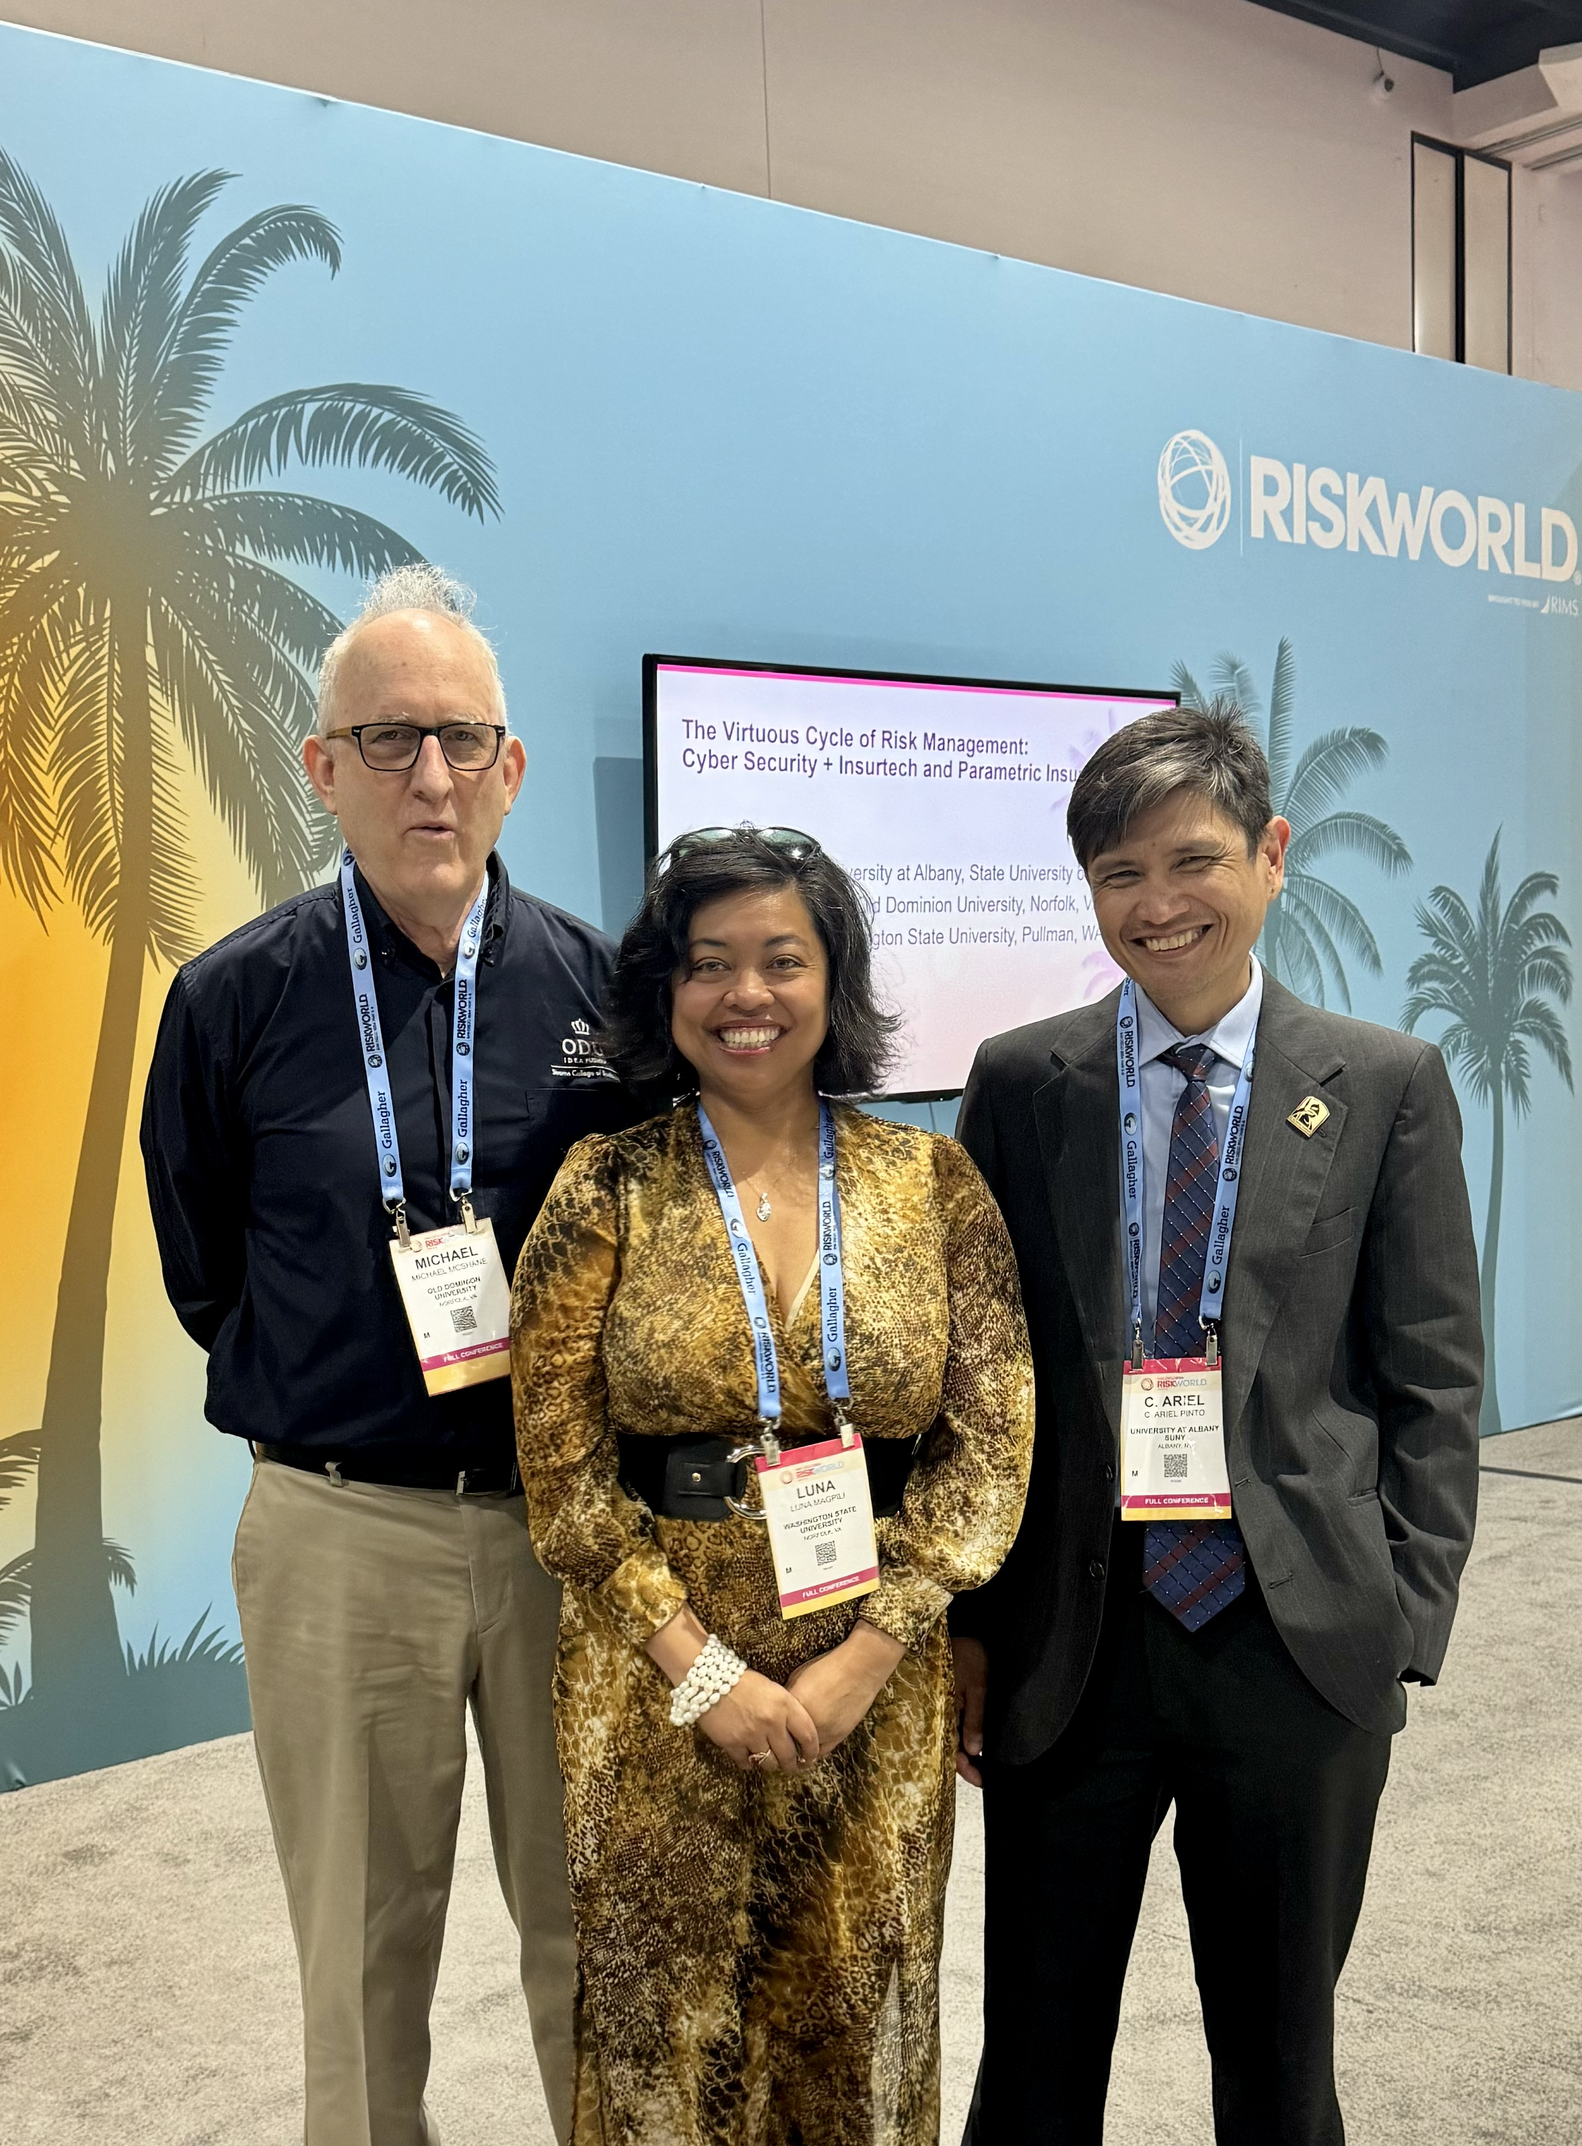
The Virtuous Cycle of Risk Management: Cyber Security + Insurtech and Parametric Insurance
Dr. C. Ariel Pinto, University at Albany, SUNY
Dr. Michael McShane, Old Dominion University, Norfolk, VA
Dr. Luna Magpili, Washington State University, Pullman, WA

Slide 2

Notes:
This presentation is derived from the Educational Modules we developed with funds from The Spencer Educational Foundation and FM Global
Cybersecurity has both socio-economic dimension and technical dimensions.
Reliable and secure cyber and data infrastructures make socio-economic investment (e.g., R&D) in the above technologies more efficient.
Overall result is faster technological progress and faster adaption.
As more organizations, agencies, and enterprises adapt and include these technologies in their operations, the easier Parametric Insurance can be implemented.

Slide 3




Recently used at
Notes:
Where has some of this modules been deployed?
UAlbany’s College of Emergency Preparedness Homeland Security and Cybersecurity
Old Dominion University
ETM program at WSU
Presented in Cameroon for Fulbright project under the sessions for Digital Governance
And possibly at other institutions that downloaded the modules

Slide 4

Cybersecurity as a socio-economic-technical dilemma
This Photo by Unknown Author is licensed under CC BY
Notes:
Cybersecurity has both socio-economic dimension and technical dimensions
We often hear that cybersecurity is mostly about technology, but some of the so-called best technologies may also be the most expensive
And some are even ‘too advanced’ to be socially acceptable
It is a dilemma, i.e., a situation in which a difficult choice must be made between two or more alternatives, especially equally undesirable ones
Simply looking at one, two, but not all three dimensions is like plugging a round hole with a square peg – it will leak
Cyber risk managers are always looking for the ‘weakest link’ – that leaky corner when we try to plug a round hole with an imperfectly shaped peg
Unfortunately, this is what cyber criminals may also be looking for

Slide 5
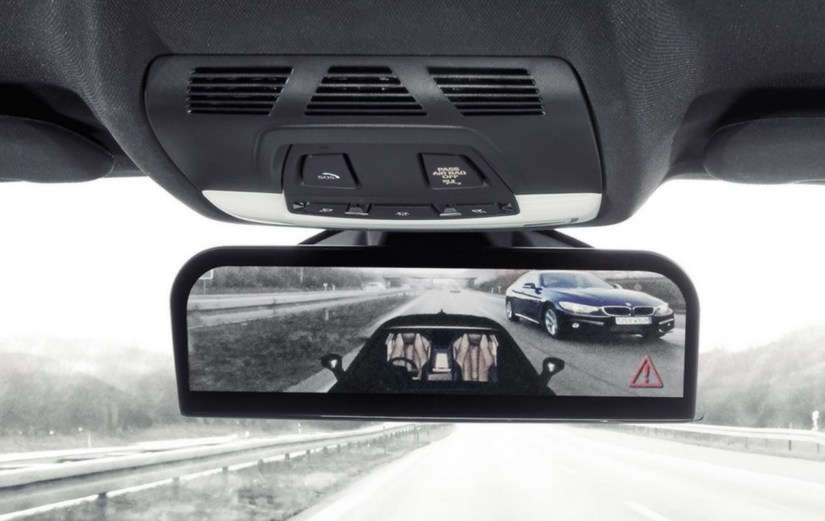
Managing Cybersecurity allows better driving forward using your rearview mirror?
This Photo by Unknown Author is licensed under CC BY-NC
Notes:
Advances in sensors, IoT’s, fast-computing, and other technologies allows many industries/institutions/agencies to make better use of high volume of data and information in their operation, albeit from the past (even almost real-time), squeezing out the benefits. For example, tons of data and advance algorithms have allowed many companies to better forecast how to optimize their operations
Better picture of the past can be recreated and may become a predictor of the road ahead
BUT this is predicated on reliable and secure cyber and data infrastructures – some guarantee of C-I-A; three pillars in cyber and information security

Slide 6

Managing Cybersecurity like driving in the rain without wipers?
This Photo by Unknown Author is licensed under CC BY-NC-ND
Notes:
These technologies – and the accompanying assurance of security - may enable us to take a virtual peek of what could be around the corner (or possible futures scenarios), even if not a single road ahead
Contributing to not just better picture of the past, better view of the future (better wipers!) – for those many industries/institutions/agencies that use of high volume of data and information
Resulting to more favorable Cost-effectiveness and socially-justifiable investment (e.g., R&D) result to faster technological progress and faster adaption, increasing expected benefits and reducing the cost-benefit gap – i.e., improved economic valuation

Slide 7
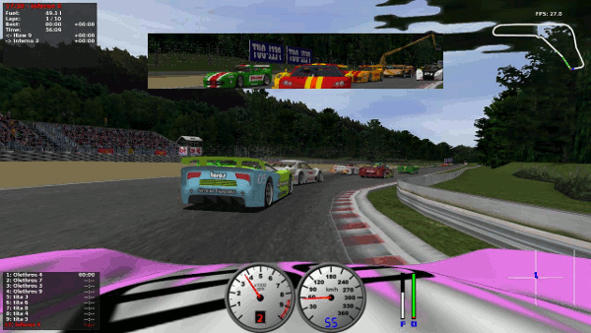
Managing Cybersecurity: future scenario creation
This Photo by Unknown Author is licensed under CC BY-SA
Notes:
With better view of the past and the possible future…
better informed what-if scenarios
Better answers to the pursuit of likelihood and consequences
R&D in technologies, faster technological progress and faster adaption
We have developed a module on how to scientifically create future cybersecurity risk scenarios that can be defensible from an analytical perspective

Slide 8
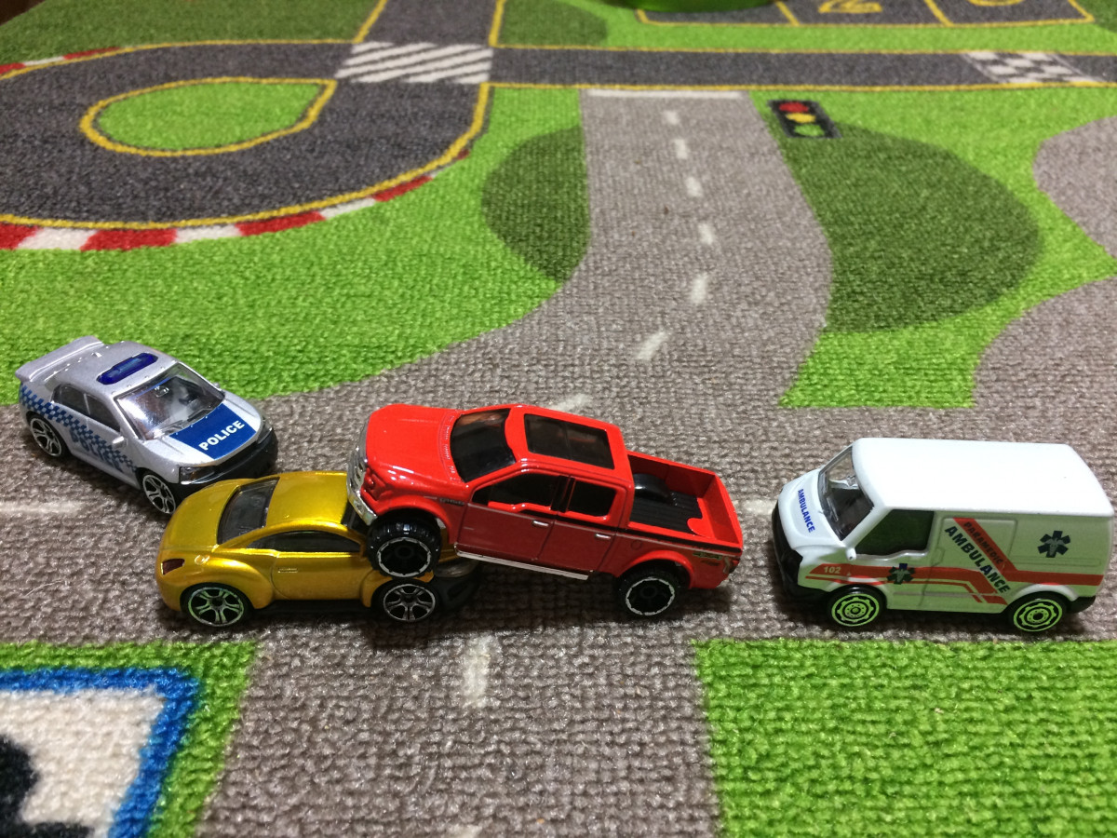
Managing Cybersecurity: cascading failures
Notes:
better informed what-if scenarios
Involving various perils or hazards – possibly triggered by, but not confined to cybersecurity
Involving potentially several entities not necessarily cyber-connected
Example of cascading failures triggered by a potential cyber incident is how cyber attach on utilities such as electricity and water may cause ‘cascading’ effects to operations of manufacturing and chemical facilities; where the consequences are felt not simply in the form of information loss

Slide 9

Managing Cybersecurity: Virtuous Cycle
Notes:
Resulting to an even faster technological progress and faster adaption, further fueling investments in future of technologies,
As more organizations, agencies, and enterprises adapt and include these technologies in their operations, the easier some types of insurance contract can be implemented, e.g., Parametric Insurance, for better management of risks, further lowering barriers for technology investments and adaption- hence the Virtuous Cycle

Slide 10
INDEMNITY vs PARAMETRIC INSURANCE Michael McShane, PhD. Old Dominion University

Slide 11
INDEMNITY vs PARAMETRIC INSURANCE
Traditional insurance is referred to as “indemnity” insurance.
In the case of insurance, what does “indemnity” imply?
The claims process starts when …

Slide 12
INDEMNITY vs PARAMETRIC INSURANCE
Parametric insurance can be an alternative or a supplement to traditional indemnity insurance.
Other names for parametric insurance?
Where the payment of a pre-agreed amount is triggered when ….
Example?

Slide 13
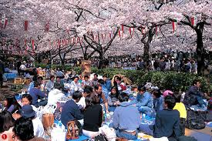
INDEMNITY vs PARAMETRIC INSURANCE
Cherry Blossom Insurance in Japan. What is it?

Slide 14
INDEMNITY vs PARAMETRIC INSURANCE
Determining the trigger is key for parametric insurance.
The three important criteria are:
Must be able to model the trigger
Must be able to measure trigger objectively
An independent 3rd party must be able to verify when the trigger threshold is reached.

Slide 15
INDEMNITY vs PARAMETRIC INSURANCE
Advantages of Parametric Insurance over Indemnity Insurance
What are advantages for underwriting process?
Less uncertainty: maximum payout is known
Simpler: no need to know underwriting factors
No moral hazard: fraud by policyholder is almost impossible.

Slide 16
INDEMNITY vs PARAMETRIC INSURANCE
Advantages of Parametric Insurance over Indemnity Insurance
Claims process is not required.
CLAIMS PROCESS: TRADITIONAL INDEMNITY INSURANCE
Acknowledge/Assign Claim
Identify Policy
Contact Insured
Investigate/Document Claim
Determine cause of loss, liability, loss amount
Set Reserves
Conclude Claim
Payout
CLAIMS PROCESS: PARAMETRIC INSURANCE
3rd Party Verifies that Trigger Threshold Level is Reached.
Payout
Simpler process
Rapid payout
Reduced disputes
Lower cost

Slide 17
INDEMNITY vs PARAMETRIC INSURANCE
Disadvantage of Parametric Insurance over Indemnity Insurance?
Basis risk:
Risk that the payment might not match the actual loss suffered by the policyholder.
This basis risk problem has been decreasing recently because of technology.

Slide 18
SPECIFIC APPLICATIONS OF PARAMETRIC INSURANCE
Parametric insurance can be especially useful in covering losses caused by climate-related events.
Which are becoming more frequent
Difficult for indemnity insurance to cover

Slide 19






FloodFlash: Parametric Flood Insurance
Cloud Computing
Trigger for pre-agreed payment amount:
Flood waters reach a
pre-agreed depth at property.
When you need a plumber bad,
you want him good.
No Claims
Process
Required
1930
$
IoT
Enabled
Flood
Gauge
So Rapid Payment
After
Trigger Event
Cat modeling
FloodFlash case study:
Paying claims in under 6 hours

Slide 20
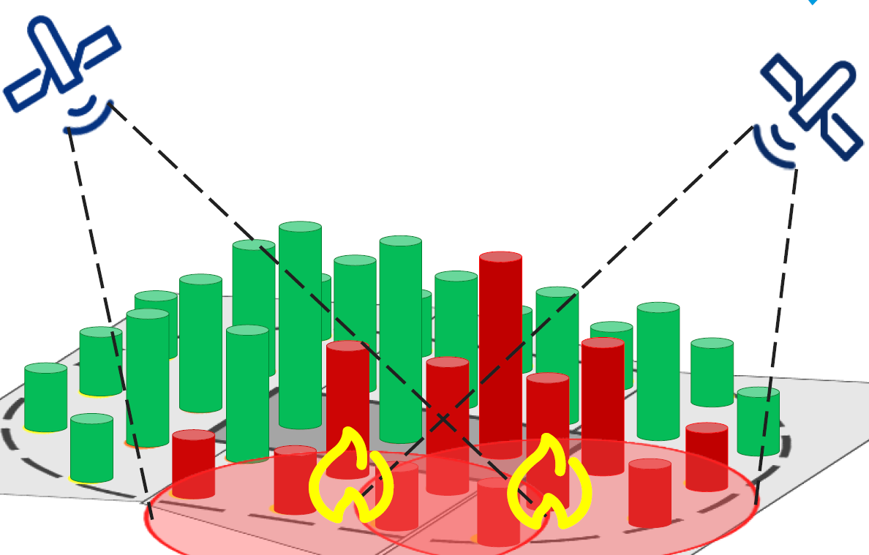
GC FirecellSM Provides Parametric Wildfire Coverage
Customized coverage based on wildfire information published in real time by NASA’s FIRMS that reduces basis risk by using high-resolution satellites.
To monitor fire intensity of small regions on the ground: virtual stations that represent exposures as pixels with a resolution of 0.001 decimal degrees--about 100 meters.

Slide 21
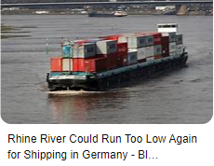
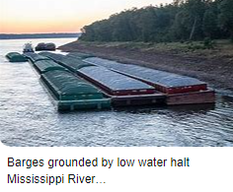
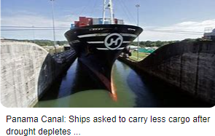
Parametric River Level Volatility Insurance
Descartes provides: “parametric river level cover that uses daily water level data from specific stations that have proven to be linked to transportation disruptions and losses for the client in the past”
Pays out a pre-agreed amount if water level goes below a pre-agreed threshold.
Non-physical damage business interruption insurance for shipping companies.

Slide 22
More Advantages of Parametric Insurance over Indemnity Insurance
Increased flexibility/Immediate Liquidity
Flexibility to cover almost any kind of financial loss. Why?
The almost immediate liquidity can be used where it is most needed. Example?
Unlike indemnity insurance, can cover business interruption losses when there is no physical damage. Example?

Slide 23
Another Advantage of Parametric Insurance over Indemnity Insurance
Increases accessibility
Indemnity insurance not available for some communities.
Microinsurance becomes more feasible
Drought insurance for Mexican farmers

Slide 24
More advantages of Parametric Insurance over Indemnity Insurance
Can be customized:
Insurers often work directly with policyholders (PHs) to customize coverage for specific risks faced by the PH.
Create index and payout structure to conform with the policyholder’s risk tolerance.
Payout can be on gradation. Example?
Can be in force for longer periods:
Traditional indemnity insurance policies are typically 1-year policies.
Parametric insurance policies are often multiyear policies.

Slide 25
How can parametric and traditional indemnity insurance be used together?
Indemnity insurance can have the following:
Limits
Exclusions
Deductibles
A policyholder can use parametric insurance to cover these when using indemnity as the main policy.

Slide 26
Parametric Cyber Policy
“World’s first parametric cyber policy that makes fixed daily payments upon confirmation of an encryption event by a third party, allowing faster claims settlement” Descartes Group
Feb 3, 2024: https://complexdiscovery.com/parametric-cyber-insurance-coverage-breaks-new-ground-in-insurance-innovation/

Slide 27
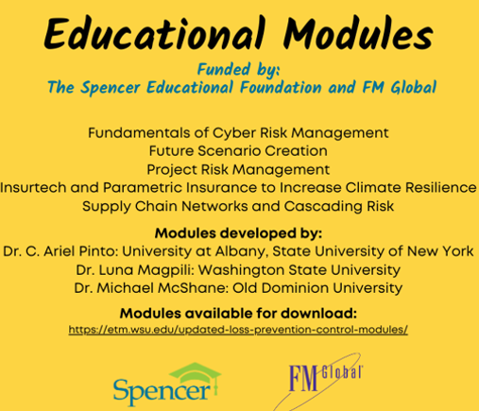
THANK YOU.
Please rate and share your takeaways in the events app. Complete the rating form.
Dr. C. Ariel Pinto: cpinto2@albany.edu
Dr. Michael McShane: mmcshane@odu.edu
Dr. Luna Magpili: luna.magpili@wsu.edu
Download Modules Free:
https://etm.wsu.edu/updated-loss-prevention-control-modules/

